Slide 1


Your church name
Date

Slide 2
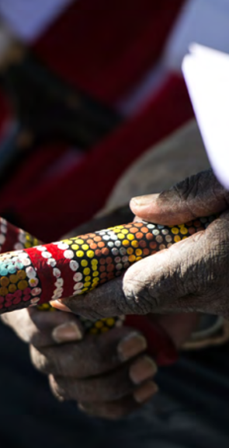

Acknowledging Country
Leader:
From before recorded time…

Slide 3
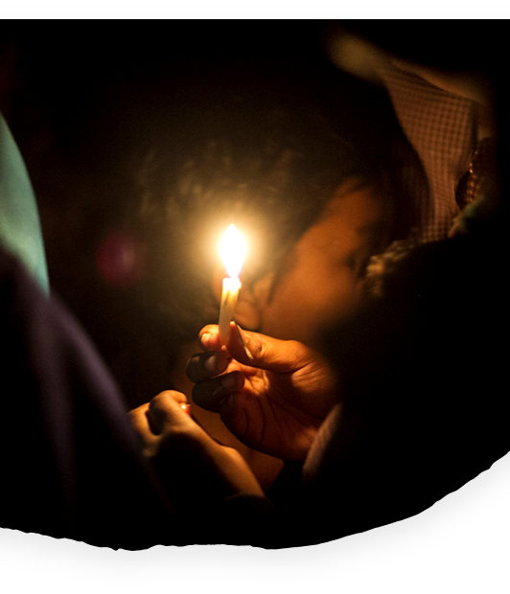
Call to worship
Leader:
Once there was someone who said such wonderful things and did such amazing things that people just had to ask him who he was. One time when they asked him who he was he said:
“I am the light of the world, and whoever walks with me will never walk in darkness”
This is the one who we follow.

Slide 4
Jesus is light - not just of this place, of just this nation, or just of people like us. Jesus is the light of the world.
And so, we gather, knowing that we are joined across the world by countless thousands of our brothers and sisters. In cathedrals and cottages, people are gathered, candles are lit, and the Spirit of God threads us together in love and grace.

Slide 5
Across the globe
we gather to worship.
Our God is here!
People:
God’s Spirit dwells with us.
Leader:
We are one in Christ.

Slide 6

Welcome to
UnitingWorld Sunday

Slide 7
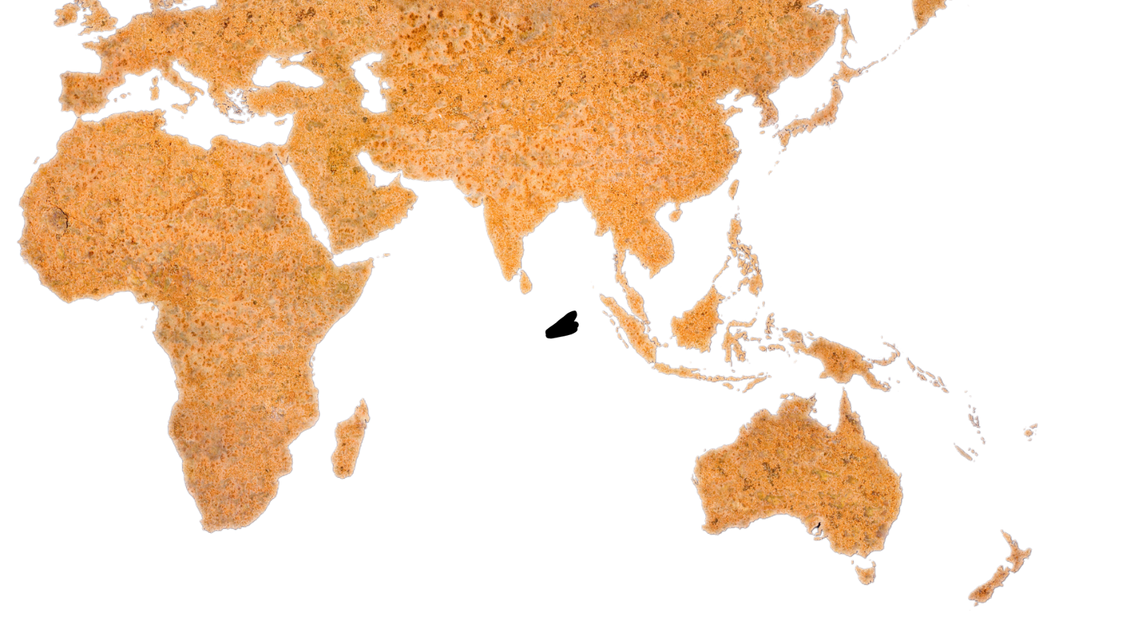
We in the Uniting Church in Australia are connected in partnership with churches across the Pacific, Asia and Africa.
They are vibrant, inspiring, and dedicated people of God who are transforming lives and communities for the better.
Many of our overseas church relationships reach back more than 150 years and have impacted countless lives,
through many generations.

Slide 8
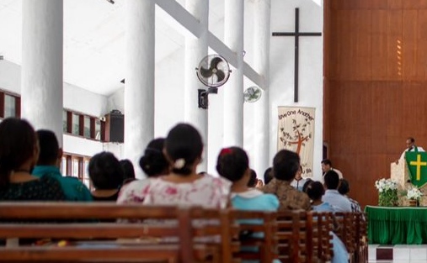
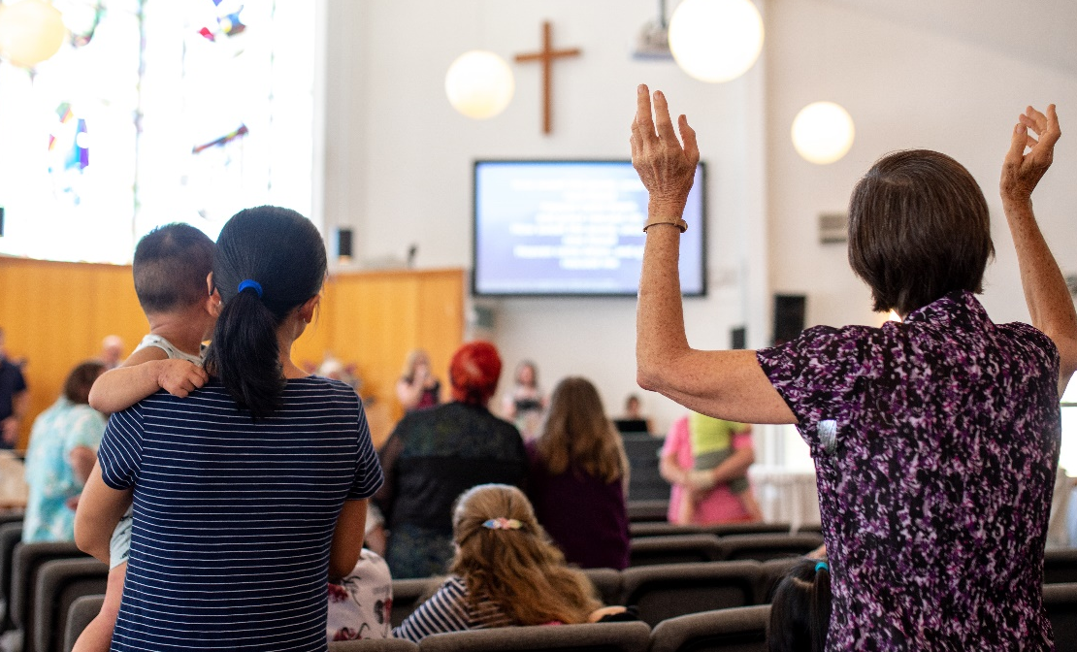
Through these relationships, we seek to act as one body of Christ in the world, each playing our part to build hope and end poverty and injustice.
UnitingWorld is the agency that manages these partnerships for the wider Uniting Church , and today we have a chance to hear more about their work and to celebrate our global neighbours together.
Congregation in Timor-Leste
Congregation in Australia

Slide 9
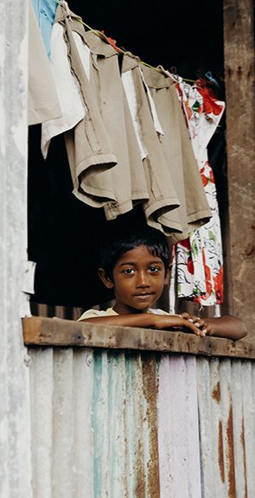
Prayer
LEADER:
God who knows no boundaries, who neither time nor space can hinder.
God who pursues us with unconditional love and
inexhaustible grace.
God who lifts us out of blindness and conflict and shows us the path of reconciliation and unity with each other.
We turn our hearts and our minds
to you in worship.
We come to you, each of us in our aloneness, and all of us in our yearning for true community.

Slide 10
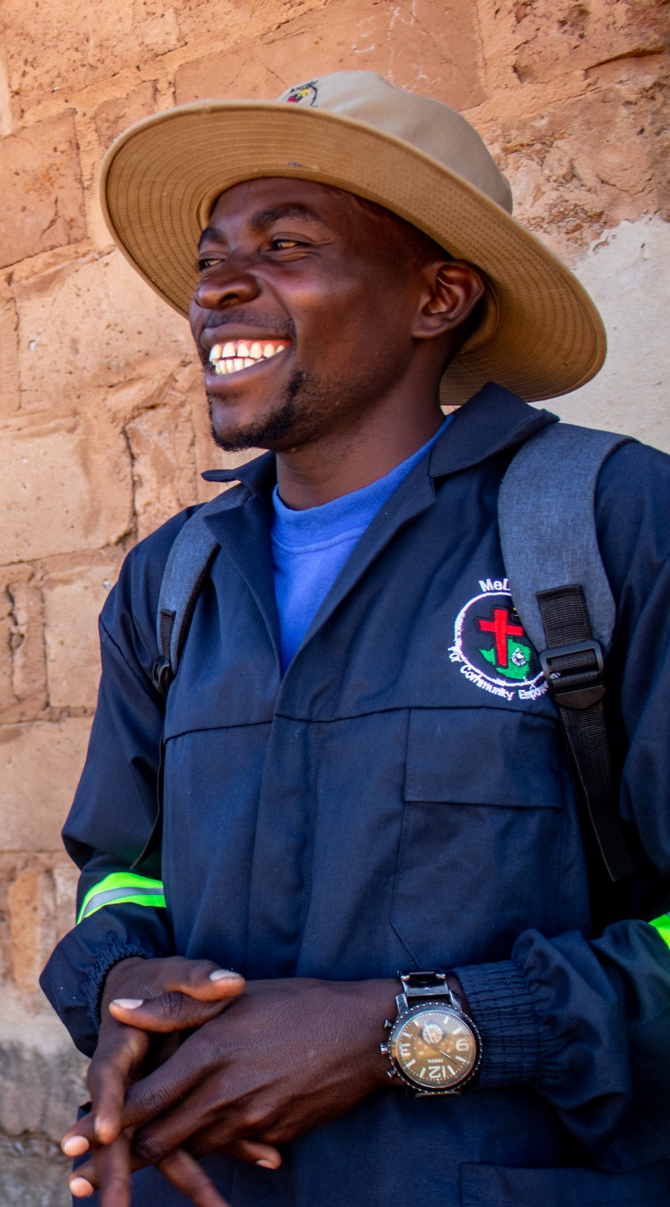
Meet us here today, Lord Jesus.
Help us to lay aside the distractions, the anxiety and the sorrows that hinder.
Fill our hearts with your presence and our minds with your guidance.
Refresh and renew our spirits,
so that we may once again remember the joy of being known and loved by you.

Slide 11
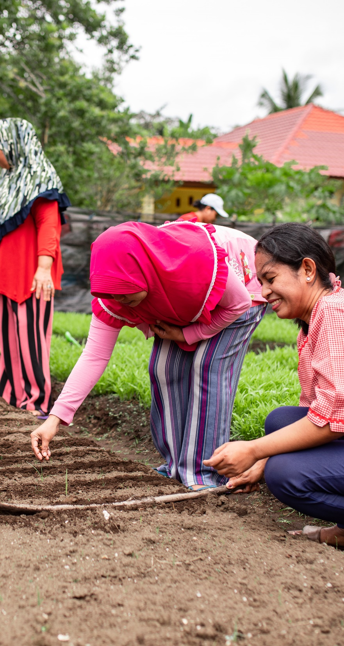
And today, as we turn our gaze to the wonders that you are working across the world, help us feel true connection and compassion for all your people across the world.
Fill our hearts with joy and humility as we bear witness to the power of your love working through human hands.
Awaken in us again that zeal to be a part of your work.
Fill our eyes with your vision for a world renewed and reconciled.
Give us courage to act boldly in obedience to
your call on our lives.
Emmanuel, God with us.
Amen

Slide 12
Song
Add the lyrics, video or the book number of the song you have chosen/​
Duplicate this slide for additional verses​

Slide 13
Kids’ Talk

Slide 14
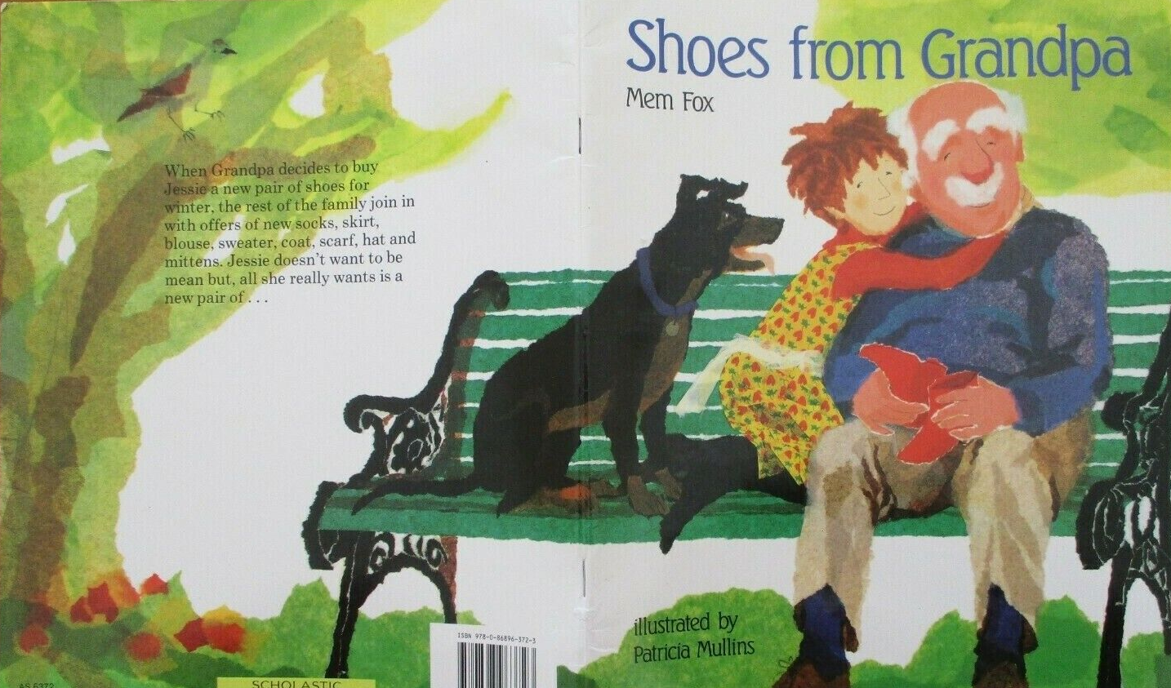
Kids’ Talk

Slide 15
Song
Add the lyrics, video or the book number of the song you have chosen/​
Duplicate this slide for additional verses​

Slide 16
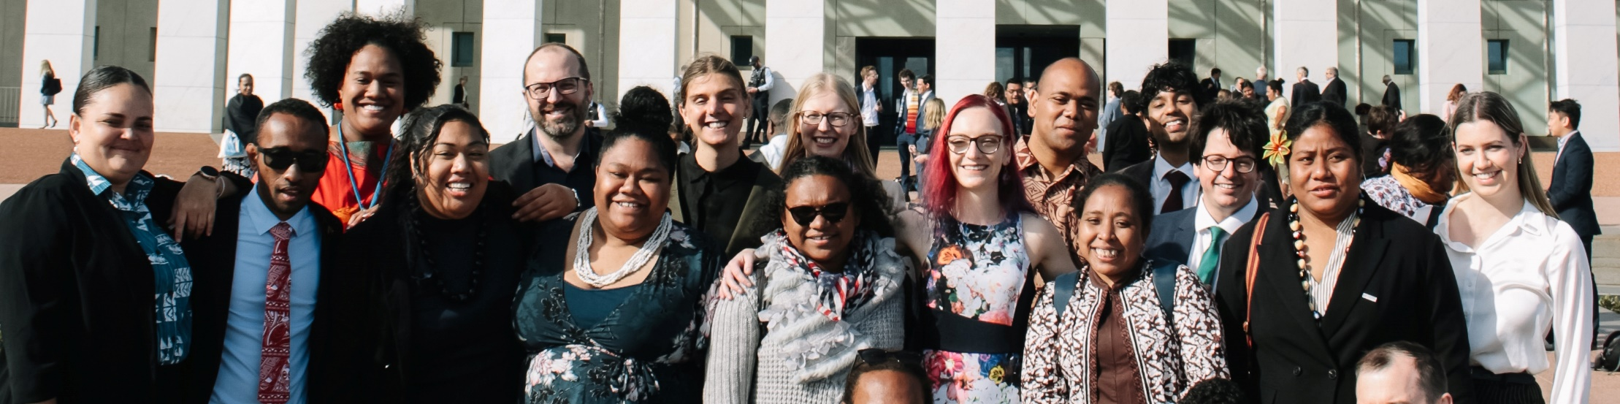
1 Corinthians 12:12-27
One Body with Many Members
12 For just as the body is one and has many members, and all the members of the body, though many, are one body, so it is with Christ. 13 For in one Spirit we were all baptized into one body—Jews or Greeks, slaves or free—and all were made to drink of one Spirit.

Slide 17
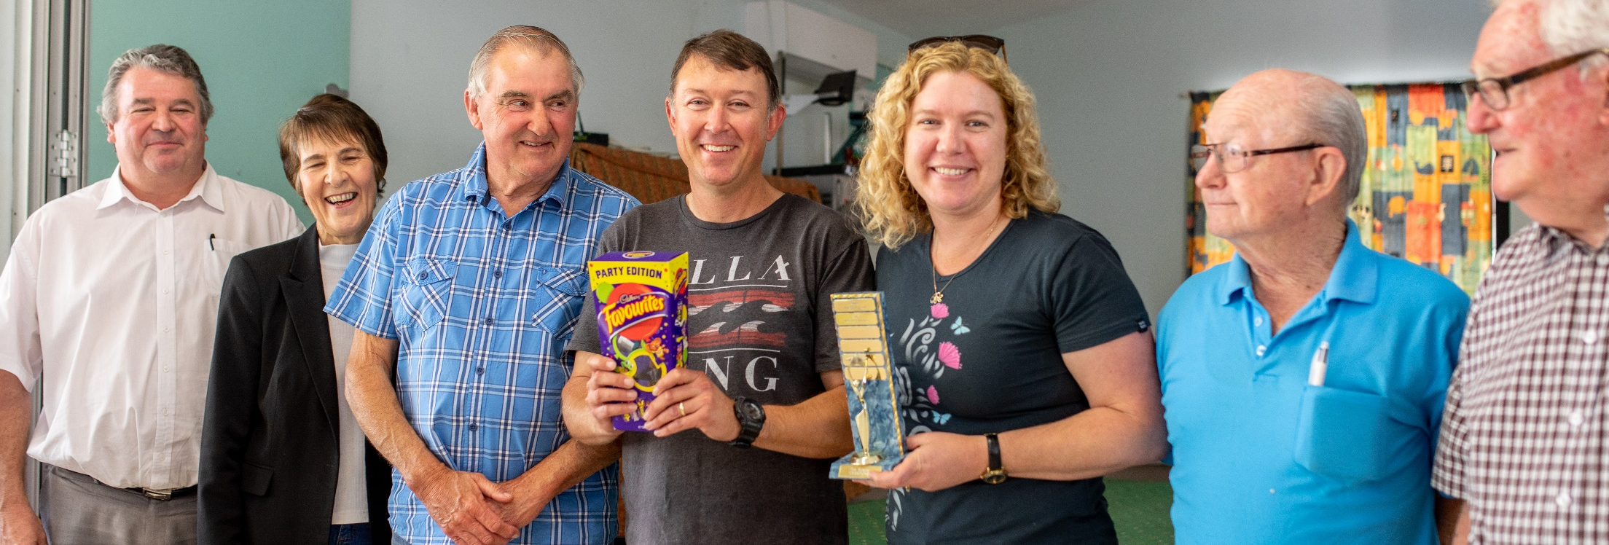
14 For the body does not consist of one member but of many. 15 If the foot should say, “Because I am not a hand, I do not belong to the body,” that would not make it any less a part of the body. 16 And if the ear should say, “Because I am not an eye, I do not belong to the body,” that would not make it any less a part of the body. 17 If the whole body were an eye, where would be the sense of hearing? If the whole body were an ear, where would be the sense of smell?

Slide 18
18 But as it is, God arranged the members in the body, each one of them, as he chose. 19 If all were a single member, where would the body be? 20 As it is, there are many parts yet one body.
21 The eye cannot say to the hand, “I have no need of you,” nor again the head to the feet, “I have no need of you.” 22 On the contrary, the parts of the body that seem to be weaker are indispensable, 23 and on those parts of the body that we think less honorable we bestow the greater honor, and our unpresentable parts are treated with greater modesty, 24 which our more presentable parts do not require.
But God has so composed the body, giving greater honor to the part that lacked it, 25 that there may be no division in the body, but that the members may have the same care for one another. 26 If one member suffers, all suffer together; if one member is honored, all rejoice together.
27 Now you are the body of Christ and individually members of it.

Slide 19
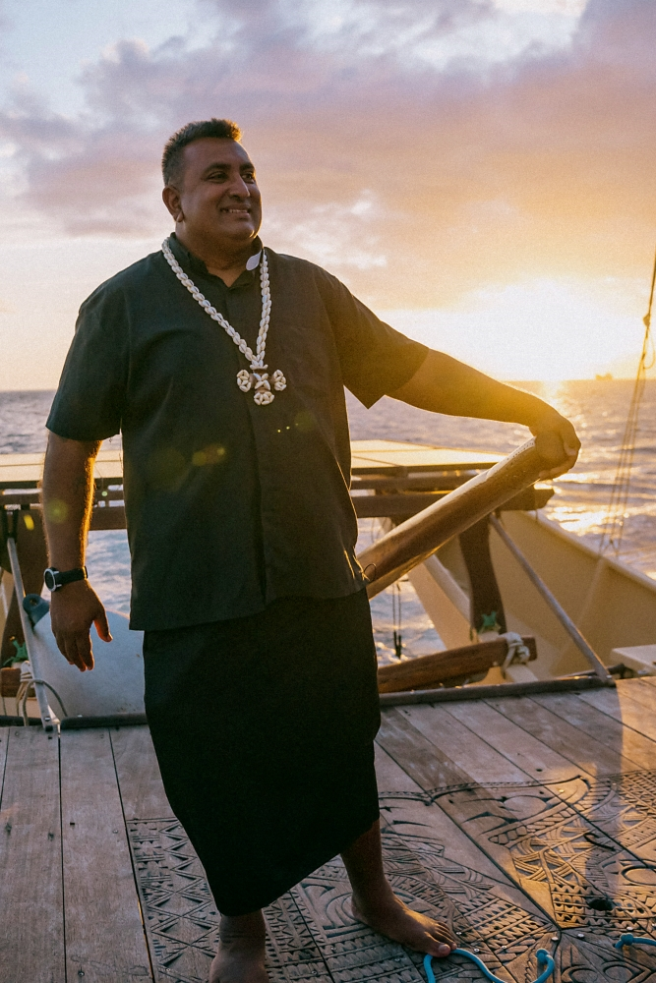
Sermon
Rev James Bhagwan,
General Secretary of the Pacific Conference of Churches

Slide 20
Song
Add the lyrics, video or the book number of the song you have chosen/​
Duplicate this slide for additional verses​

Slide 21
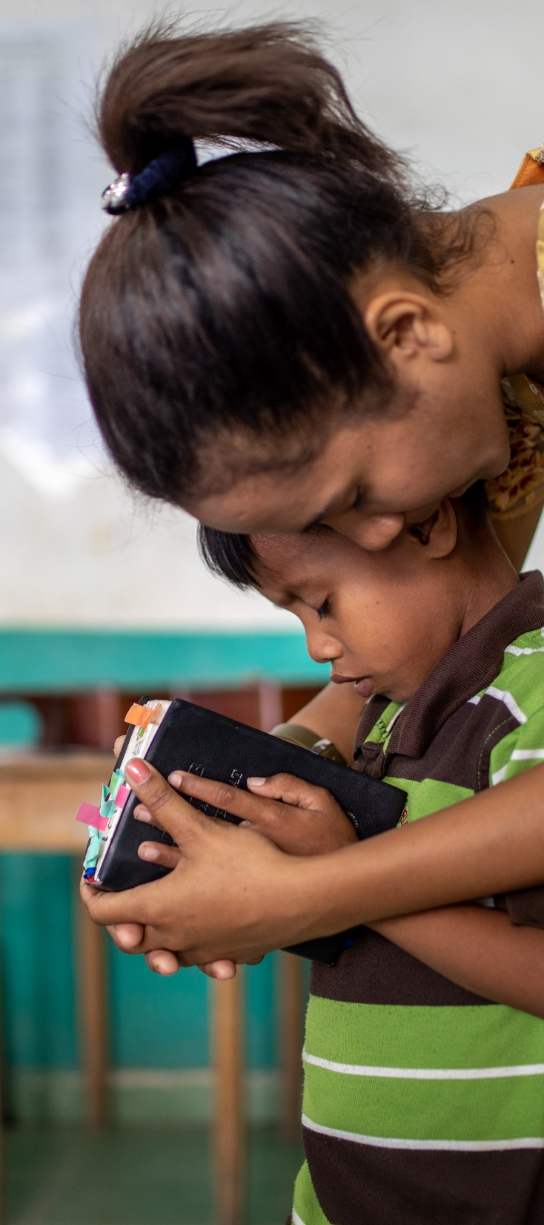
Prayers of Intercession
LEADER:
God of infinite compassion, from age to age we tell the stories of Jesus’ time on earth comforting the suffering, healing the sick, speaking out against injustice, challenging the powerful, and bringing hope to all humanity.
Though those feet no longer walk the earth, and those hands no longer rest on the afflicted, we know you still hear the calling of your people, and we bring our prayers for the world in this time.

Slide 22
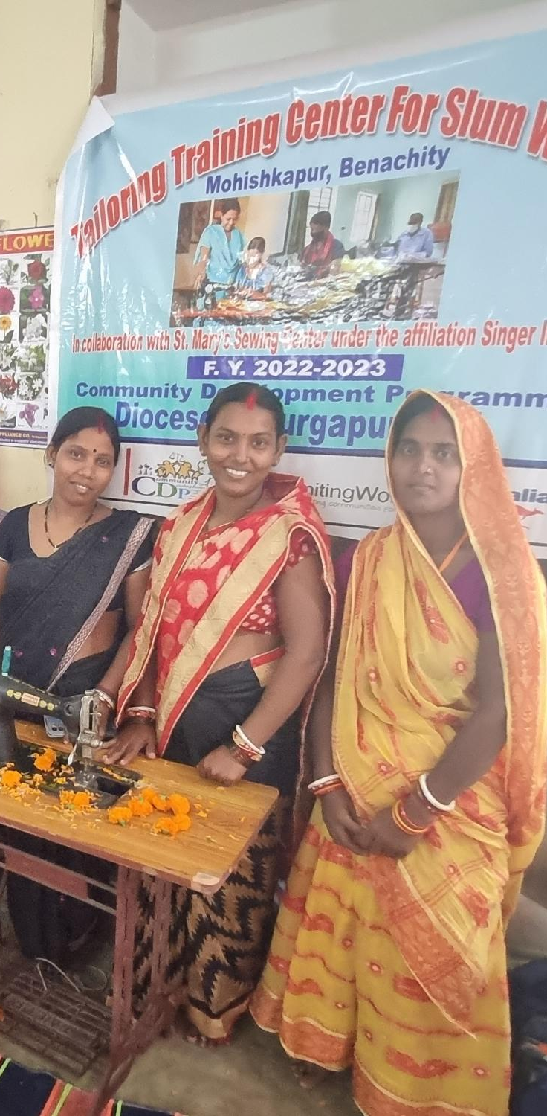
SPEAKER 1:
We pray for all people struggling for the essentials of life – for food, clothing and shelter, but also for healthcare and education – we pray that every bowl and every belly might be filled, and that every child might have the hope that comes from learning and dreaming.
We pray for everyone who is oppressed or exploited in this time, and for victims of violence and trauma, that their wounds might be healed with peace, grace and justice.
SPEAKER 2:
We pray for our partners addressing extreme poverty in places like India, Sri Lanka, Indonesia and Timor-Leste. Give them hope and courage as they help the most marginalised people to overcome poverty and injustice.

Slide 23

SPEAKER 3:
We pray for our partners across the Pacific who are fighting the impacts of disasters and the changing climate, at the same time as preparing their communities and building resilience to future disasters.
May we learn from their example and play our part to address the threat of climate change.

Slide 24
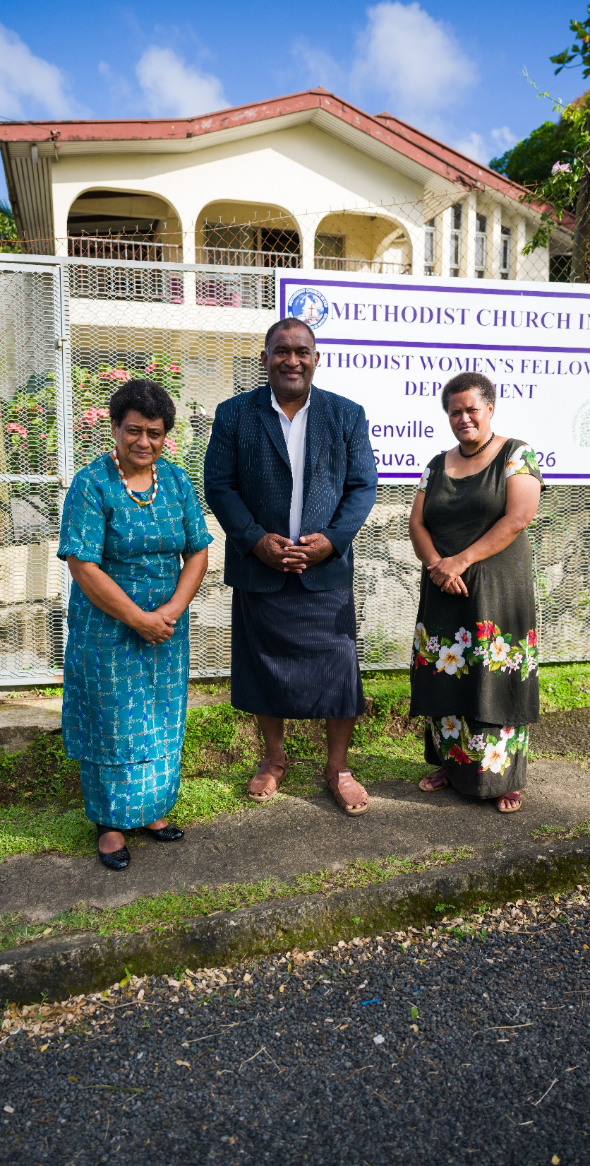
SPEAKER 4:
We pray for our partners training and equipping the next generation of Christian leaders in places like Zimbabwe, South Sudan, Papua New Guinea and Fiji. Fill them with passion and creativity to be your hands and feet and spread hope in their communities.
SPEAKER 5:
We pray for our partners raising up women in the church and community and leading a discussion on the biblical basis for gender equality and anti-violence. In the Pacific, where rates of men’s violence against women are among the highest in the world, we pray that our partners’ messages continue to cut through and change hearts.

Slide 25
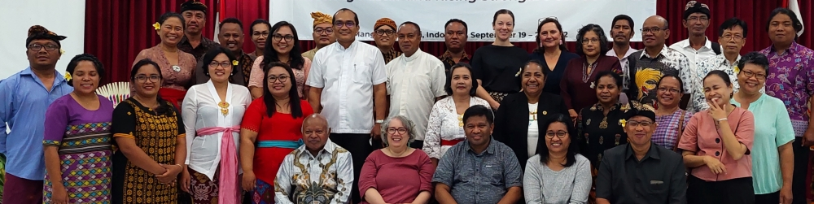
LEADER:
Lord God, we pray for UnitingWorld staff and partners, and the life-changing work that you are doing through our Christian family
across the globe.
We pray for the courage to remain engaged with the messy, broken, beautiful world around us and that we would each find ways to play our part as the body of Christ – whether down the street or the other side of the world.
Amen

Slide 26
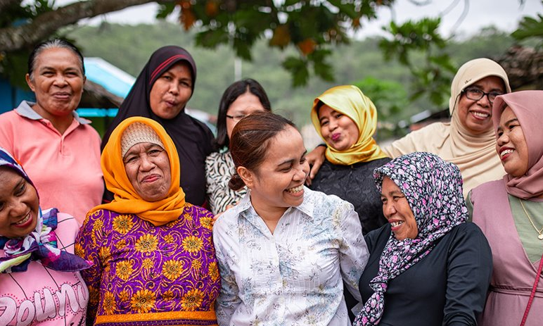
Offering
Every one of us has a role to play
alongside our church partners.
Your gift will be used with care, resourcing our partners to
transform lives and communities. ​

Slide 27
Dedication of Offering
LEADER:
Loving God, we join today in celebration of your work in your world. We give you thanks for all the people reaching out in love and compassion in your name, and for the countless more acts of grace and works of your Spirit that go unnoticed.
We give you thanks, too, for calling us to be part of this story, participants by word and deed in the work of making your Kingdom known to all.
We give thanks for all those who have gone before us and championed this work, and those who stitched our call to support the global church into the Uniting Church's founding documents.

Slide 28
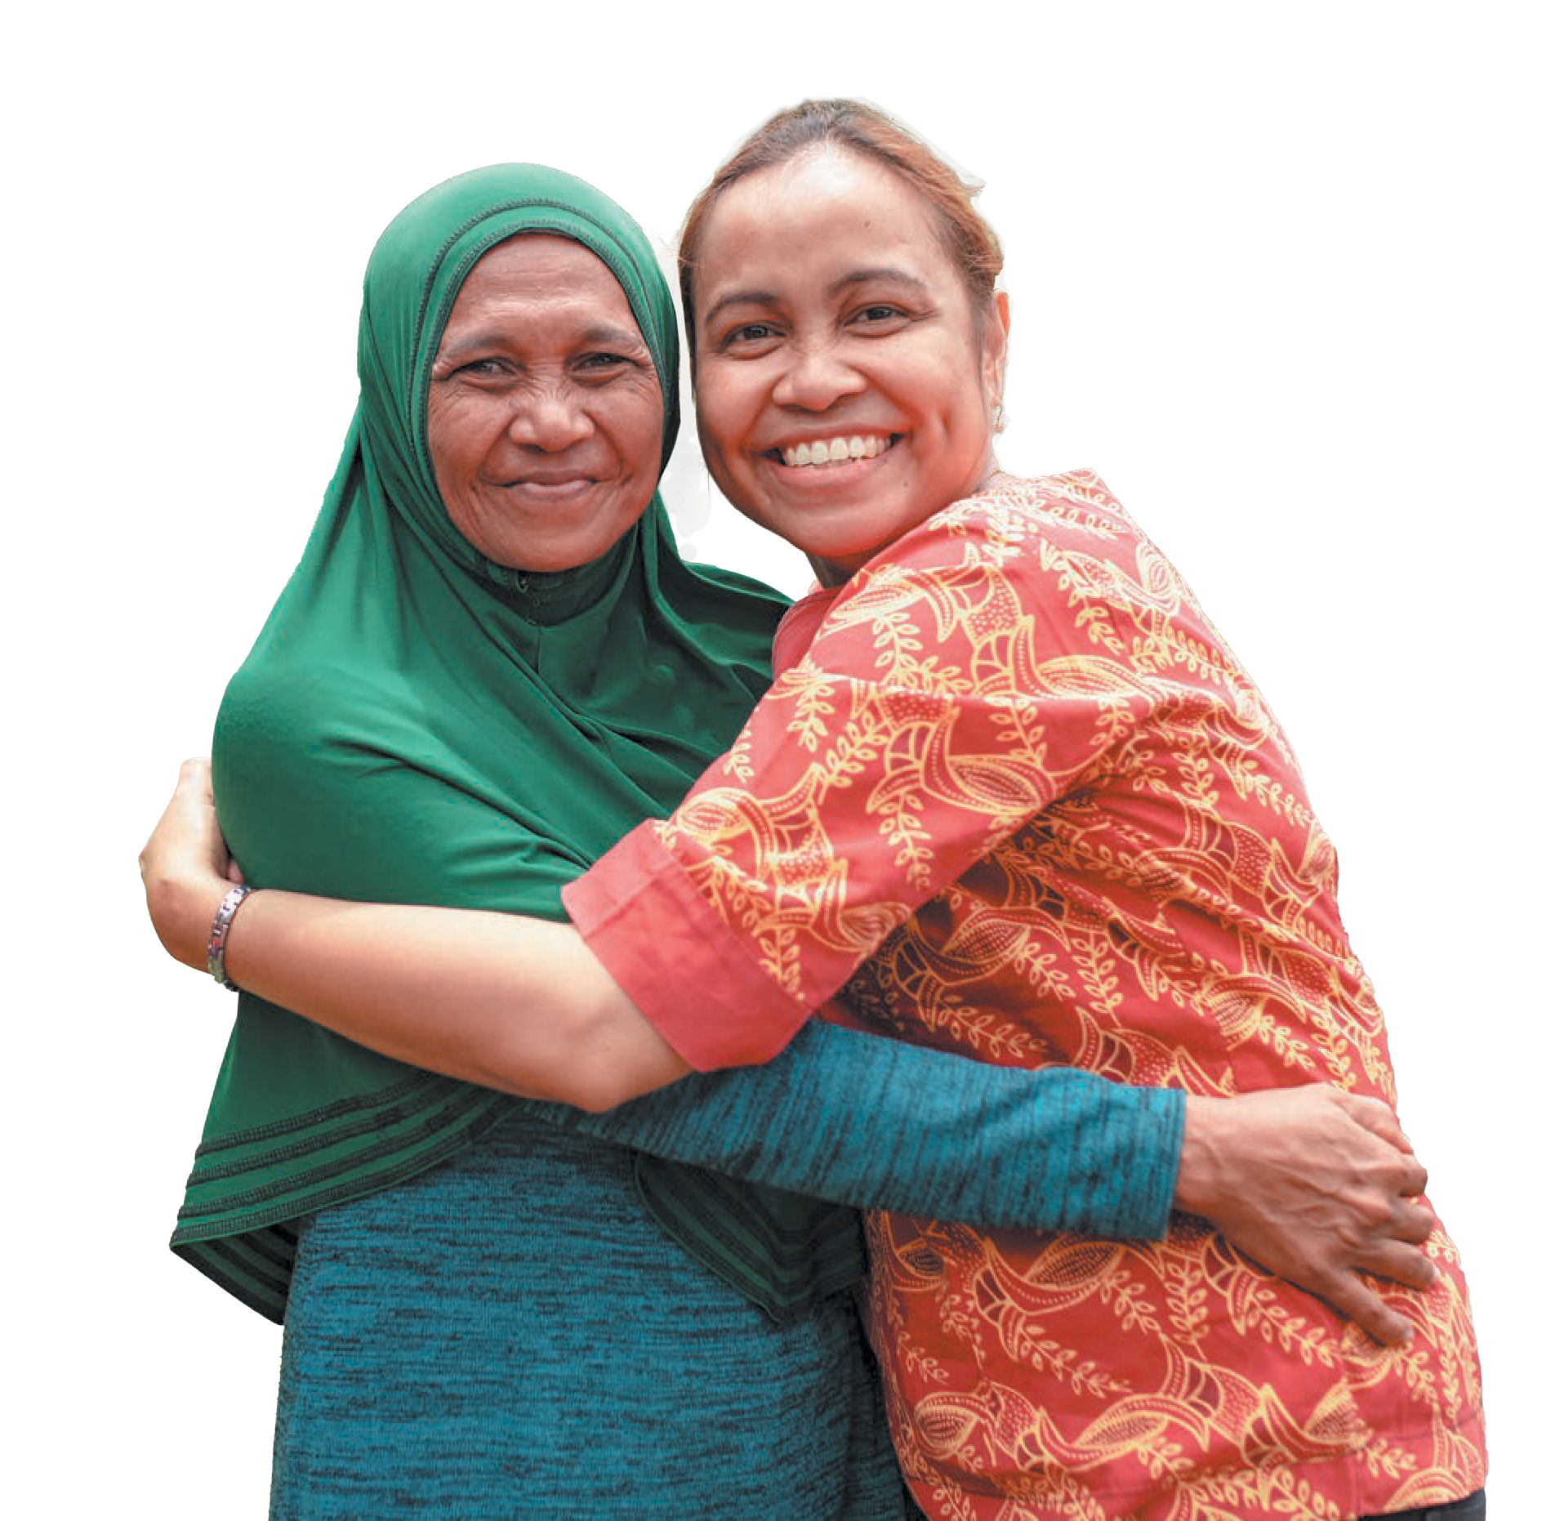
And as part of our response to that call, we bring these gifts, and with them, we recommit ourselves into your service.
Use our money and ourselves, here in our local community, and throughout your world.
For we ask in the name of our risen Lord, Jesus Christ.
Amen

Slide 29
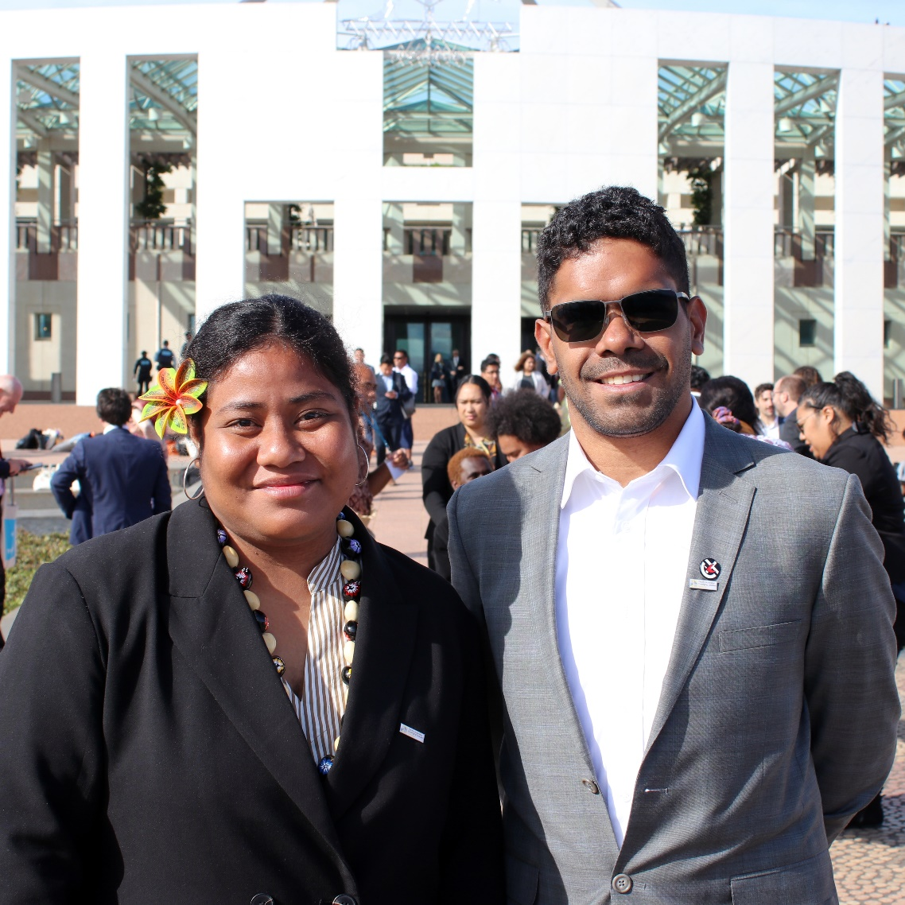
A Sending
Blessing
May God bless us with a spirit of solidarity to fight together against poverty, injustice, social inequality and environmental damage.
May God bless us with the spirit of courage to improve, renew and transform the social order that has lost its conscience because of greed and selfishness.

Slide 30
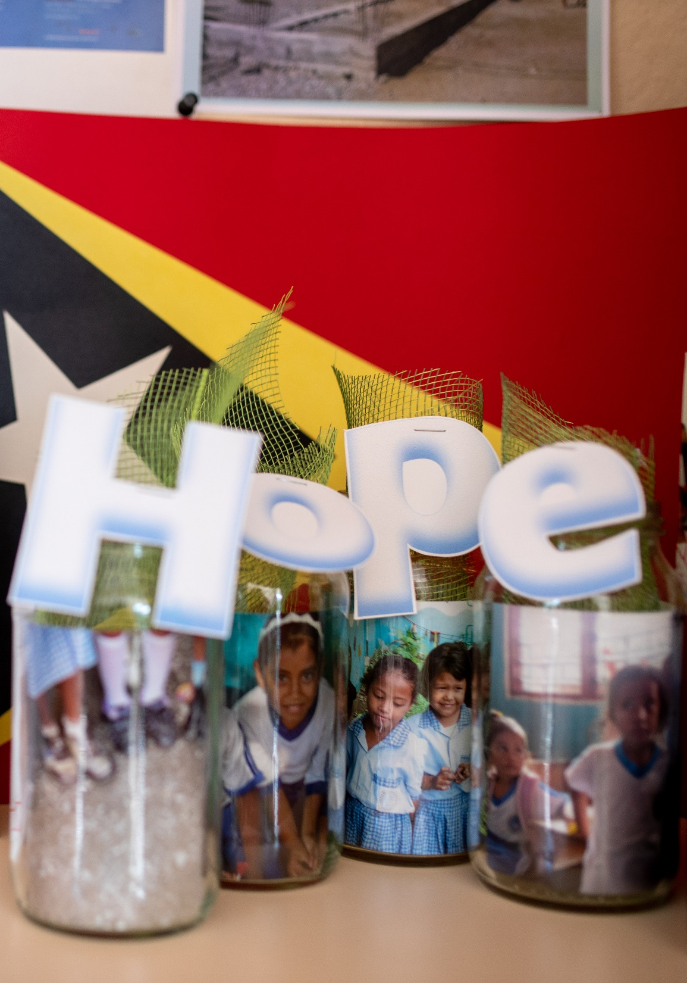
May God bless us with a spirit of gentleness to hear and understand the voices of those who are oppressed, left behind and pushed aside by the bustle of worldly pride.
May God bless us with a spirit of peace amidst the difficulties and challenges of the world so that we can continue to be God’s witnesses who radiate love, generosity, forgiveness and hope.
In the name of Christ.
Amen

Slide 31


Thank you for
celebrating with us! ​
To give online and find out
more about UnitingWorld
and our partners, please visit
www.unitingworld.org.au/sunday​

