Slide 1
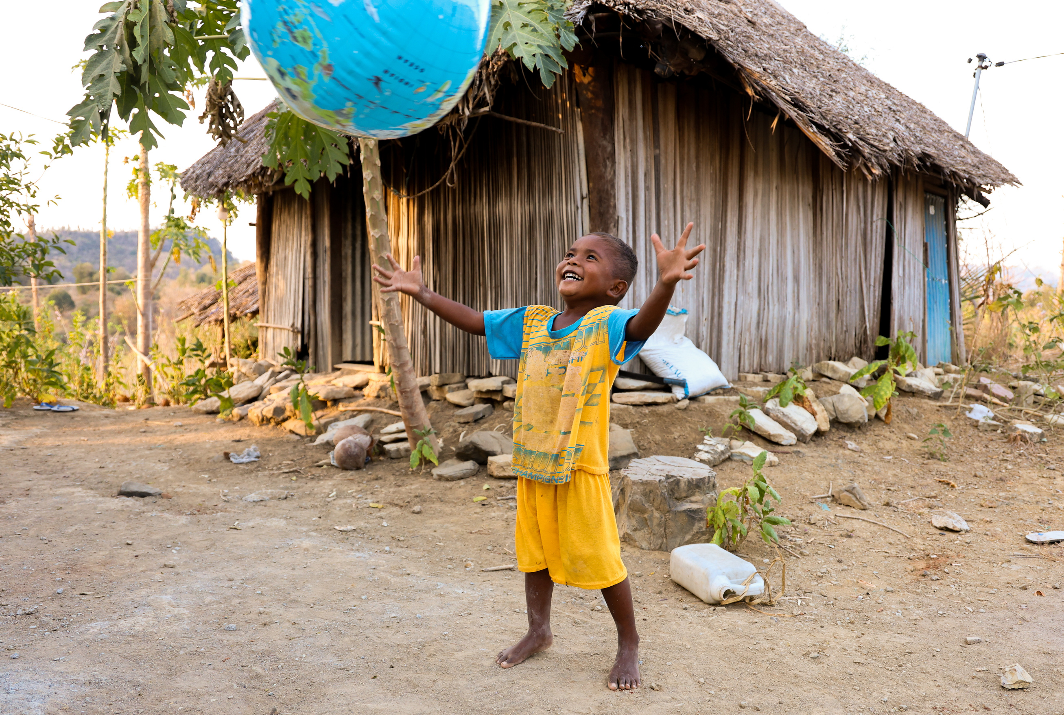

UnitingWorld Sunday
A celebration of our global neighbours

Slide 2
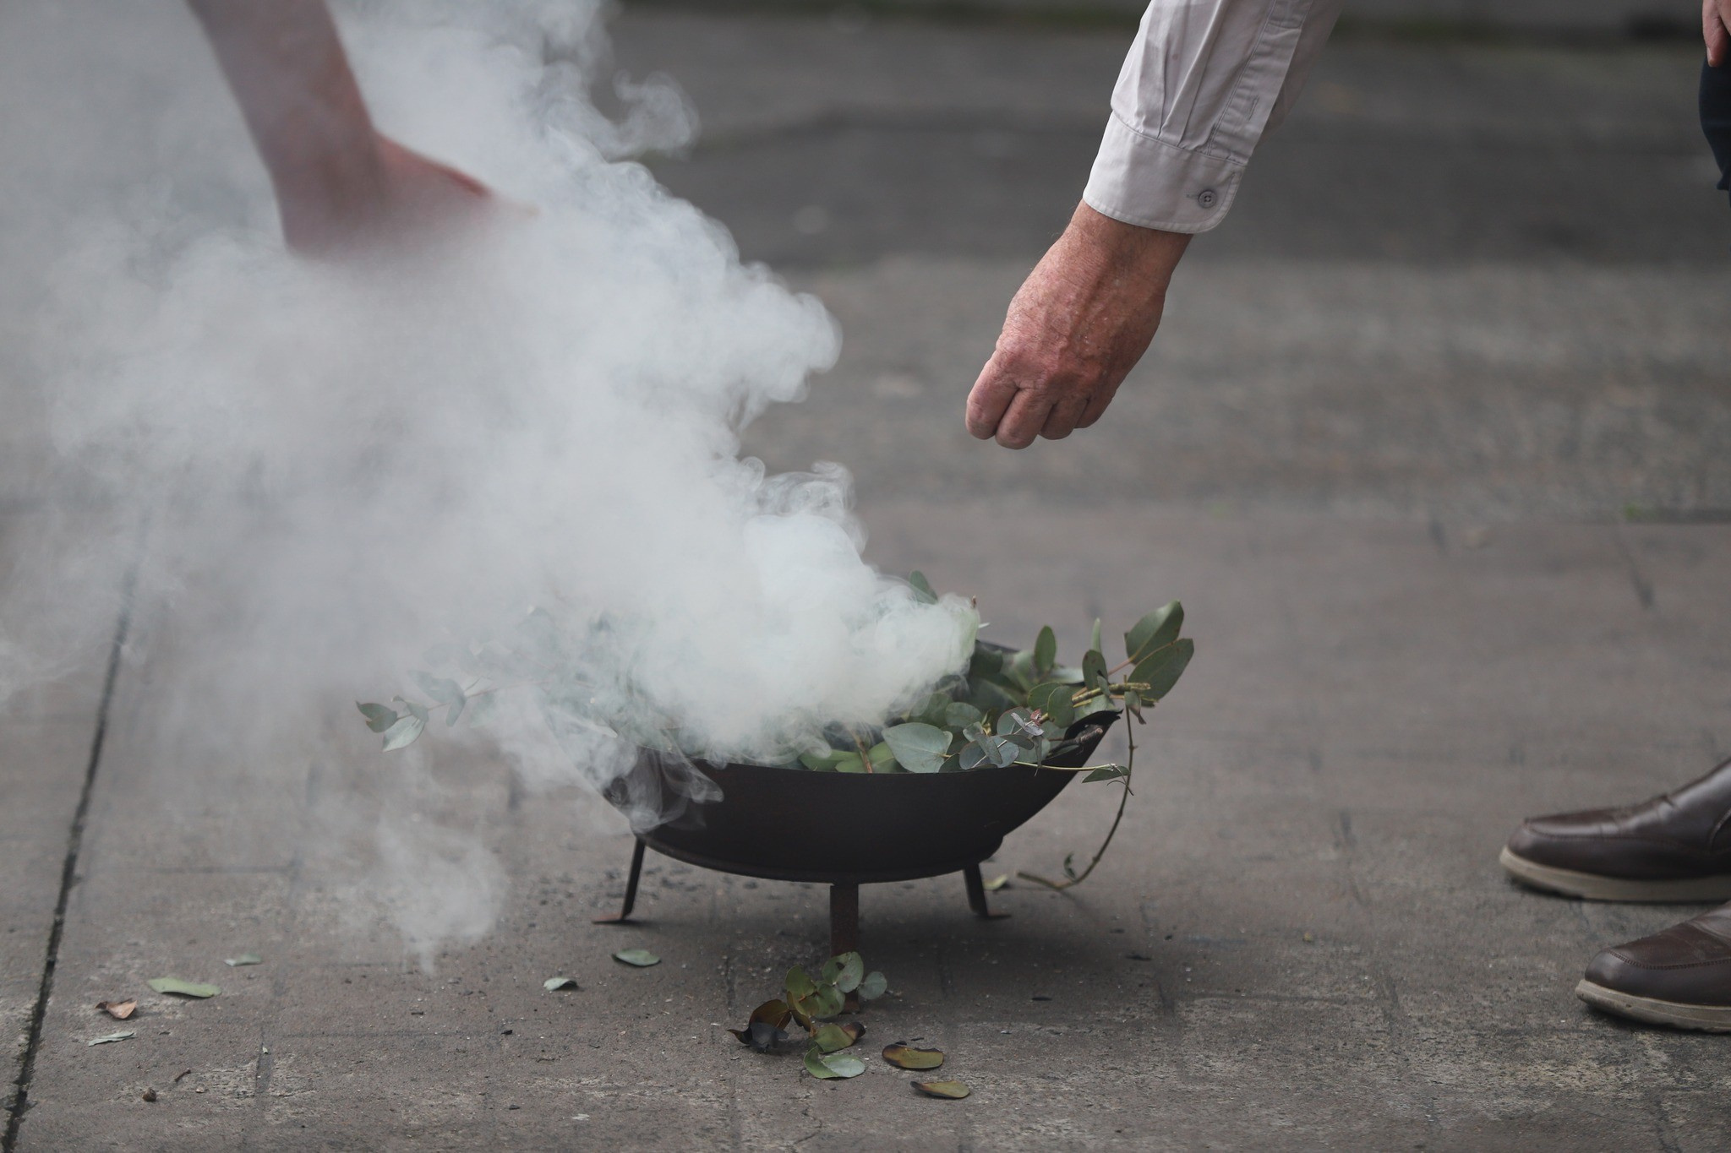
Acknowledgment
of Country

Slide 3

Lighting
the Christ Candle

Slide 4
Worship Leader
We light the Christ Candle to remind us that Christ came that we might have life and live it abundantly.
People
In our emptiness, we come to worship our God of Wonders and to celebrate the overflowing grace that fills our empty places.

Slide 5
Worship Leader
God calls us out of scarcity and into a
flourishing life of peace, purpose and
radical love.
People
We bring our whole selves to be
renewed by the Spirit.
Let us worship the Lord of abundant life!
Amen

Slide 6
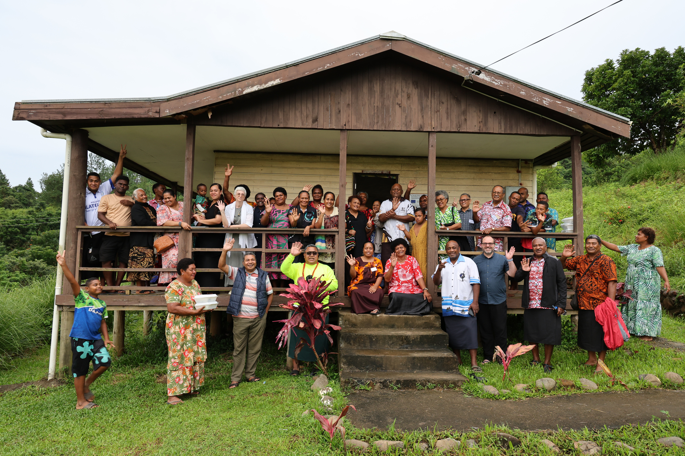
UnitingWorld Sunday
UnitingWorld Pacific Partners Forum Fiji 2026

Slide 7
Call to Worship
Leader
We gather today as people who know the Shepherd's voice.
People
We come to listen, to follow, to be led.

Slide 8
Leader
We gather with family across Asia, the Pacific and Africa. One flock, one Shepherd.
People
We come as part of a family larger than we can imagine.

Slide 9
Leader
Jesus said, I came that you might have life, life in all its fullness.
People
We come hungry for that life and
ready to share it.

Slide 10
Leader
Let us worship the Good Shepherd,
who calls us each by name.
All
Come, let us follow where He leads.
Amen

Slide 11
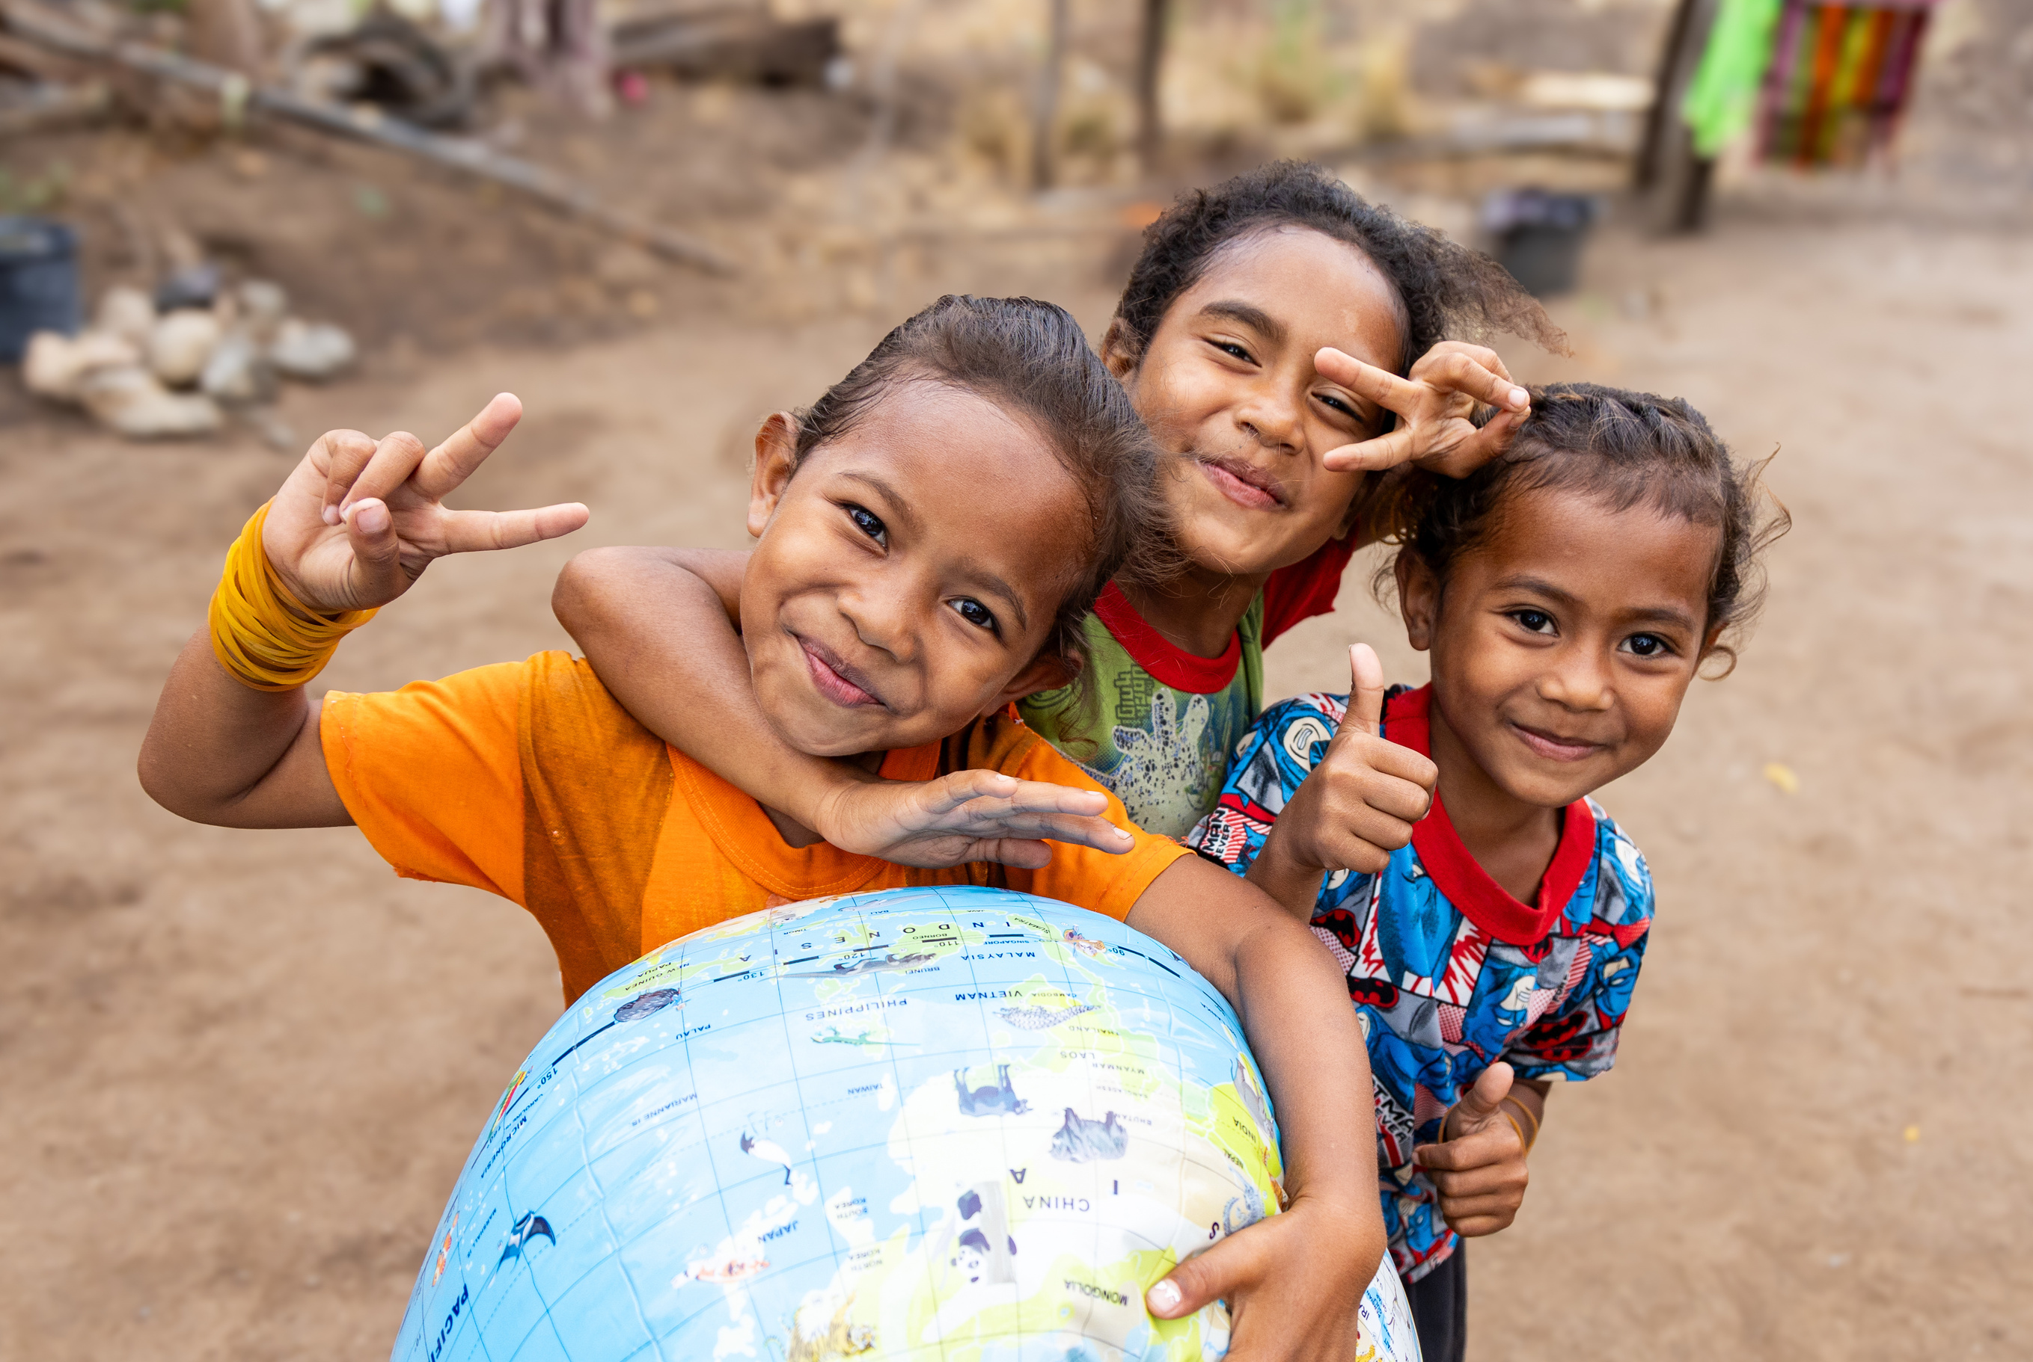
Climate-resilient Food Security, Timor-Leste
The Peace

Slide 12
Insert song of choice here

Slide 13
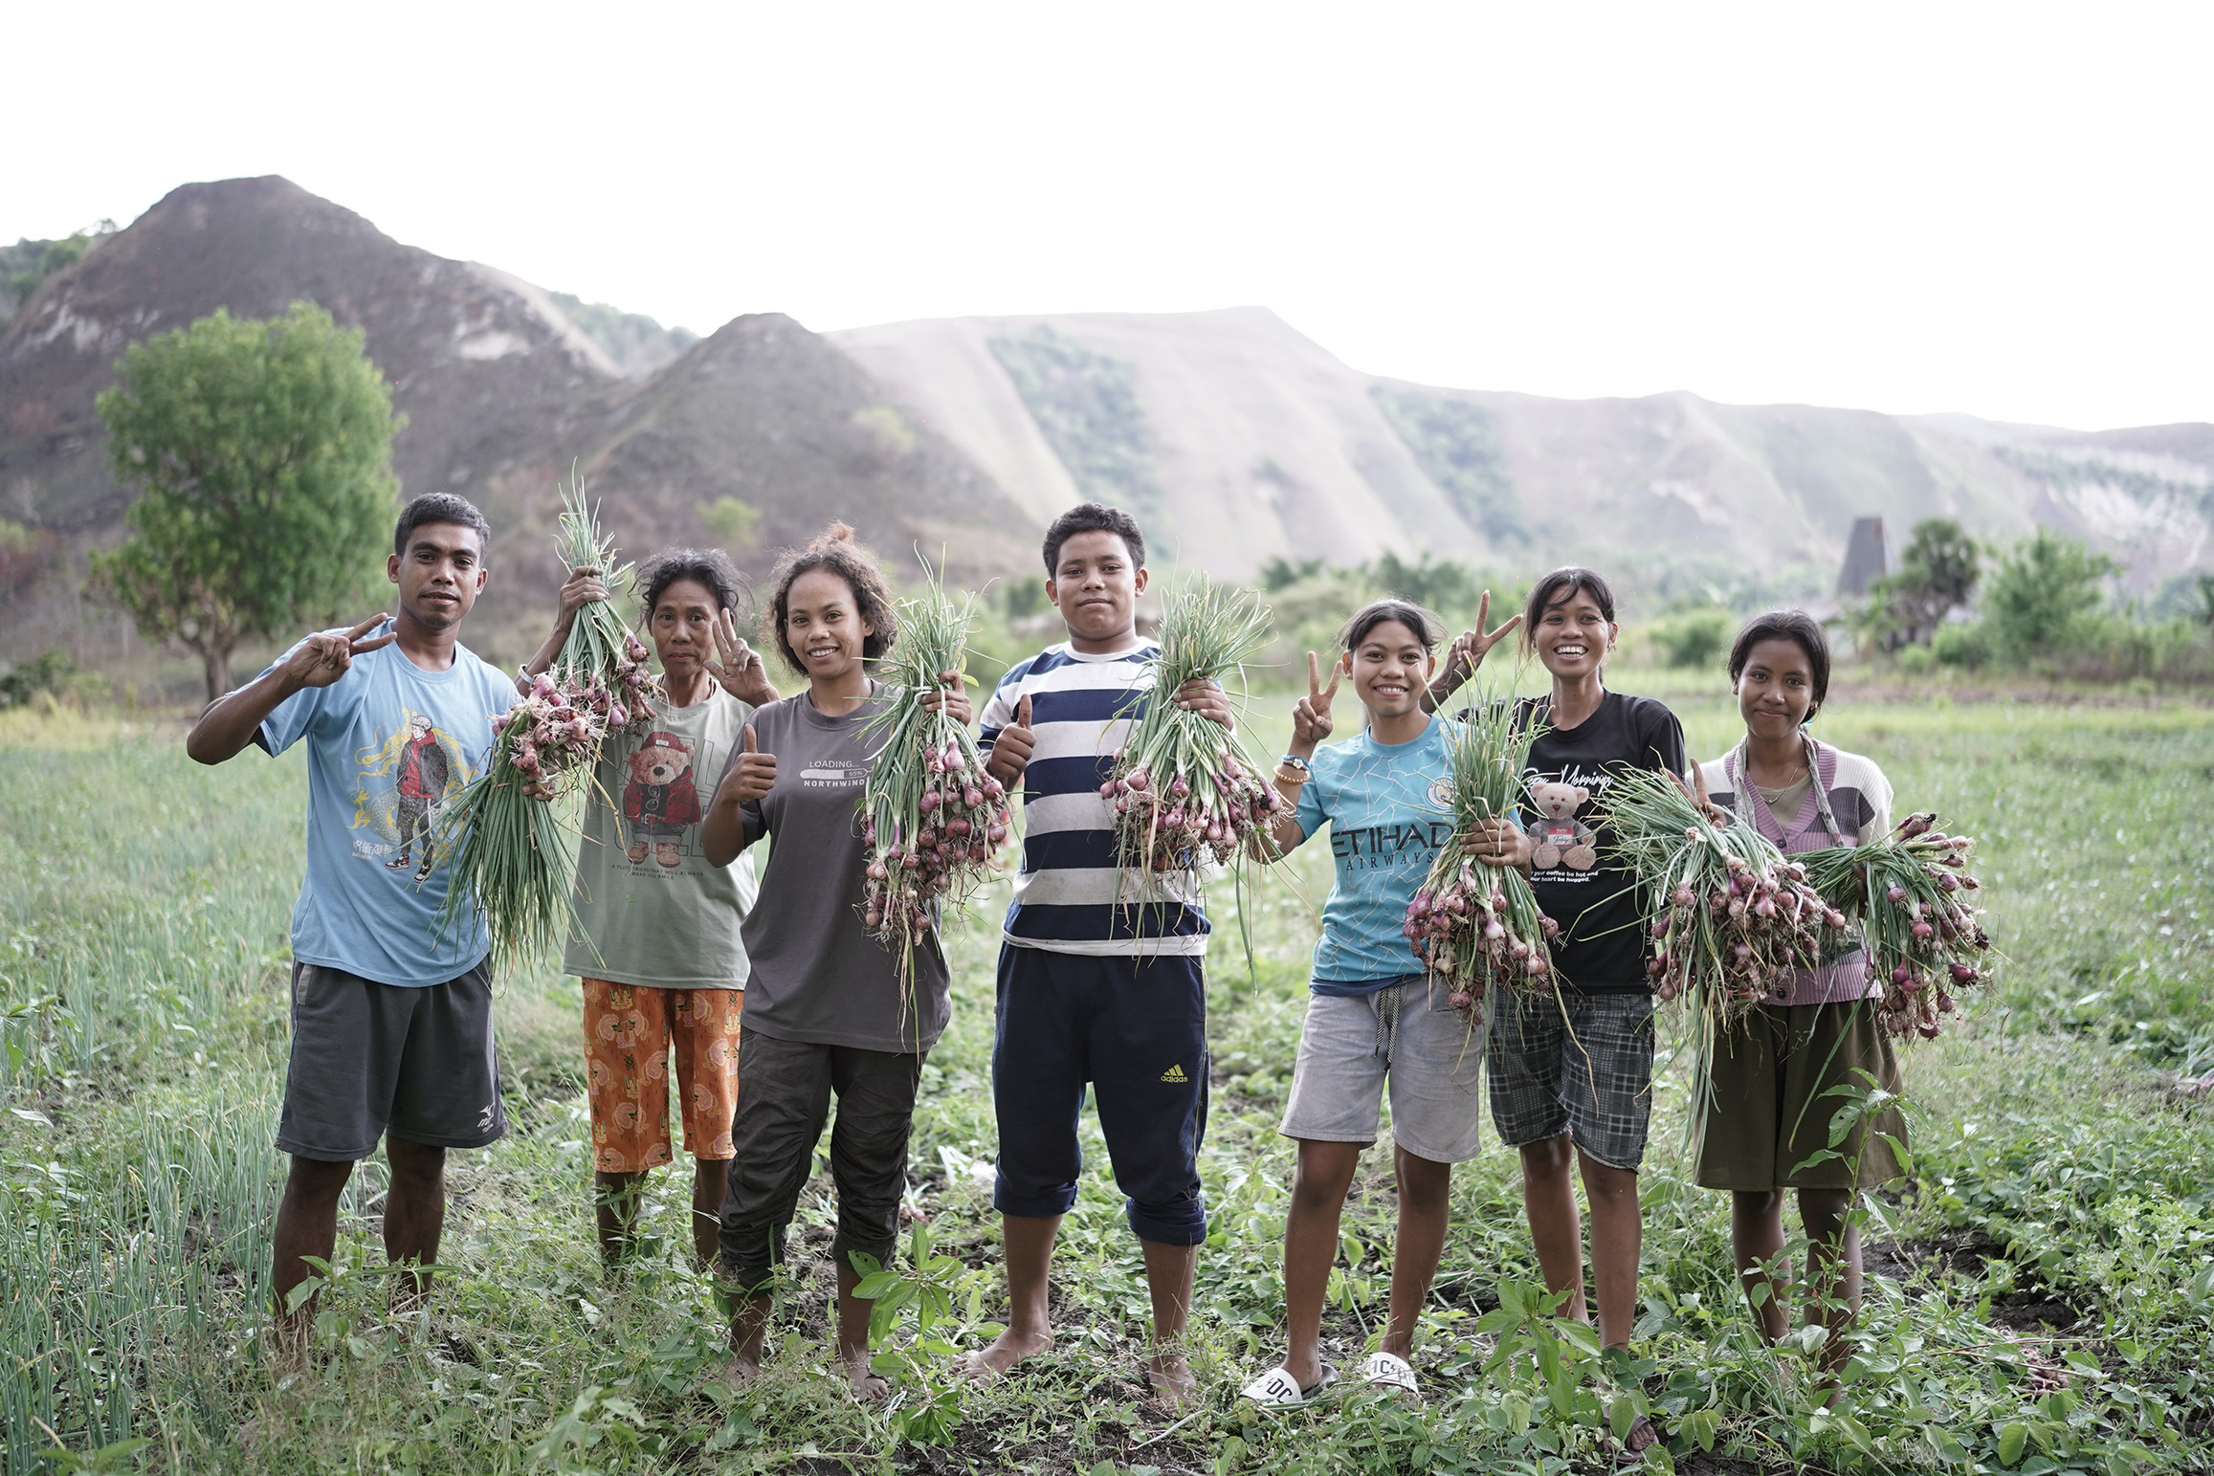
Climate-Sensitive Health and Livelihoods (Sumba and Bali, Indonesia)
Opening Prayer

Slide 14
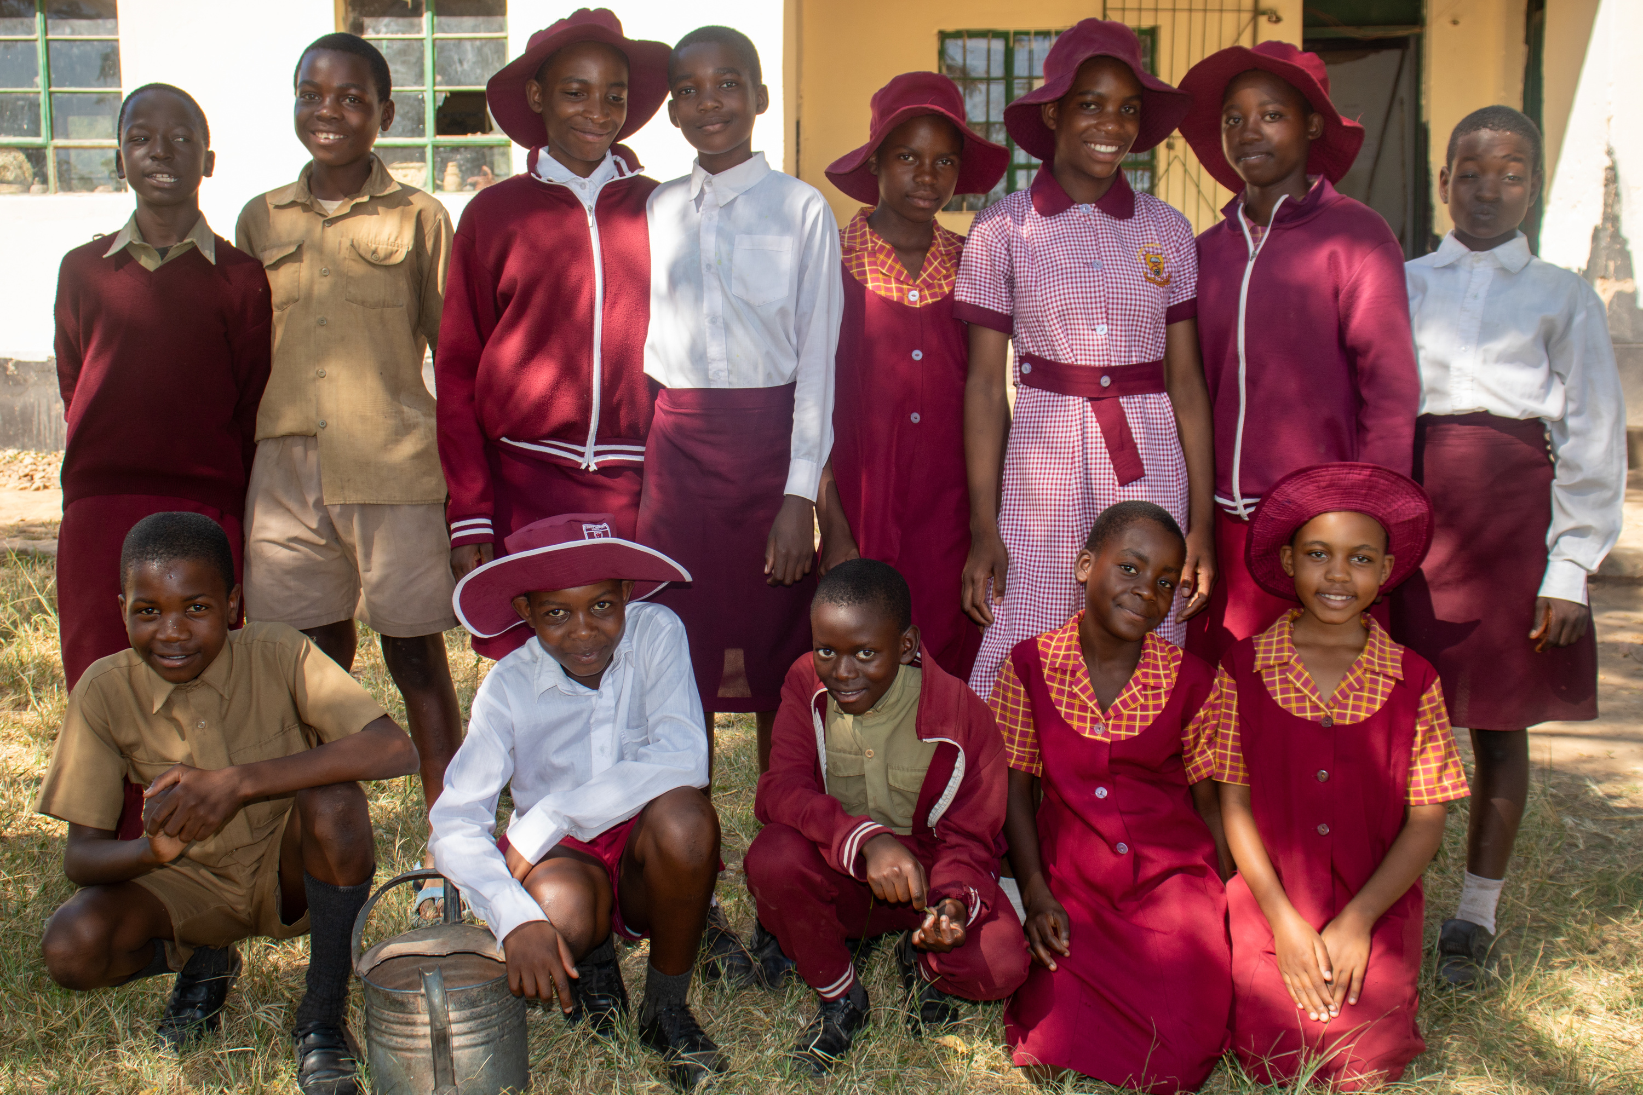
Children’s Talk
Safety and Inclusion project, Methodist Church in Zimbabwe

Slide 15
Insert song of choice here

Slide 16
Insert Bible reading text in your usual format here

Slide 17
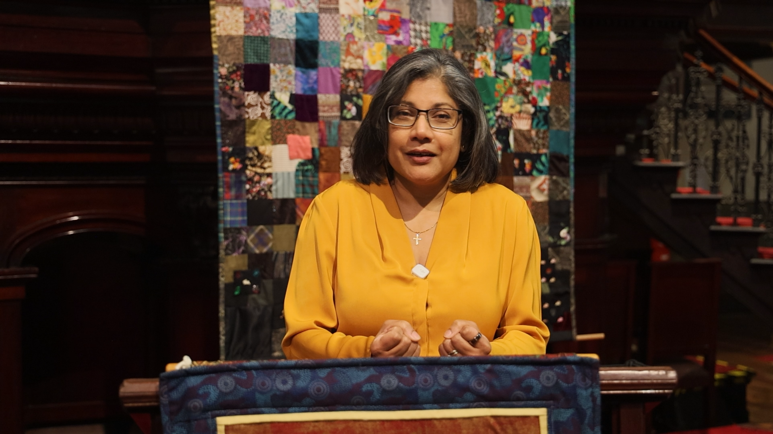
Sermon
Dr Sureka Goringe
National Director
UnitingWorld

Slide 18
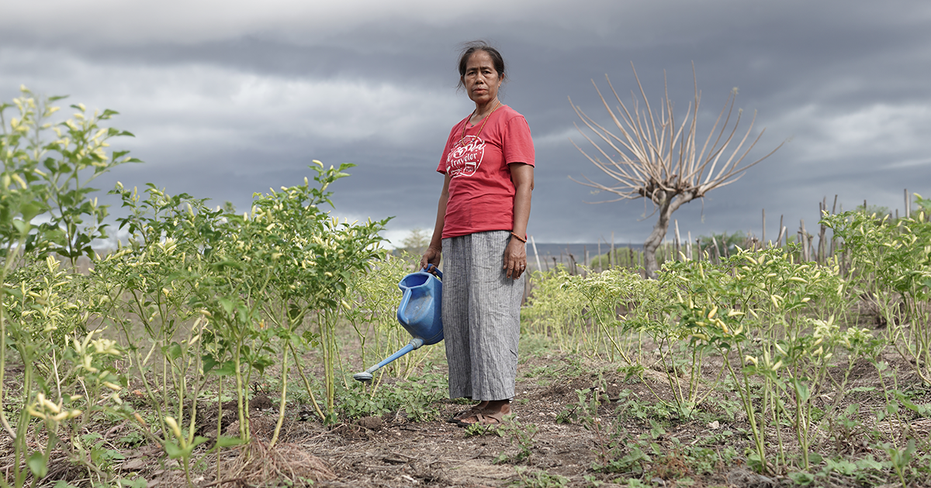
Sermon
Climate-Sensitive Health and Livelihoods (Sumba and Bali, Indonesia)

Slide 19
Play the UnitingWorld Sunday video sermon here

Slide 20
Insert song of choice here

Slide 21
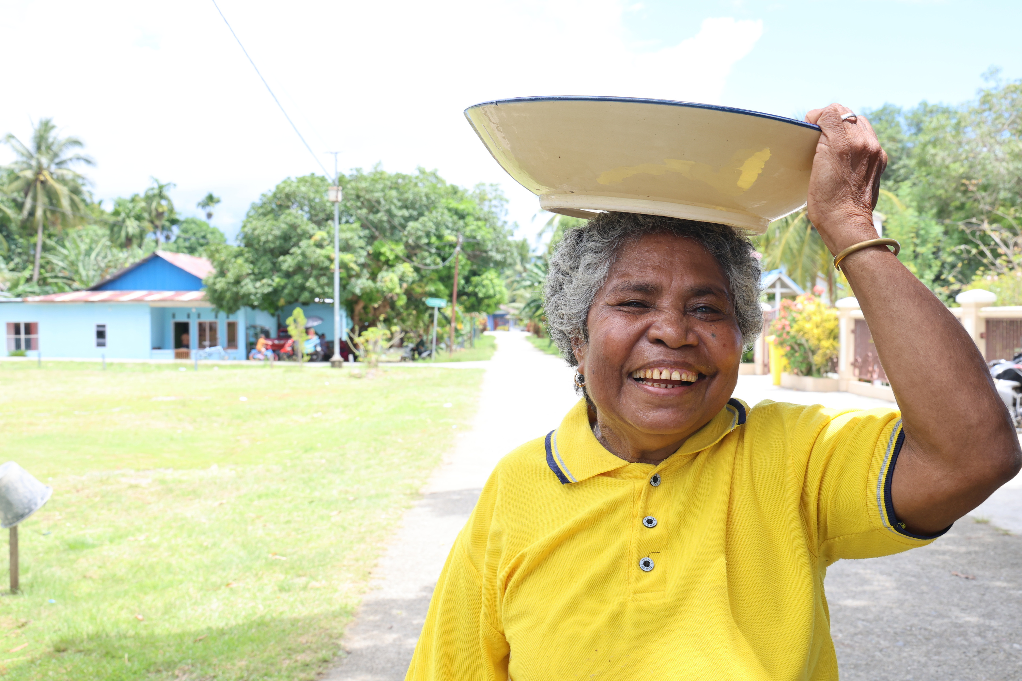
Prayers of Intercession
...That leads to abundance of joy in relationship with you.
Lord hear us.
People:
Lord, hear our prayer
Amen
West Papua Livelihoods and Forest Conservation

Slide 22
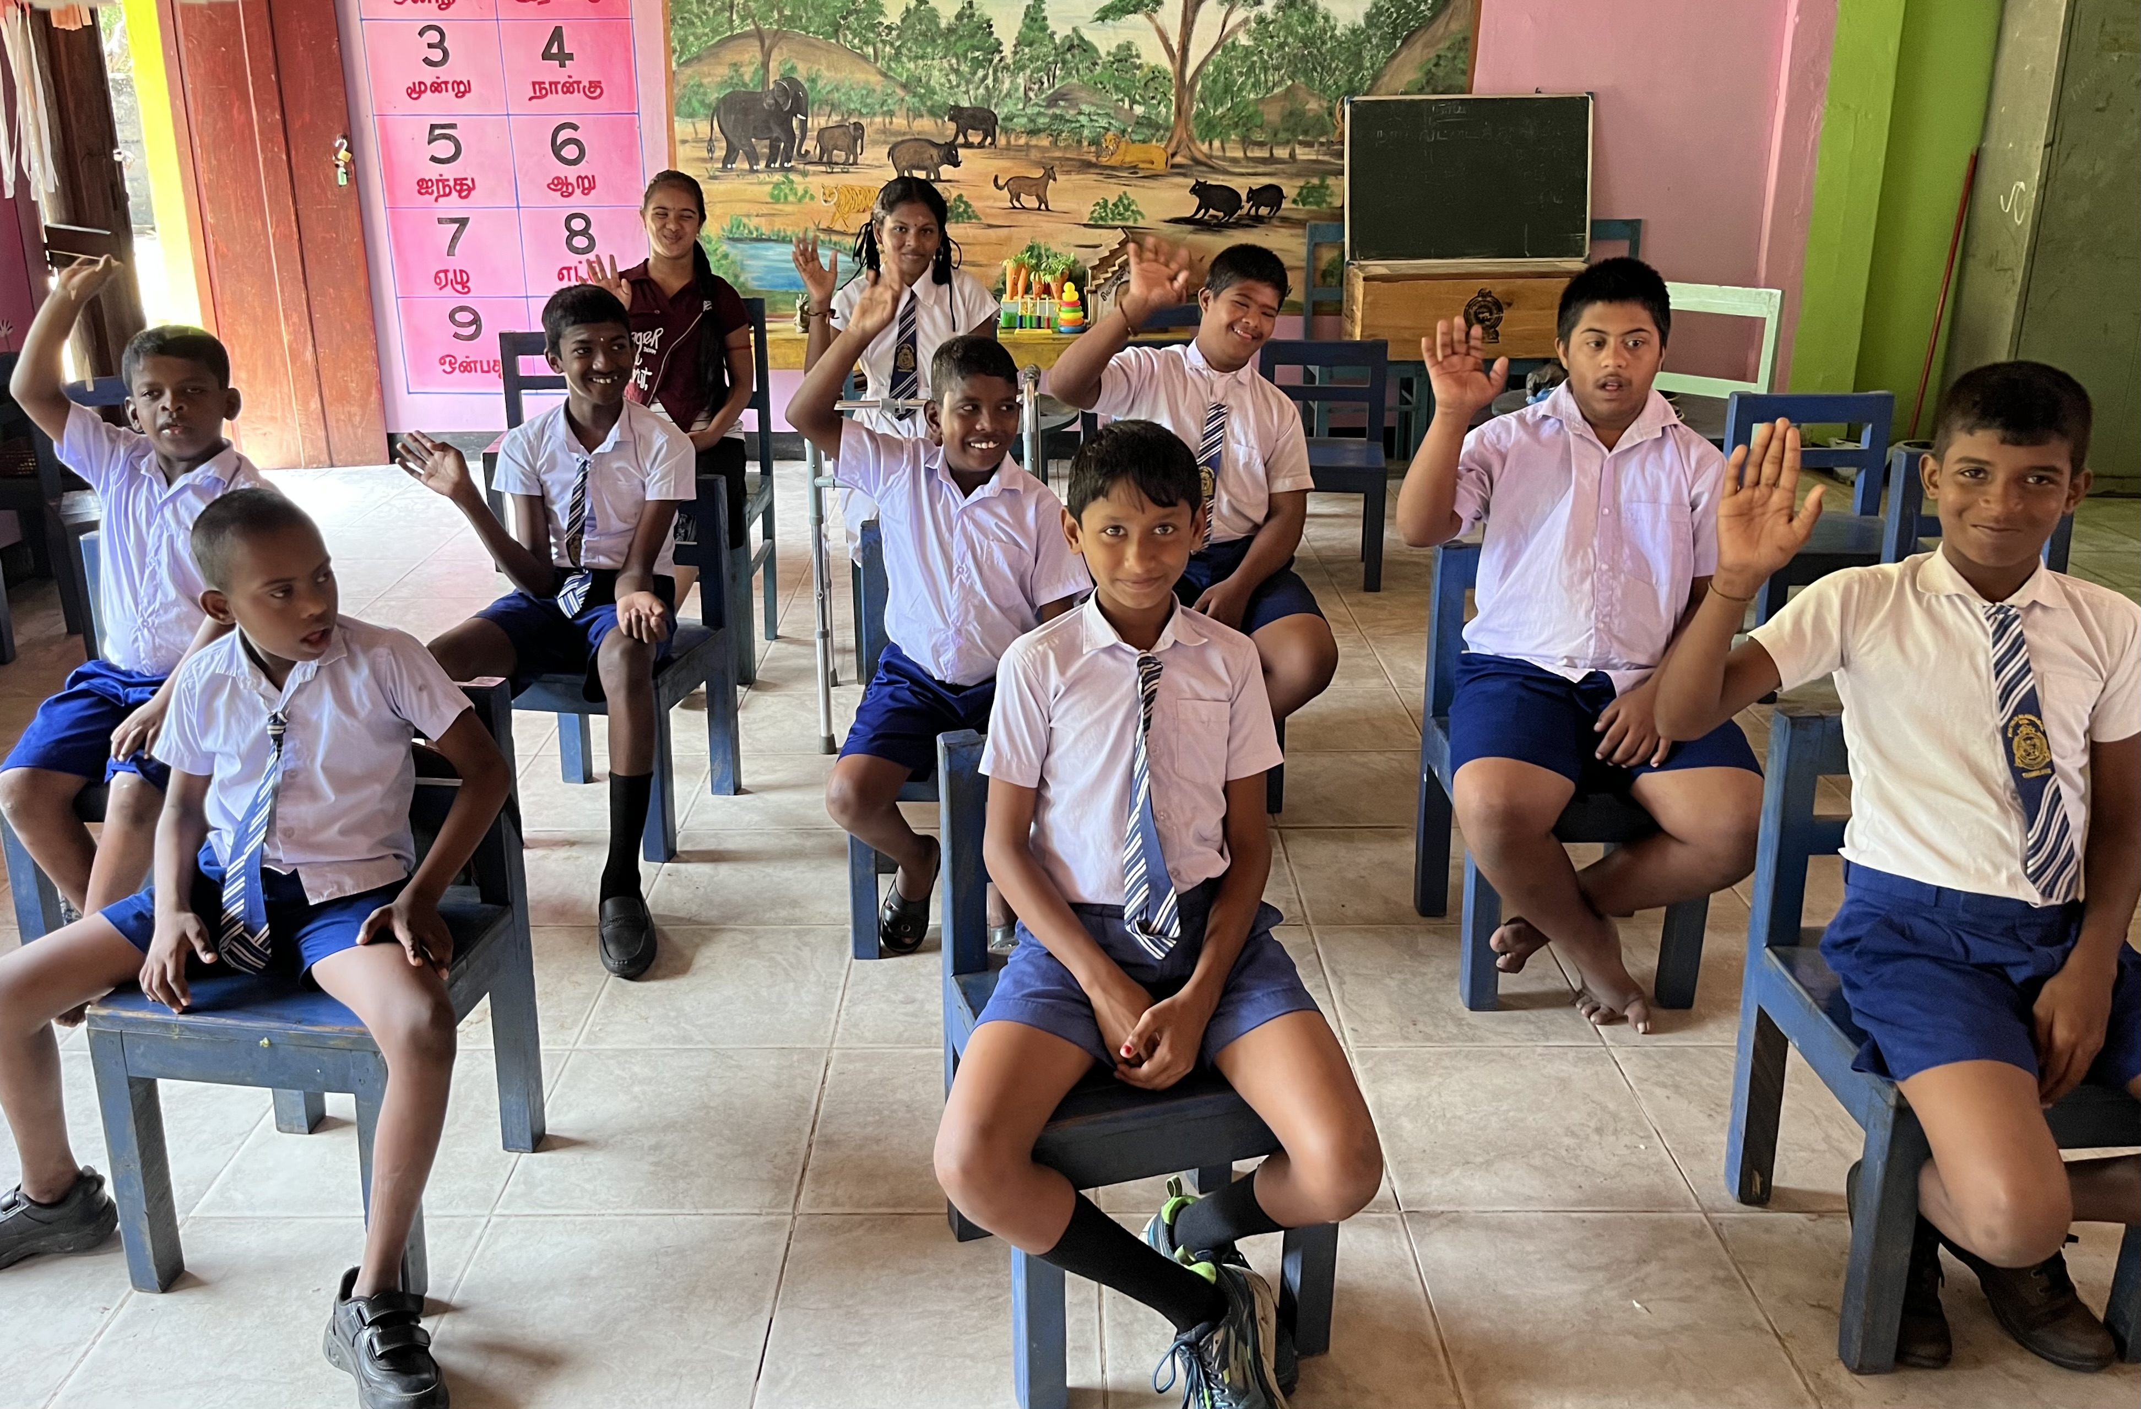
Offering
Empowering People with Disabilities, Methodist Church in Sri Lanka

Slide 23
Insert song of choice here

Slide 24
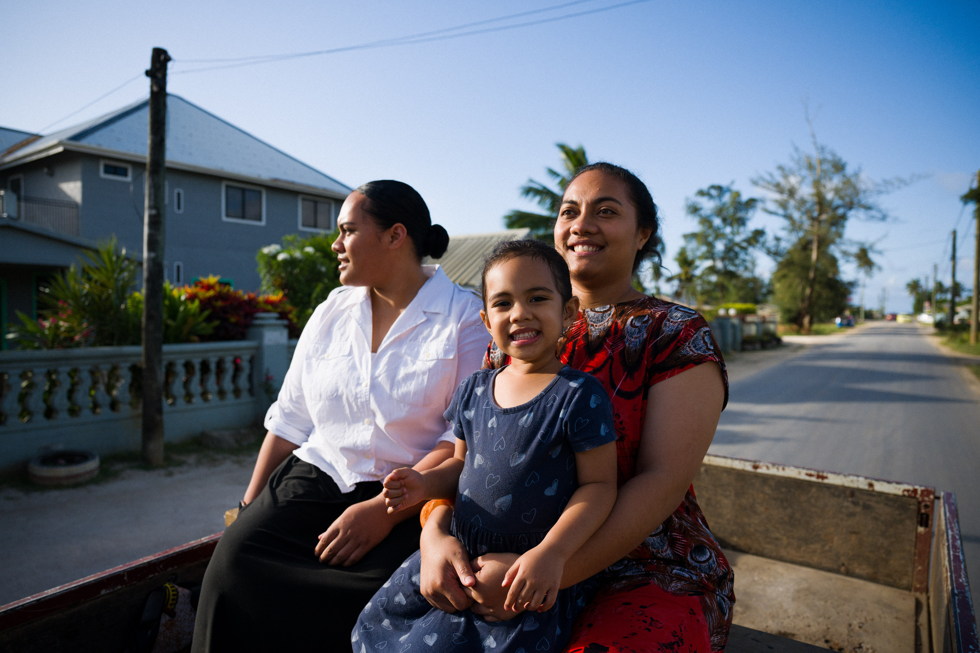
A Sending Blessing
Members of the Free Wesleyan Church Tonga on the way home from church

Slide 25
Insert song of choice here

Slide 26



Find out more and support UnitingWorld at www.unitingworld.org.au/sunday
scan here!

