Slide 1
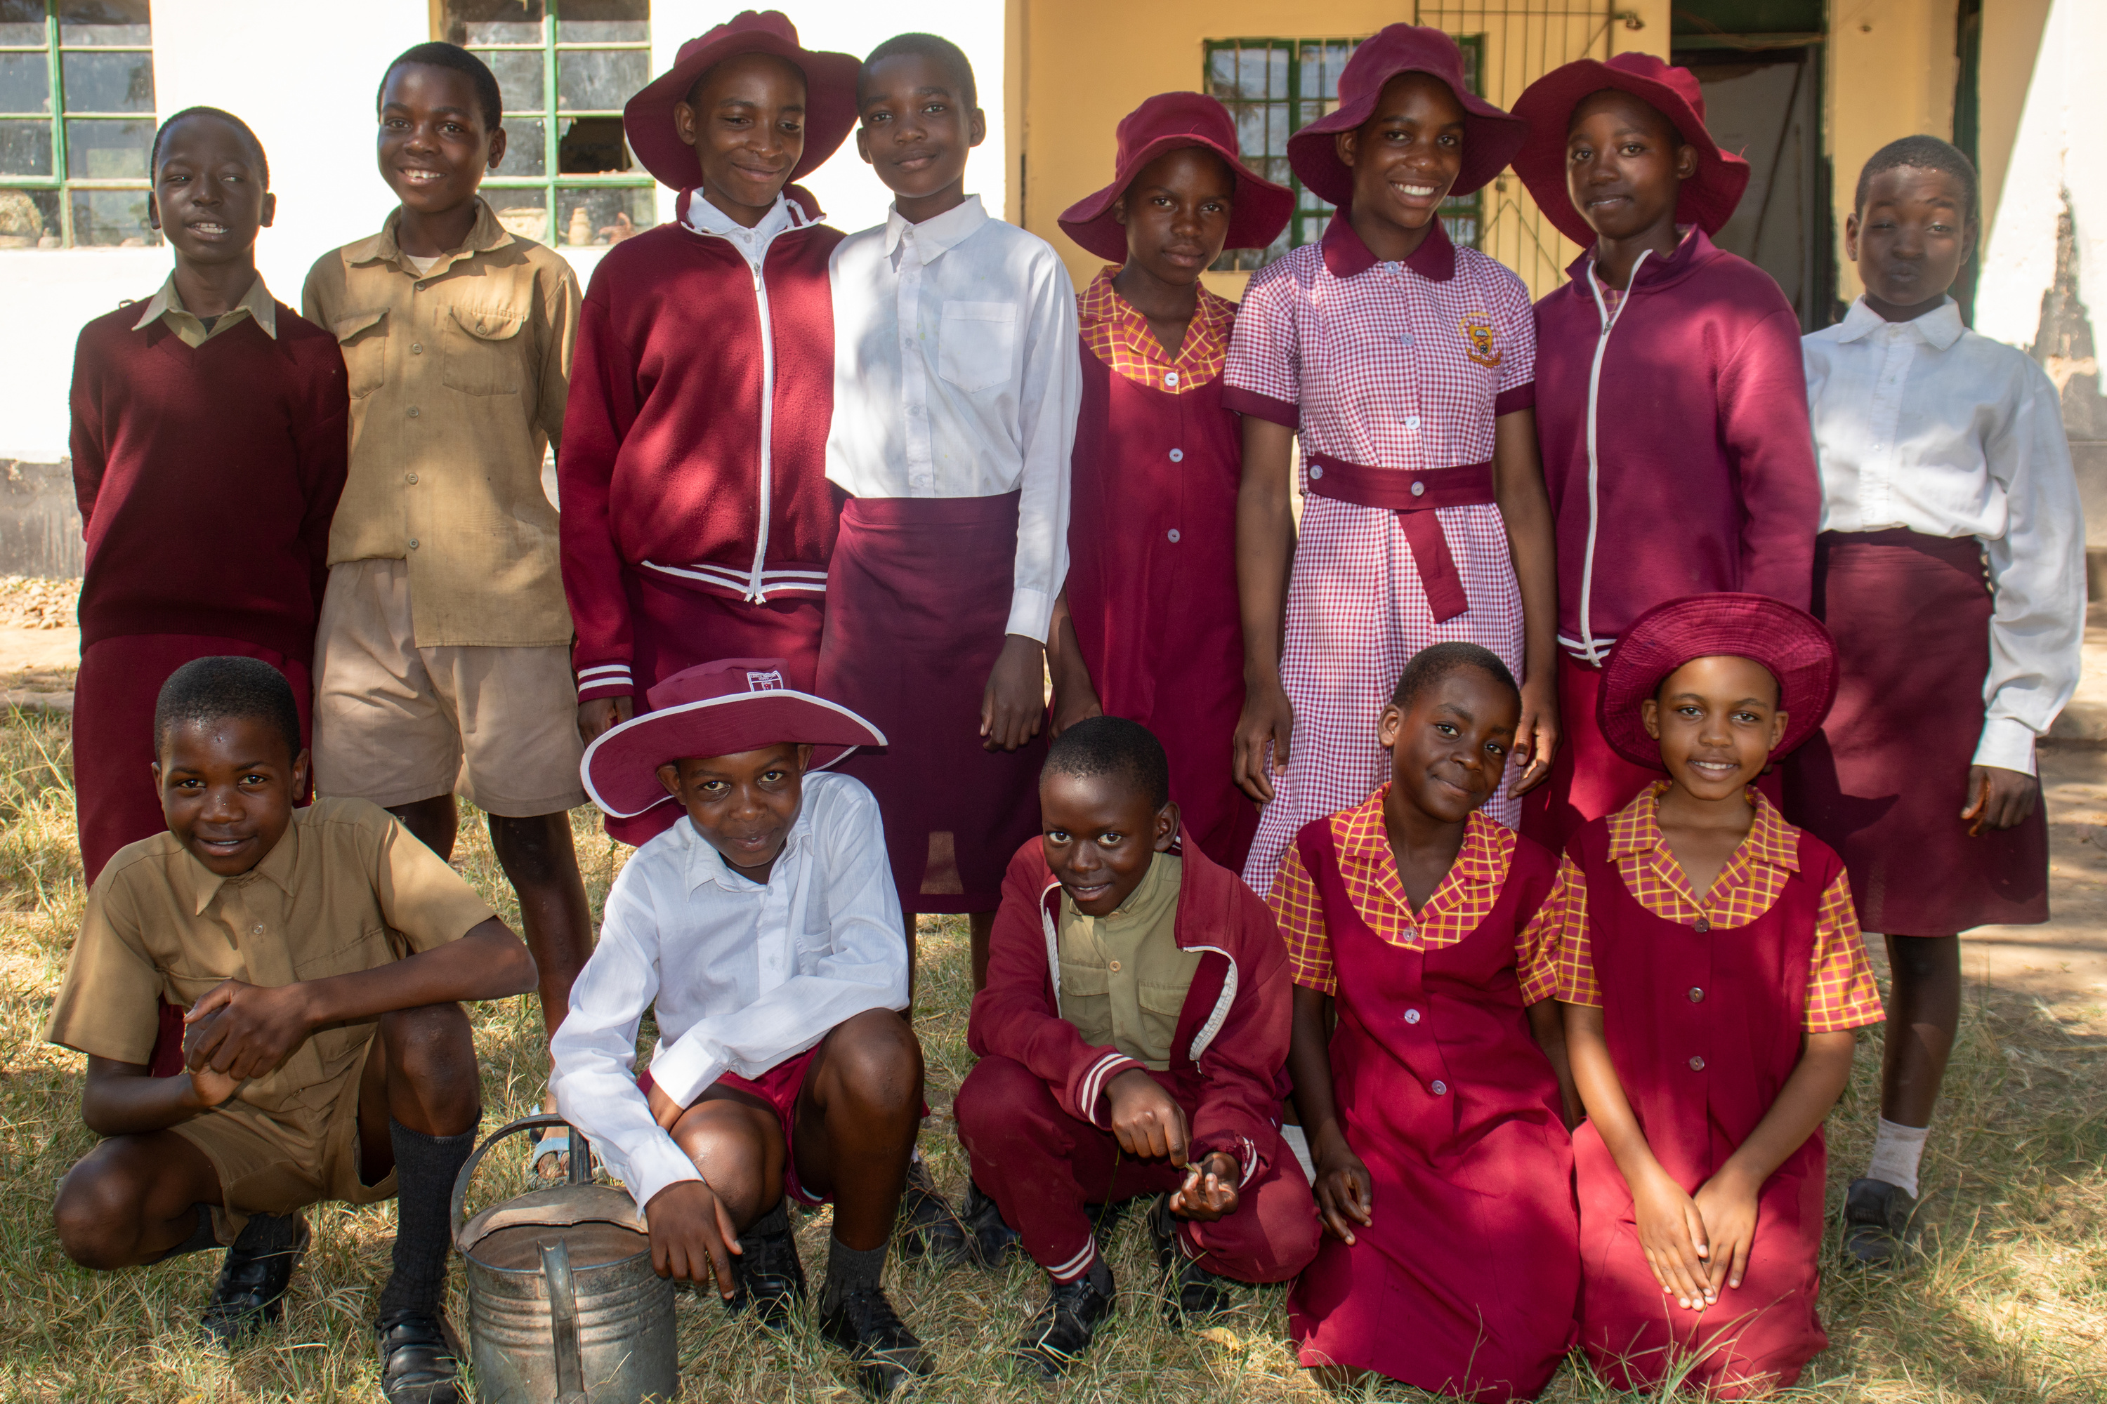
Children’s Talk
Safety and Inclusion Project, Methodist Church in Zimbabwe​

Slide 2
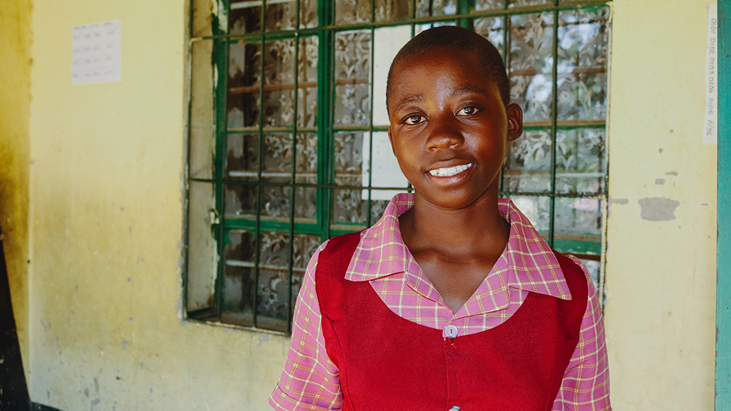
Tanaka

Slide 3
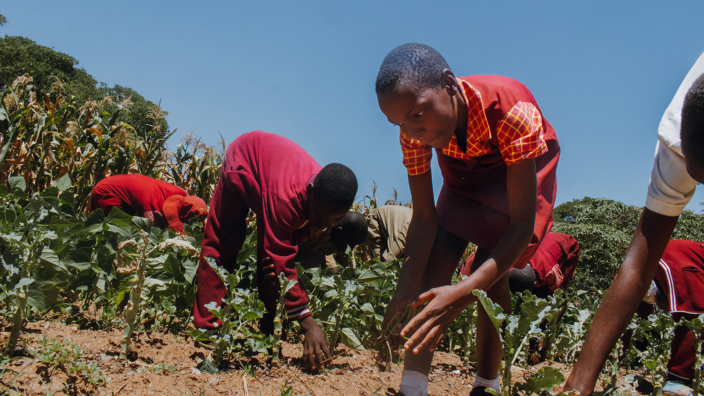

Slide 4
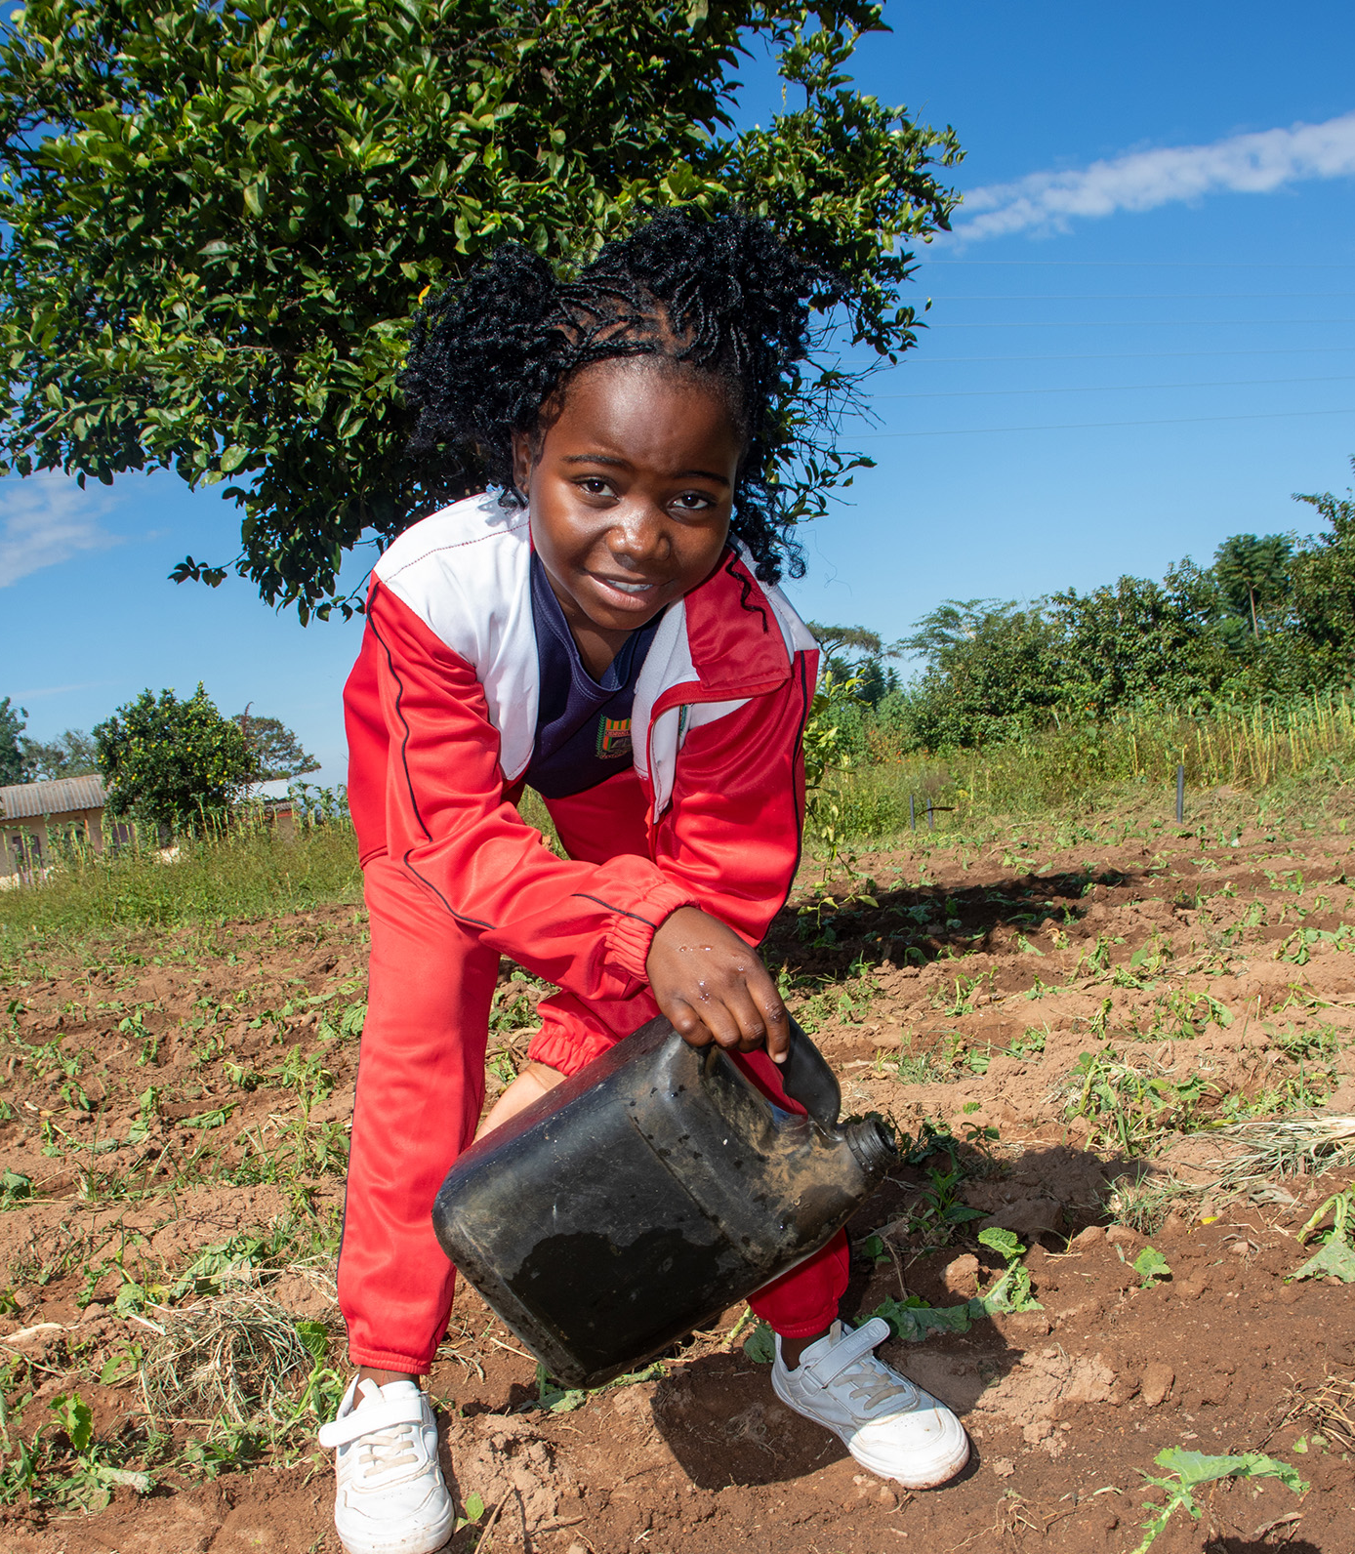
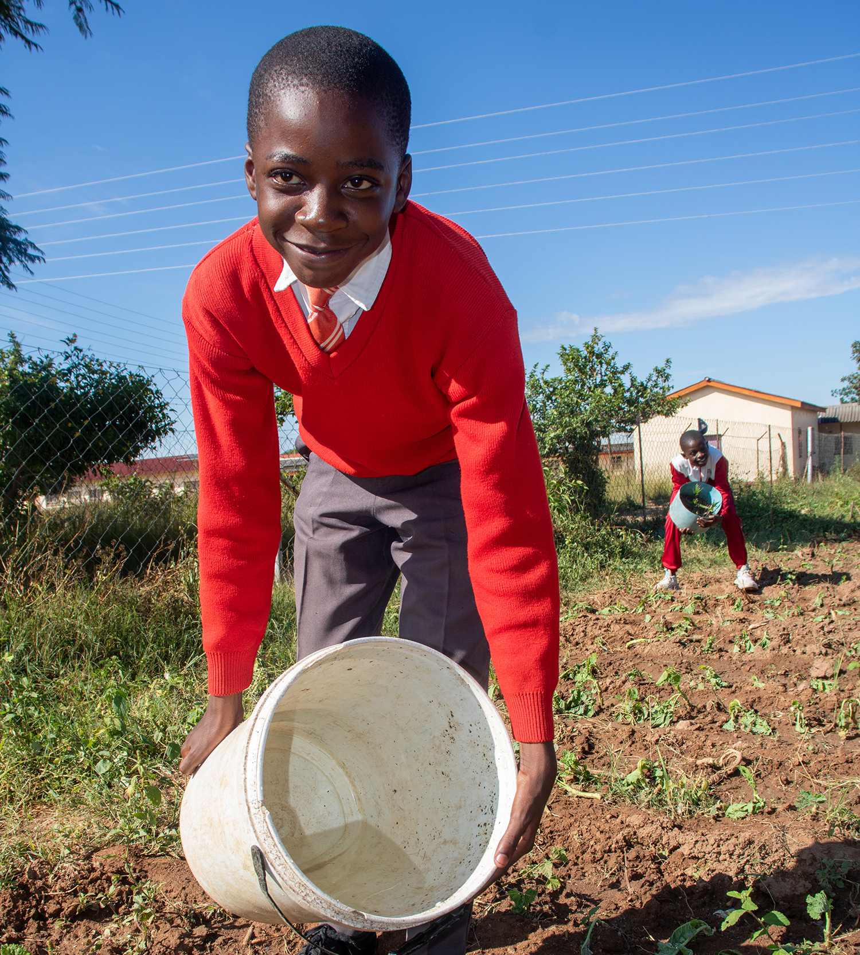

Slide 5
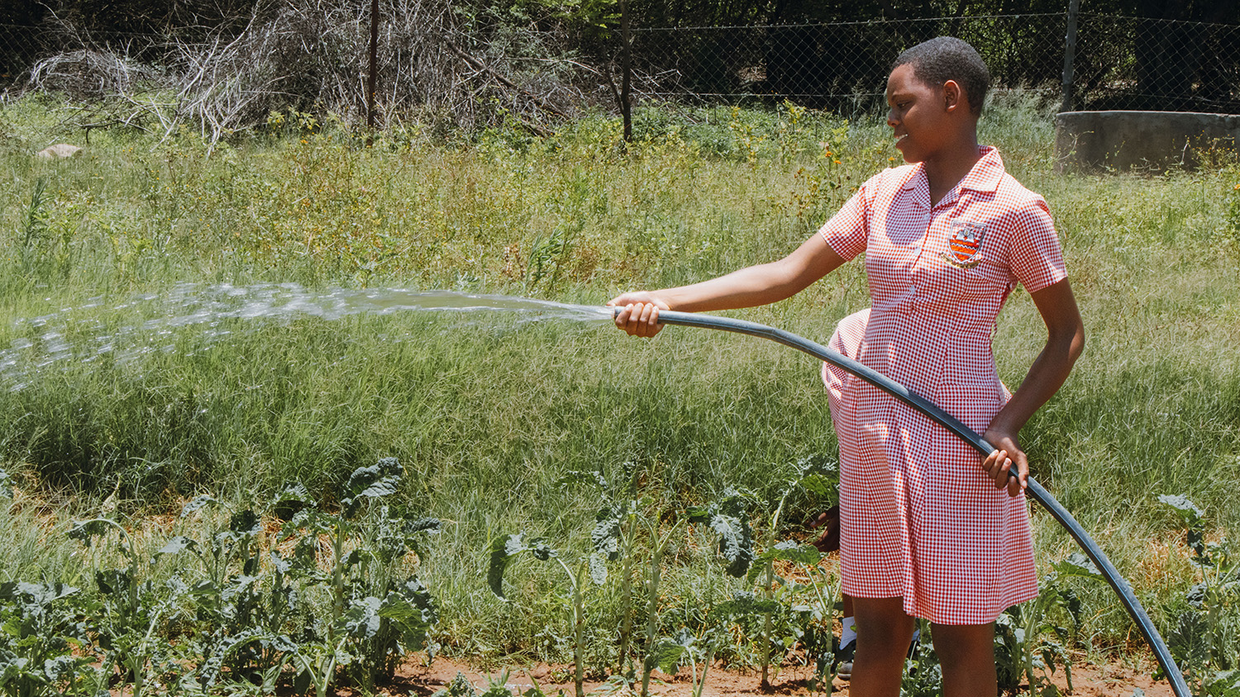

Slide 6
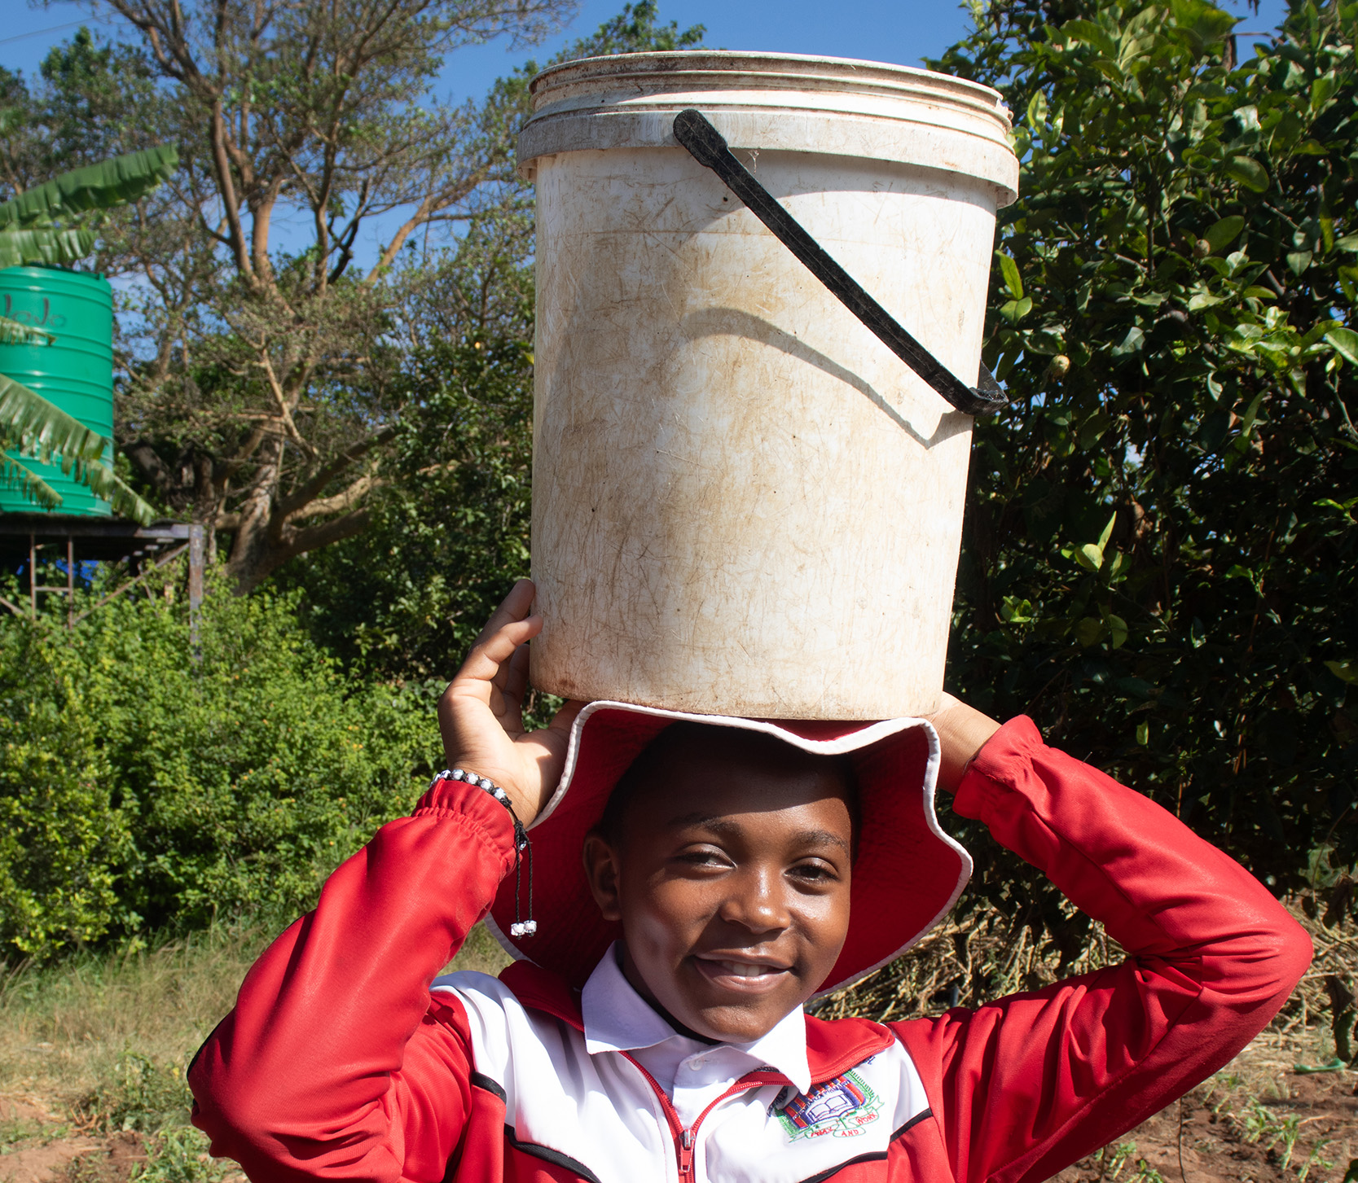

Slide 7
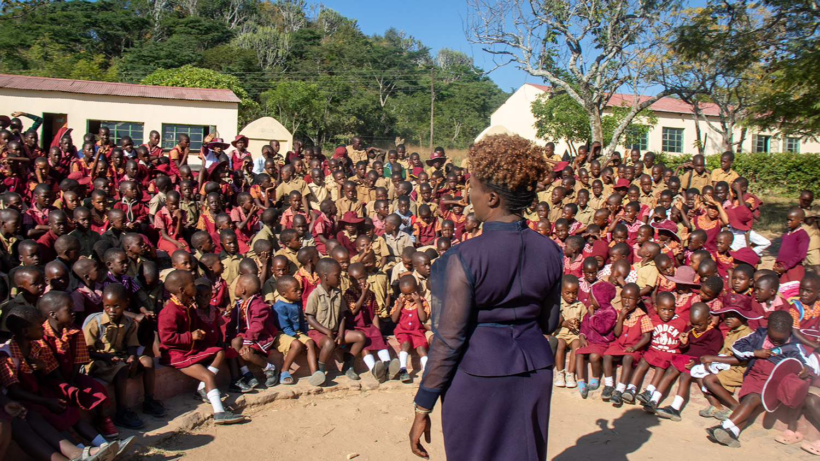
Rev Junior teaching children in Zimbabwe

Slide 8
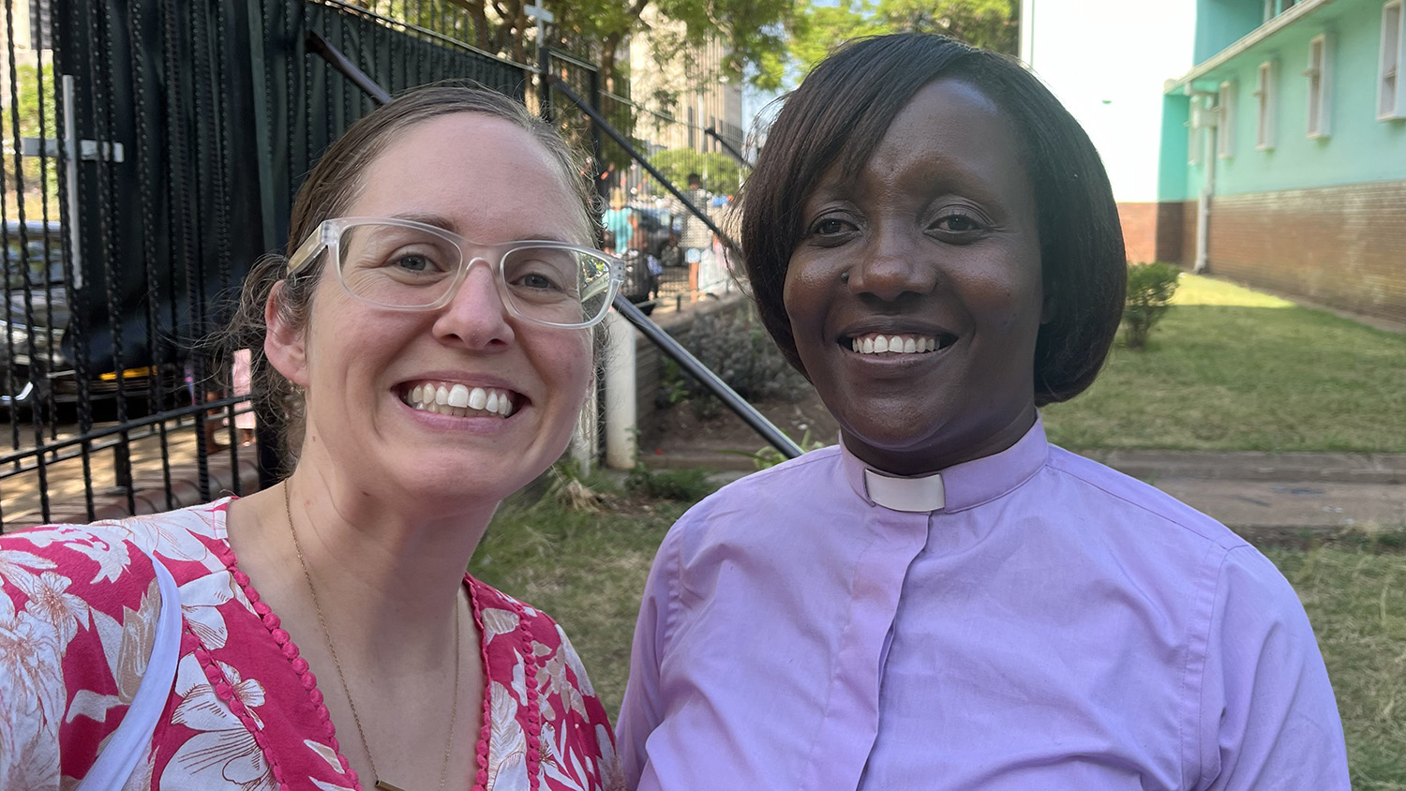
UnitingWorld Program Manager Stephanie Dalton with Rev Junior in Zimbabwe

Slide 9
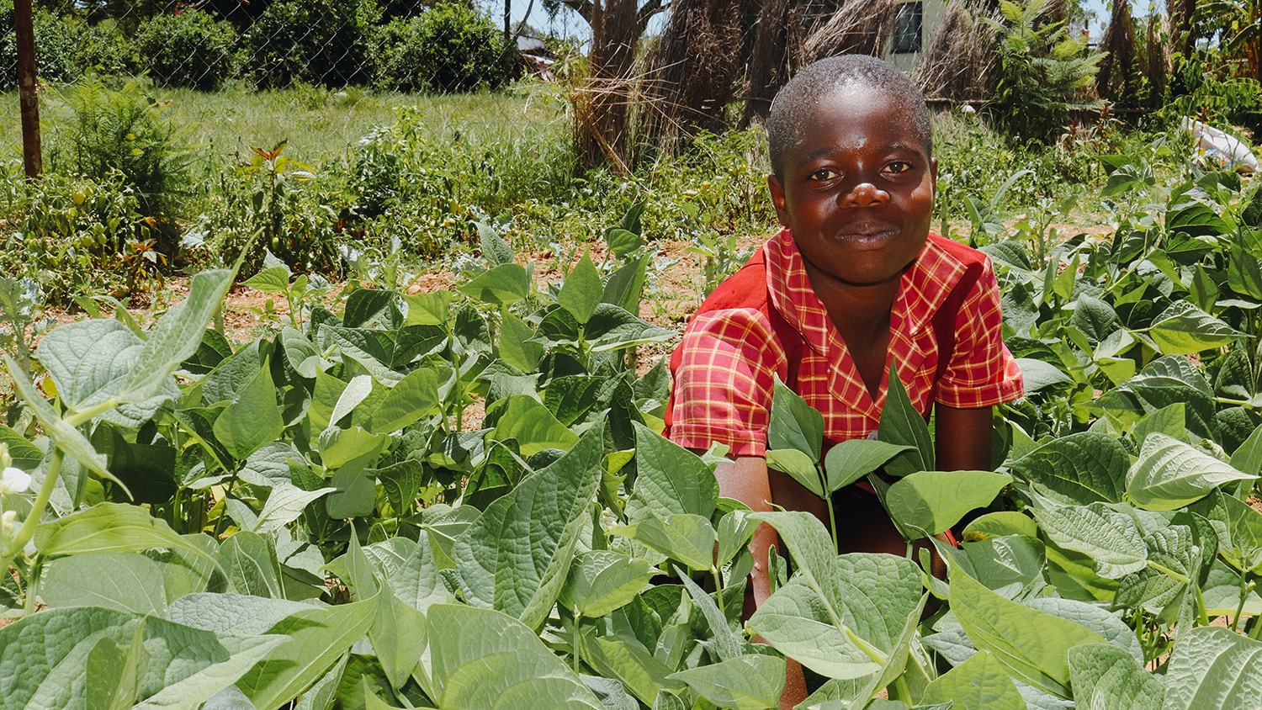

Thank you
    for being part of the story, helping communities build lives of hope and abundance

