Slide 1


Your church name
Date

Slide 2
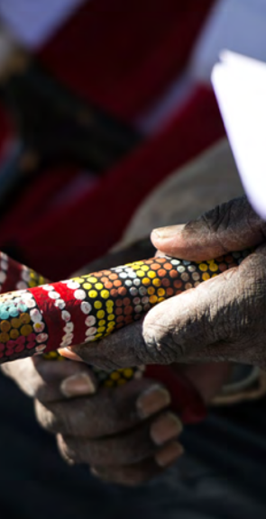

Acknowledging Country
Leader:
From before recorded time…

Slide 3
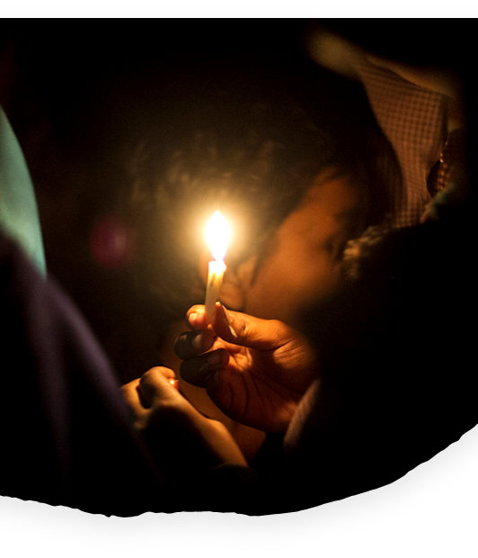
Call to worship
Leader:
All over the world, in villages and cities, in sweltering heat and icy cold, in the deep darkness of storm or in the stillness of blue skies, people like you and I are gathering, as we have for centuries, to remember our Christ. Storyteller, healer, hand of hope; we remember in different ways in different places, but we share the one spirit of love.

Slide 4
Leader:
Join me as we light the Christ candle to affirm:
Here and now God waits to break into our experience.
Congregation:
To change our minds
To change our lives
To change our ways

Slide 5
Leader:
To help us see the world and the whole of life in a new light.
Congregation:
To fill us with hope, joy and certainty for the future.
Leader:
This is the place, as are all places.
This is the time, as are all times.

Slide 6
Congregation:
O God of this place, and every place,
God of this time and all time,
Here and now, unite us,
nurture us, remind us of the fellowship of our brothers and sisters
Far away and near at hand.
Be among us.
Amen.

Slide 7

Welcome to
UnitingWorld Sunday

Slide 8
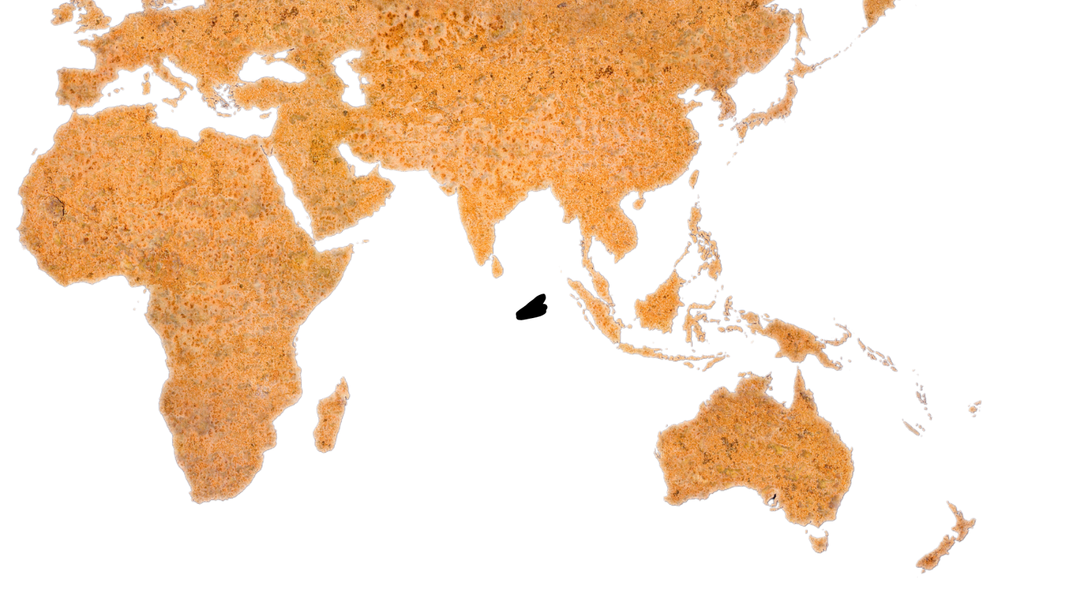
Friends, today is a special service to focus our attention on what Christ is doing in our world.
As part of the Uniting Church in Australia, we are connected in partnership with churches across the Pacific, Asia and Africa. Our partners are vibrant, inspiring, and dedicated people of God who are transforming lives and communities for the better.

Slide 9
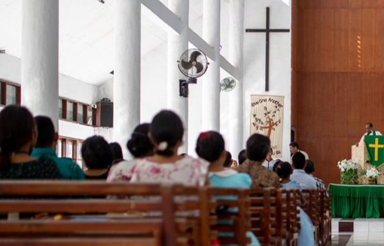
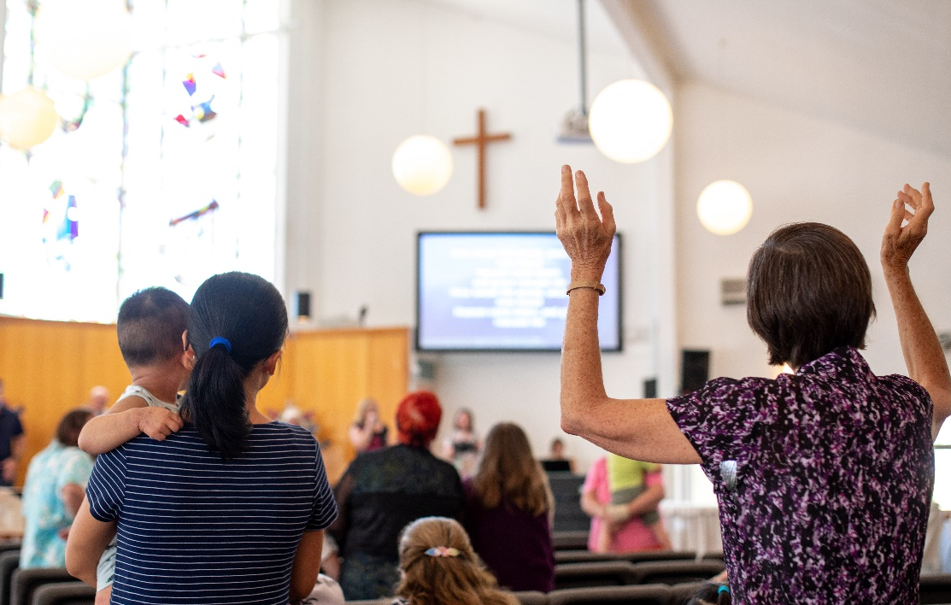
Many of our overseas church relationships reach back more than 150 years and have impacted countless lives, through many generations.
Through these relationships, we seek to act as one body of Christ in the world, each playing our part to build hope and end poverty and injustice.
UnitingWorld is the agency that manages these partnerships for the wider Uniting Church, and today we hear more about their work and celebrate our global neighbours together.
Congregation in Timor-Leste
Congregation in Australia

Slide 10
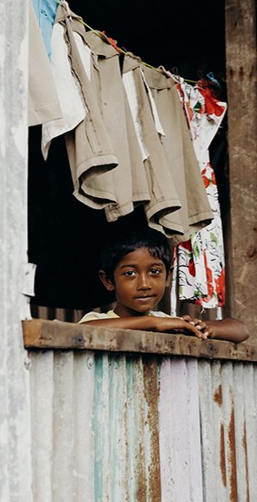
Prayer
Leader:
God of every land and people, we gather to celebrate your boundless love.
You have called us to walk with our faithful partners across Asia, the Pacific and Africa,
sharing hope,
seeking justice,
working to make lives whole and hopeful in the face of poverty,
injustice and a changing climate.

Slide 11
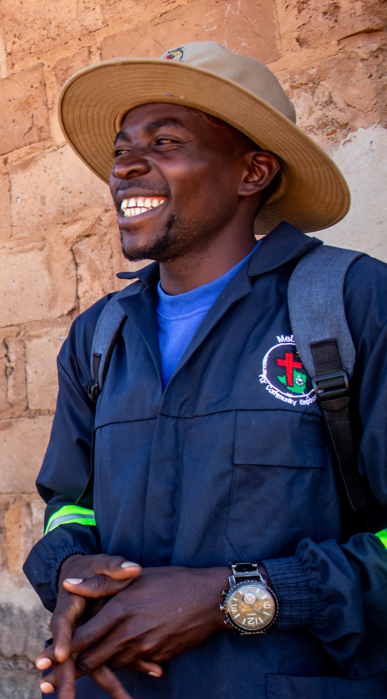
For generations, Your Spirit has woven lives together in courage and grace.
Today, stir our hearts with their witness — steadfast, resilient, alive with faith.
Open our eyes to the needs of your world, and our hands to Your work of healing.
Plant in us a bold hope that no injustice is too great, no dream of renewal too small.
Together in Christ, make us sowers of justice and harvesters of joy.
Amen.

Slide 12
Song
Add the lyrics, video or the book number of the song you have chosen/​
Duplicate this slide for additional verses​

Slide 13
Children’s Talk

Slide 14
Create slides for your chosen option here

Slide 15
Song
Add the lyrics, video or the book number of the song you have chosen/​
Duplicate this slide for additional verses​

Slide 16
Genesis 2:1-15 (NRSVUE)
¹ Thus the heavens and the earth were finished and all their multitude. ² On the sixth day God finished the work that he had done, and he rested on the seventh day from all the work that he had done. ³ So God blessed the seventh day and hallowed it, because on it God rested from all the work that he had done in creation.
⁴ These are the generations of the heavens and the earth when they were created.

Slide 17
In the day that the Lord God made the earth and the heavens, ⁵ when no plant of the field was yet in the earth and no vegetation of the field had yet sprung up—for the Lord God had not caused it to rain upon the earth, and there was no one to till the ground, ⁶ but a stream would rise from the earth and water the whole face of the ground— ⁷ then the Lord God formed man from the dust of the ground and breathed into his nostrils the breath of life, and the man became a living being.

Slide 18
⁸ And the Lord God planted a garden in Eden, in the east, and there he put the man whom he had formed. ⁹ Out of the ground the Lord God made to grow every tree that is pleasant to the sight and good for food, the tree of life also in the midst of the garden, and the tree of the knowledge of good and evil.
¹⁰ A river flows out of Eden to water the garden, and from there it divides and becomes four branches. ¹¹ The name of the first is Pishon; it is the one that flows around the whole land of Havilah, where there is gold, ¹² and the gold of that land is good; bdellium and onyx stone are there.

Slide 19
¹³ The name of the second river is Gihon; it is the one that flows around the whole land of Cush. ¹⁴ The name of the third river is Tigris, which flows east of Assyria. And the fourth river is the Euphrates.
¹⁵ The Lord God took the man and put him in the garden of Eden to till it and keep it*.
*KJV: …to dress it and keep it.

Slide 20
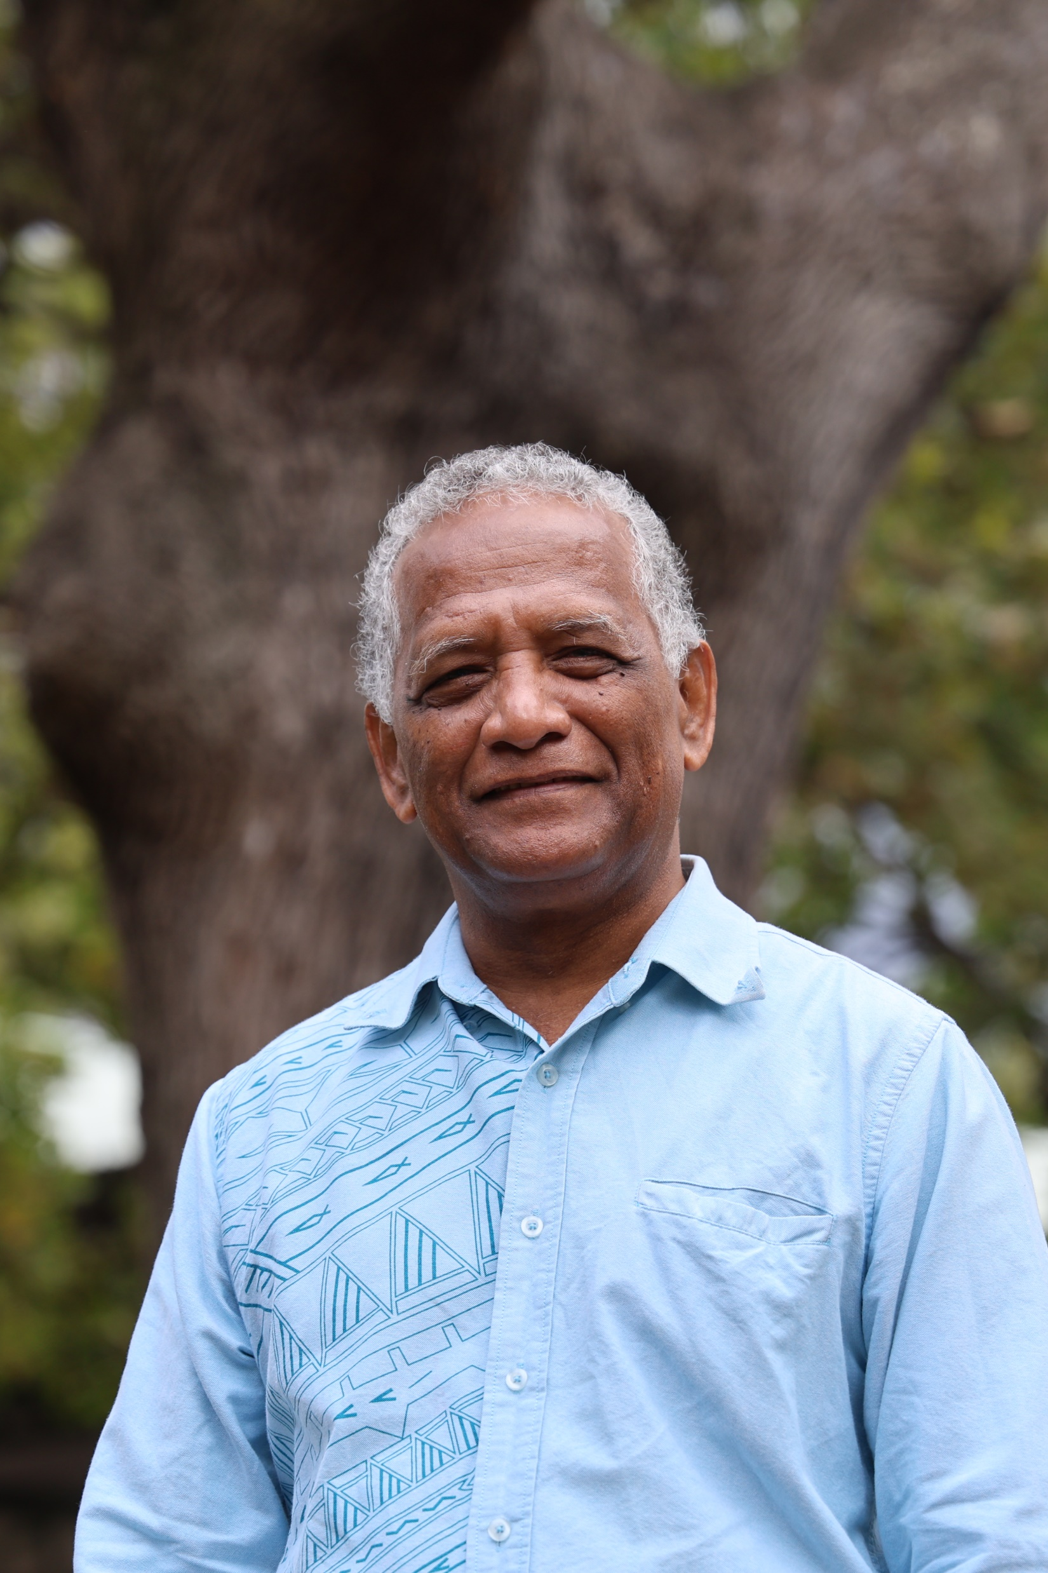
Sermon
Rev Dr Cliff Bird
United Church in the Solomon Islands

Slide 21
Play the sermon video

Slide 22
Song
Add the lyrics, video or the book number of the song you have chosen/​
Duplicate this slide for additional verses​

Slide 23
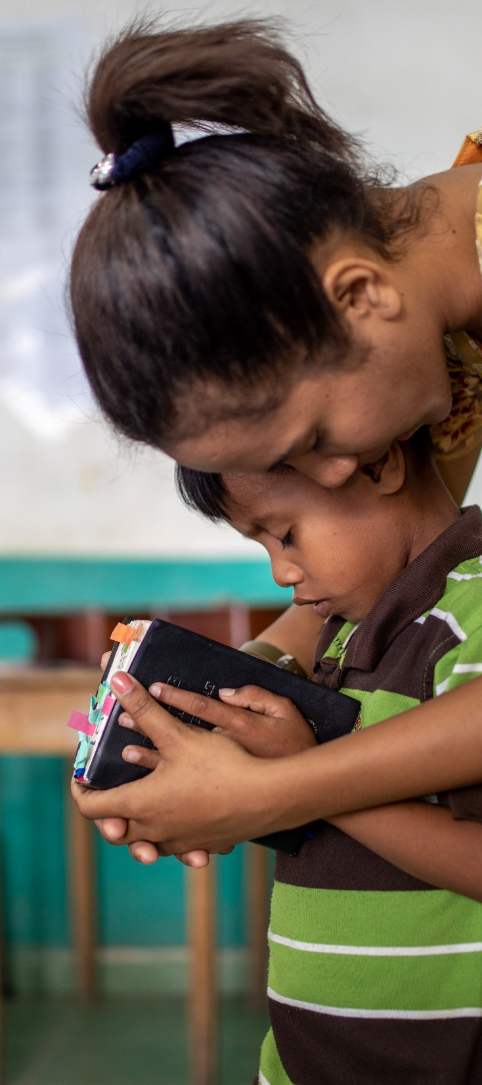
Prayers of Intercession
Leader:
Our God, we give thanks for your good gift of Creation and ask that we may learn to walk softly on the Earth. We pray for an attitude of wonder and awe in the midst of the beauty and mystery of all that surrounds us.
We pray for those who suffer because of disasters, droughts, floods, fires and famines. We pray especially for those who are impacted by our world’s greed and growth, for those who suffer most and have the fewest resources to cope.

Slide 24

We ask that here in our own congregations we may learn to make choices which are life-giving for our brothers and sisters, in our local communities and beyond.
We give thanks for those who bring awareness of the suffering planet and work to bring about a change in our attitude towards the Earth, our common home.
Help us to change our ways and guide us to live a life which is not centred on ourselves, but on all you have created.
We ask this in Jesus' name.
Amen.

Slide 25
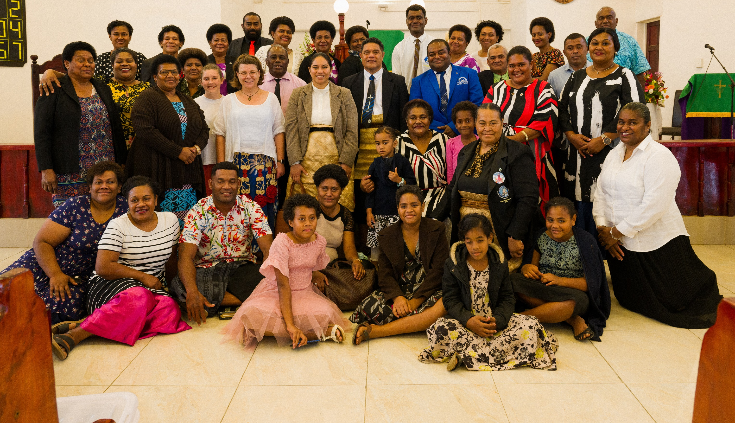
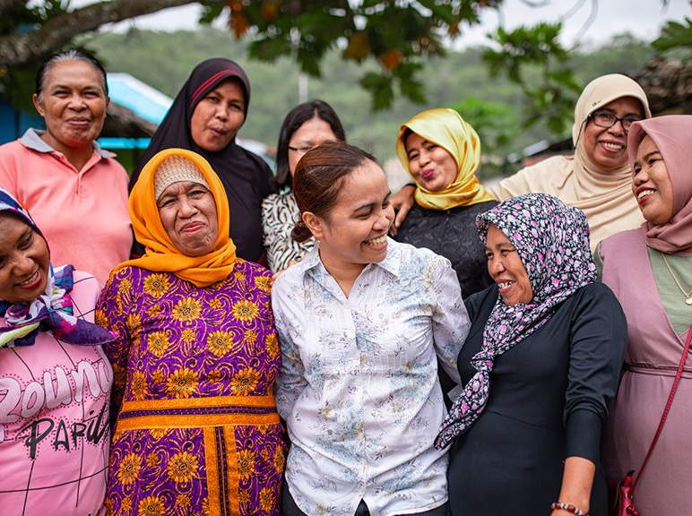
Offering
Every one of us has a role to play alongside our church partners.
Your gifts to UnitingWorld will be used with care, resourcing our partners to transform lives and communities.
​

Slide 26
Dedication of Offering
Leader:
God of extravagant mercy
With hands outstretched you have poured out
Wonder and pleasure and delight
Goodness and beauty and bounty.
Take and use these offerings we pray,
To help grow your Kingdom of justice and peace.
May we be part of building your new creation, together.
Amen.

Slide 27
Song
Add the lyrics, video or the book number of the song you have chosen/​
Duplicate this slide for additional verses​

Slide 28
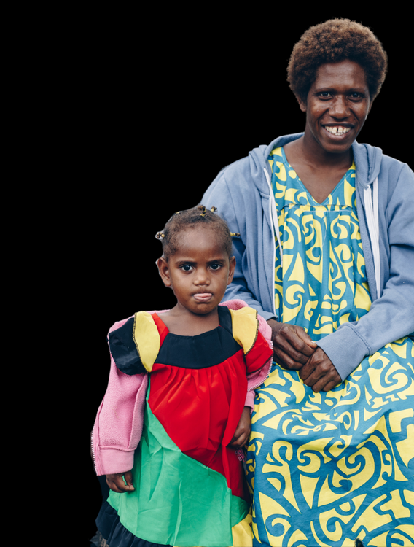
A Sending Blessing
Go now into the world in peace.
May the love of God guide you,
the compassion of Christ move you,
and the breath of the Spirit
stir you to action.

Slide 29
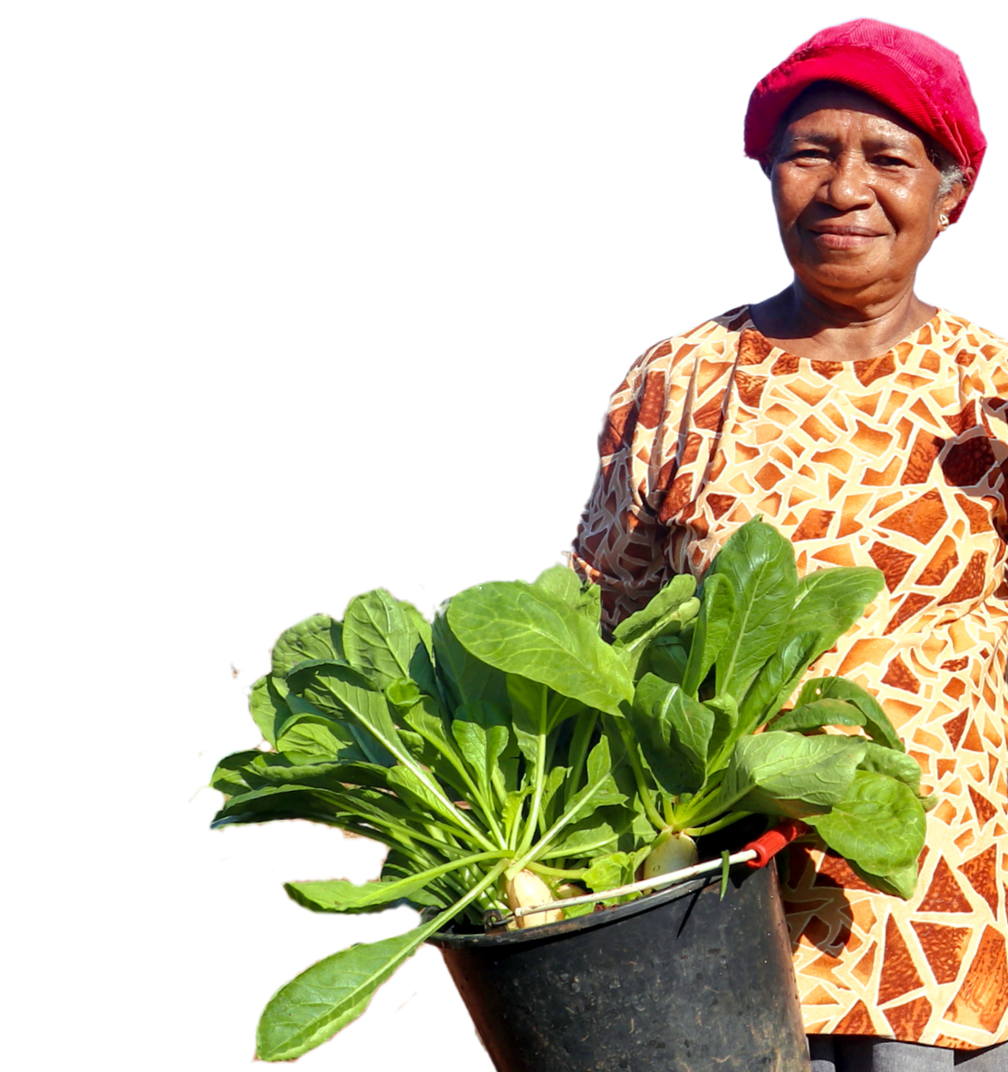
Care for the earth, tend to one another,
seek justice, love kindness, and walk humbly with your God.
And may the blessing of God
— Creator, Christ, and Spirit —
be with you and remain with you,
now and always.
Amen.

Slide 30
Song
Add the lyrics, video or the book number of the song you have chosen/​
Duplicate this slide for additional verses​

Slide 31


Thank you for
celebrating with us! ​
To give online and find out
more about UnitingWorld
and our partners, please visit
www.unitingworld.org.au/sunday​

