Slide 1


Slide 2
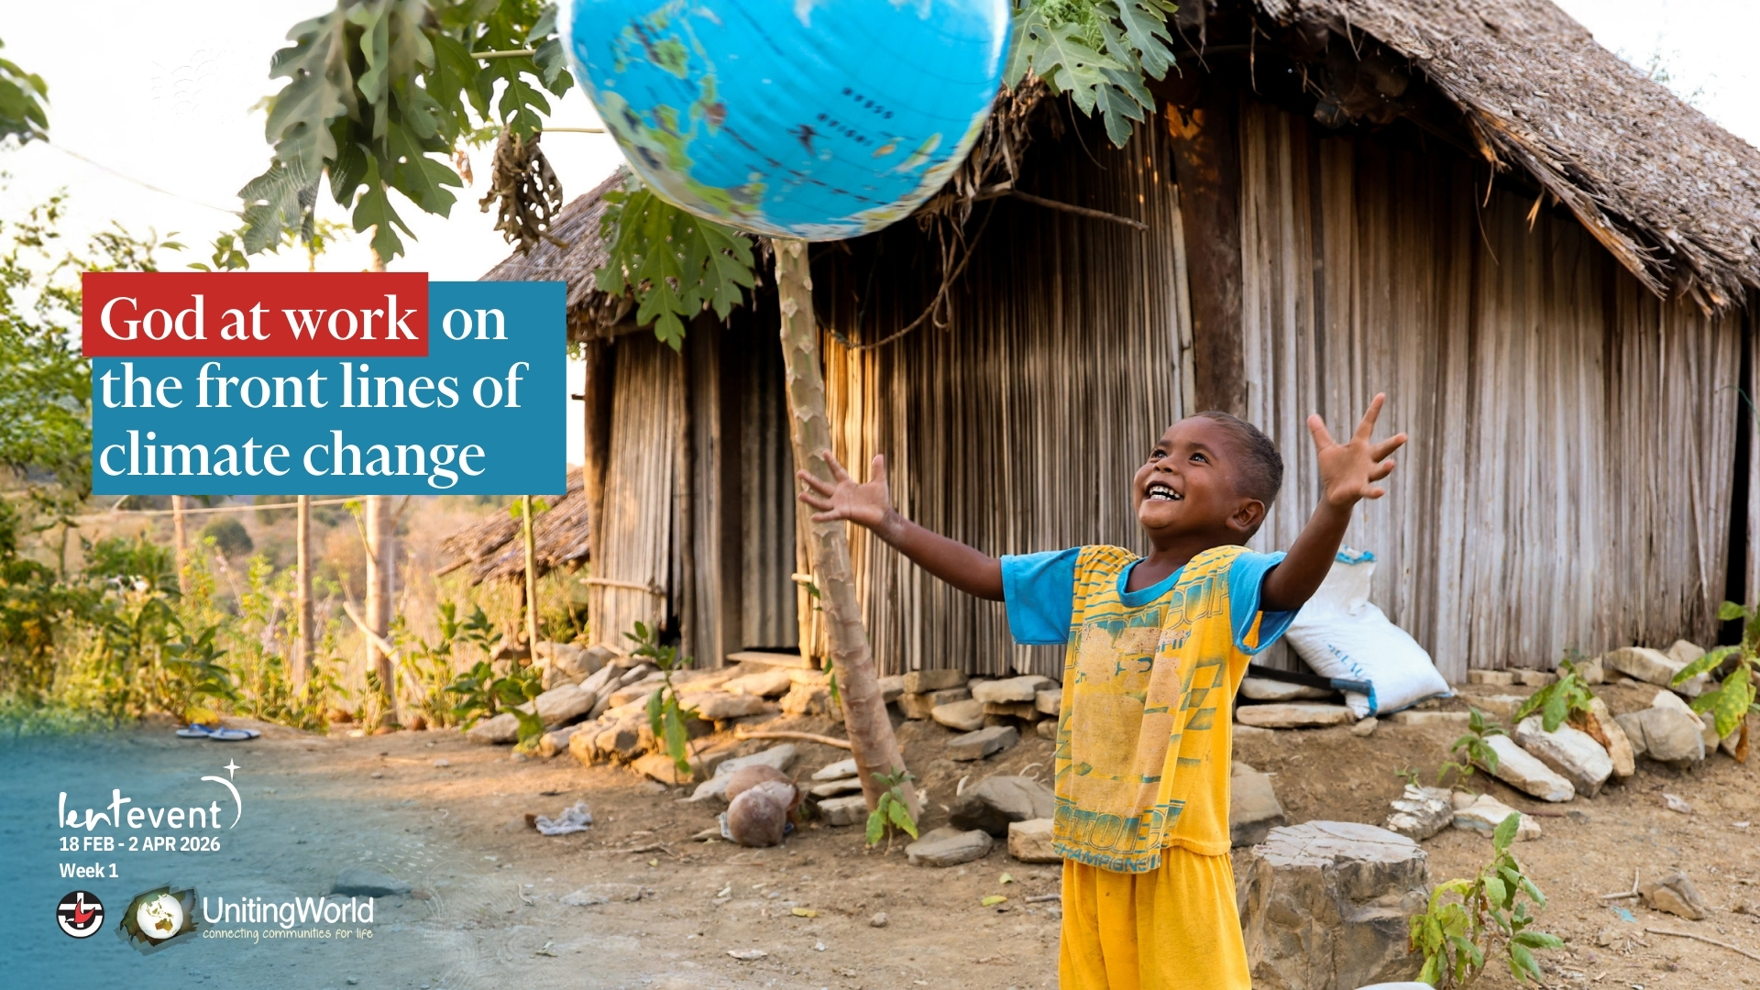

Slide 3


Slide 4


Slide 5


Slide 6
Play video here

Slide 7


Slide 8
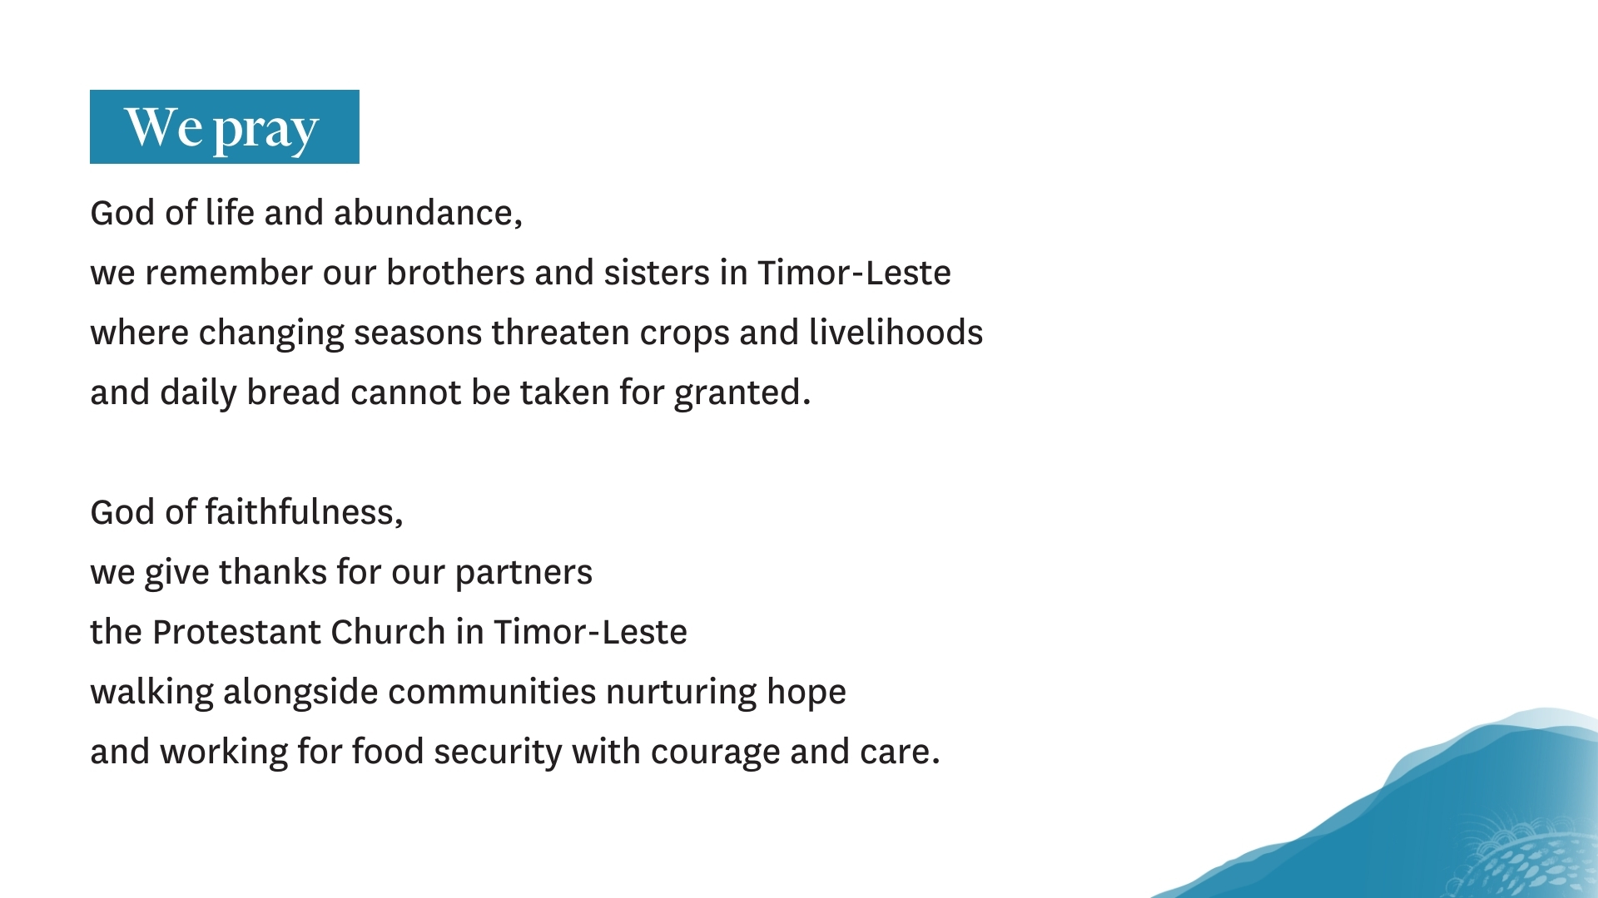

Slide 9
