Slide 1


Your church name
Date

Slide 2
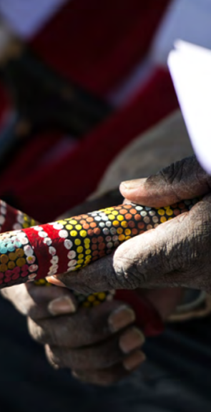
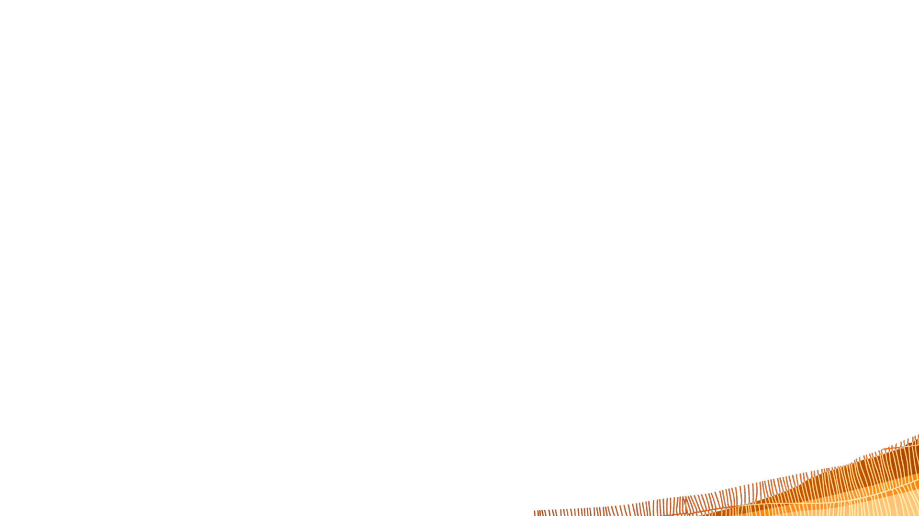
Acknowledging Country
From before recorded time…
Notes:
Leader:
From before recorded time, the People (of the Nation) cared for this Land.
We praise the Creator for the beauty of this Land and honour those who have offered themselves in tending it.
We acknowledge the Elders and communities who have told the sacred stories and nurtured faithfulness to the Creator. We pay our respects to the Elders who have gone before, all who carry the stories today, and who are emerging.
We ask God’s blessing on all those who continue to work for the healing and restoration of this Land and Her Communities.

Slide 3
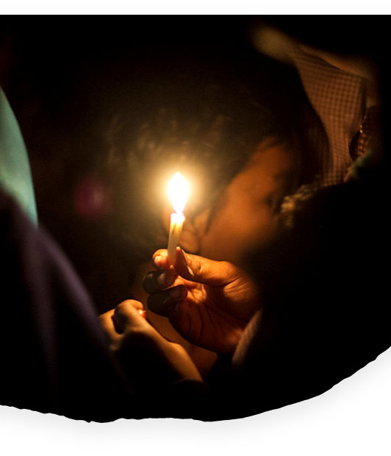
Call to worship
…
Across the globe
we gather to worship.
Our God is here!
People:
God’s Spirit dwells
with us.
Leader:
We are one in Christ.
Notes:
Leader:
Once there was someone who said such wonderful things and did such amazing things that people just had to ask him who he was. One time when they asked him who he was he said:
“I am the light of the world, and whoever walks with me will never walk in darkness” This is the one who we follow.
Jesus is light - not just of this place, of just this nation, or just of people like us. Jesus is the light of the world.
And so, we gather, knowing that we are joined across the world by countless thousands of our brothers and sisters. In cathedrals and cottages, people are gathered, candles are lit, and the Spirit of God threads us together in love and grace.
Across the globe we gather to worship. Our God is here!
Congregation: God’s Spirit dwells with us.
Worship Leader: We are one in Christ.

Slide 4

Welcome to
UnitingWorld Sunday
Notes:
Friends, today is a special service to focus our attention on what Christ is doing in our world.

Slide 5
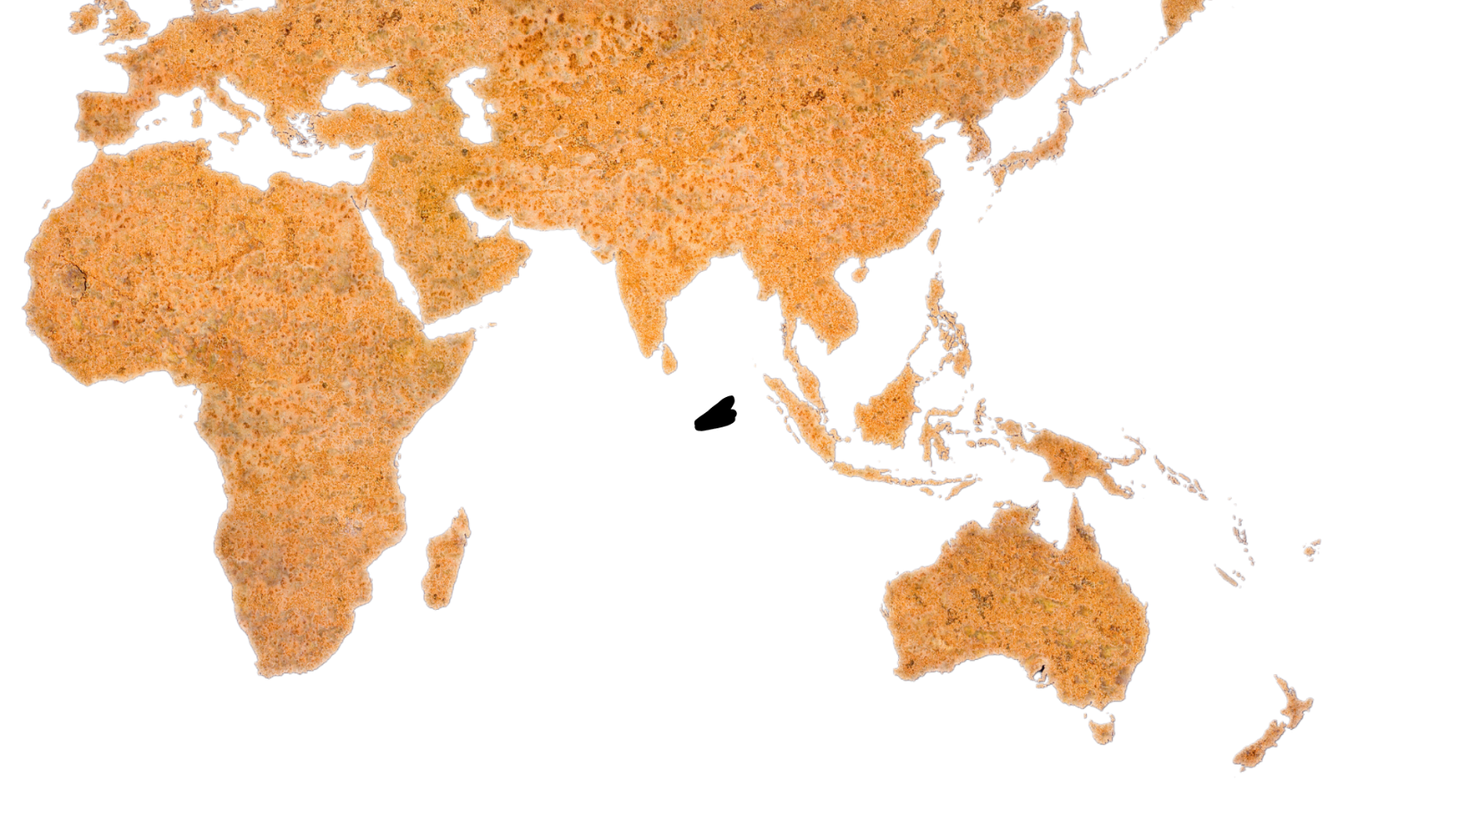
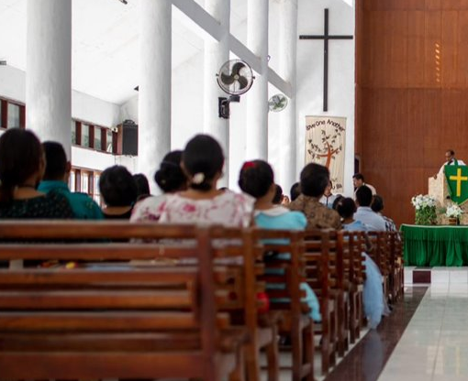
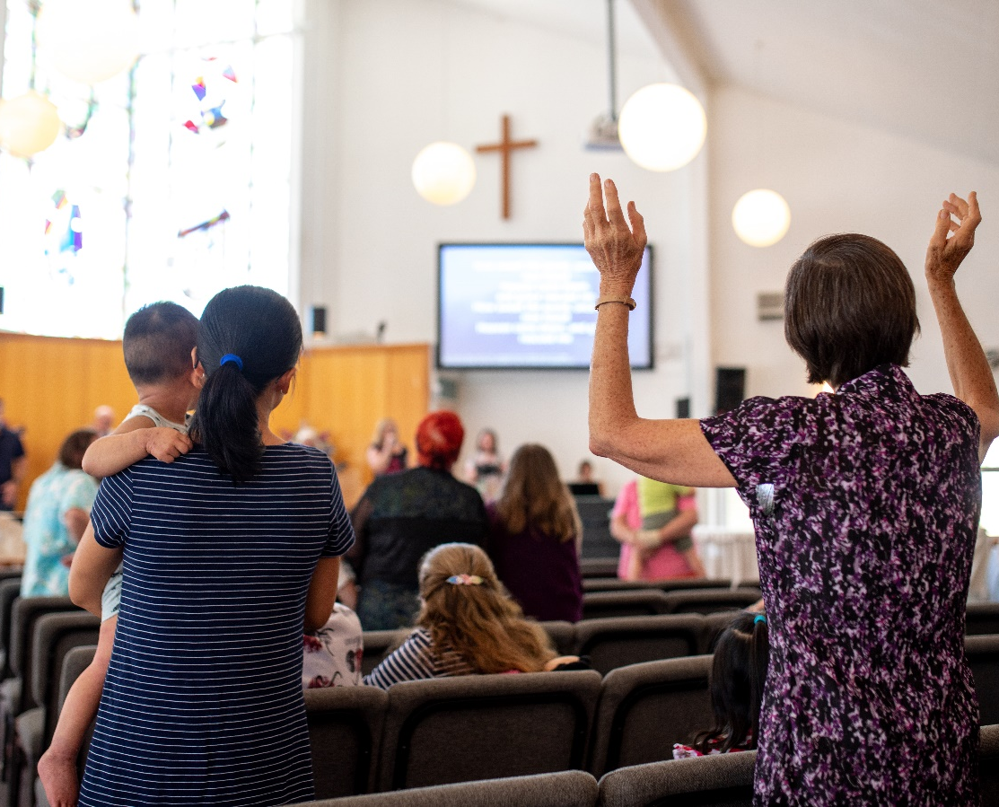
Congregation
in Timor-Leste
Congregation
in Australia
Notes:
We in the Uniting Church in Australia are connected in partnership with churches across the Pacific, Asia and Africa. Our partners are vibrant, inspiring, and dedicated people of God who are transforming lives and communities for the better.
Many of our overseas church relationships reach back more than 150 years and have impacted countless lives, through many generations.
Through these relationships, we seek to act as one body of Christ in the world, each playing our part to build hope and end poverty and injustice.
UnitingWorld is the agency that manages these partnerships for the wider Uniting Church, and today we have a chance to hear more about their work and to celebrate our global neighbours together.

Slide 6
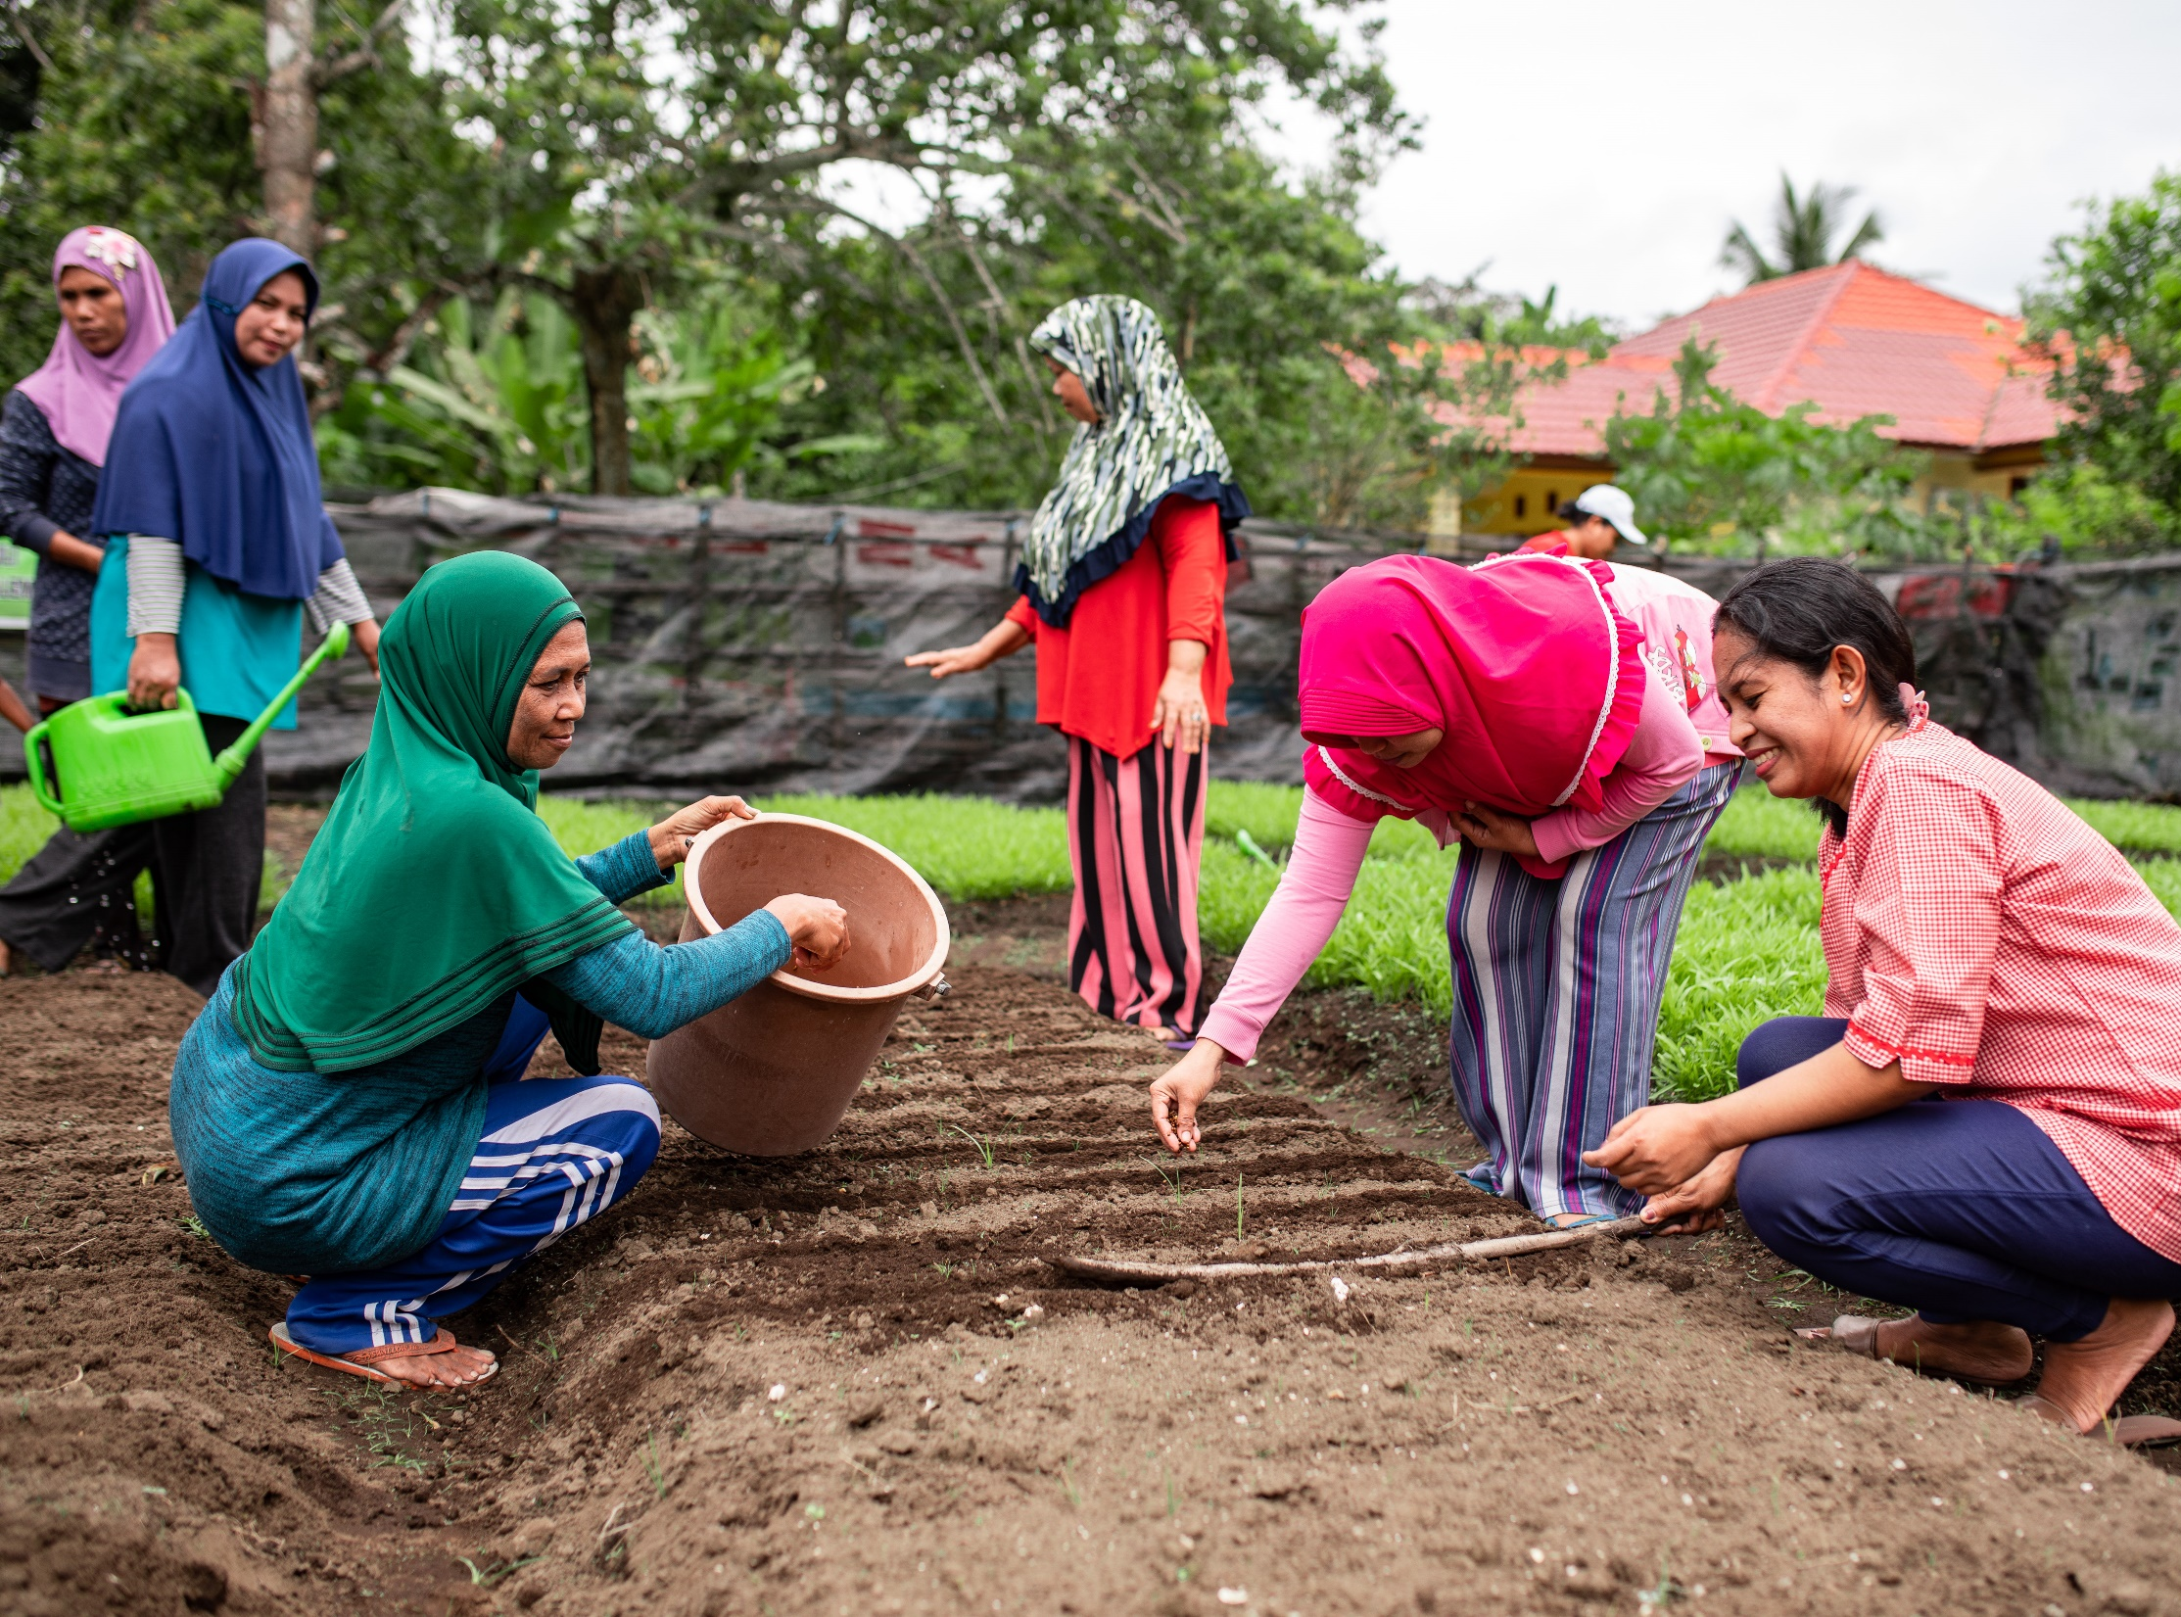
Prayer
Notes:
God who knows no boundaries, who neither time nor space can hinder. God who pursues us with unconditional love and inexhaustible grace.
God who lifts us out of blindness and conflict and shows us the path of reconciliation and unity with each other.
We turn our hearts and our minds to you in worship.
We come to you, each of us in our aloneness, and all of us in our yearning for true community.
Meet us here today, Lord Jesus. Help us to lay aside the distractions, the anxiety and the sorrows that hinder. Fill our hearts with your presence and our minds with your guidance. Refresh and renew our spirits, so that we may once again remember the joy of being known and loved by you.
And today, as we turn our gaze to the wonders that you are working across the world, help us feel true connection and compassion for all your people across the world. Fill our hearts with joy and humility as we bear witness to the power of your love working through human hands. Awaken in us again that zeal to be a part of your work. Fill our eyes with your vision for a world renewed and reconciled. Give us courage to act boldly in obedience to your call on our lives.
Emmanuel, God with us. Amen.

Slide 7
Song
Add the lyrics, video or the book number of the song you have chosen/​
Duplicate this slide for additional verses​
Notes:
Aimed at mid-primary school aged children and younger.
Read the book Shoes from Grandpa by Mem Fox as a group or to the group.
A read-along video can be found on Youtube https://youtu.be/NjXKKMWtcpw
Encourage children to say the repeated lines at the same time as the reader.
Reflect: (a. = answers, but draw out discussion with the group)
In the story, who felt good about the clothes: Jessie or her family?
What was Jessie frustrated about?
Getting clothes she didn’t want / other people making decisions for her.
(sarcastically) But shouldn’t Jessie be happy to get anything? No? Why?
The clothes weren’t right for her/what she liked doing?
Why weren’t the clothes right for Jessie?
They were assuming they knew what she wanted without asking her.
What should her family have done instead of buying her what they thought she needed?
They should have asked her what she liked or needed?
When you give a friend or family member a gift, it feels good, doesn’t it? But do you try to think about things you would like, or things they would like?
Ask if they have given someone a perfect gift. What made it perfect for that person? How did it make you feel?
[If that doesn’t work] Ask if they have ever received something they didn’t want. How did that make them feel?
What does it mean to be generous? What are some generous acts?
Can generosity hurt you or the people you’re trying to help?
Maybe – if you are giving them things they don’t need or want.
What if you send your old clothes to another county but they aren’t right for the climate there?
What if you send old books to another country but they aren’t in a language anyone speaks?
READ: At UnitingWorld we work with people and churches in other countries to help them in lots of ways. Sometimes they need help accessing clean water or toilets, sometimes they need help to clean up after a cyclone, sometimes they need help running a school for children who otherwise wouldn’t be able to go to school.
Q. What do you think UnitingWorld should do if one of our overseas church partners needs our help?
a. Ask what kind of help they might need from us.
READ: The best way for UnitingWorld to work with overseas churches is not to assume we know what they need. We aren’t better than them, just because we may have more money or opportunities. We have a lot to learn from them too. They are brave, creative, resilient, and strong in faith.
Just like Jessie, our partners know what they need or how to fix a problem and they just need our friendship and fundraising to make those things happen! Our partners are the local church, helping their communities unlock their God-given potential to set themselves free from poverty and injustice. They know their communities so can see simple, inexpensive solutions that we can’t.

Slide 8
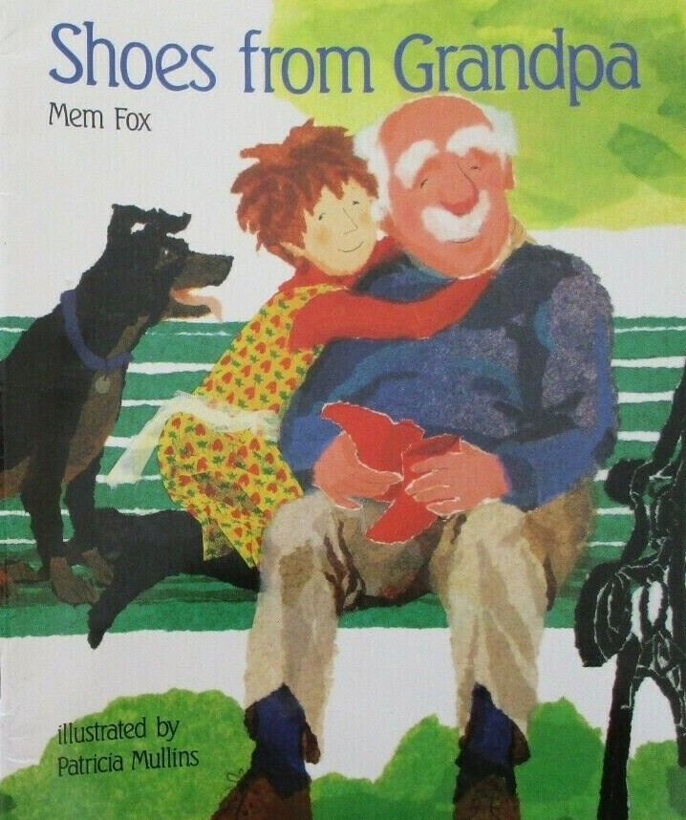
Kids’
Talk

Slide 9
Song
Add the lyrics, video or the book number of the song you have chosen/​
Duplicate this slide for additional verses​

Slide 10
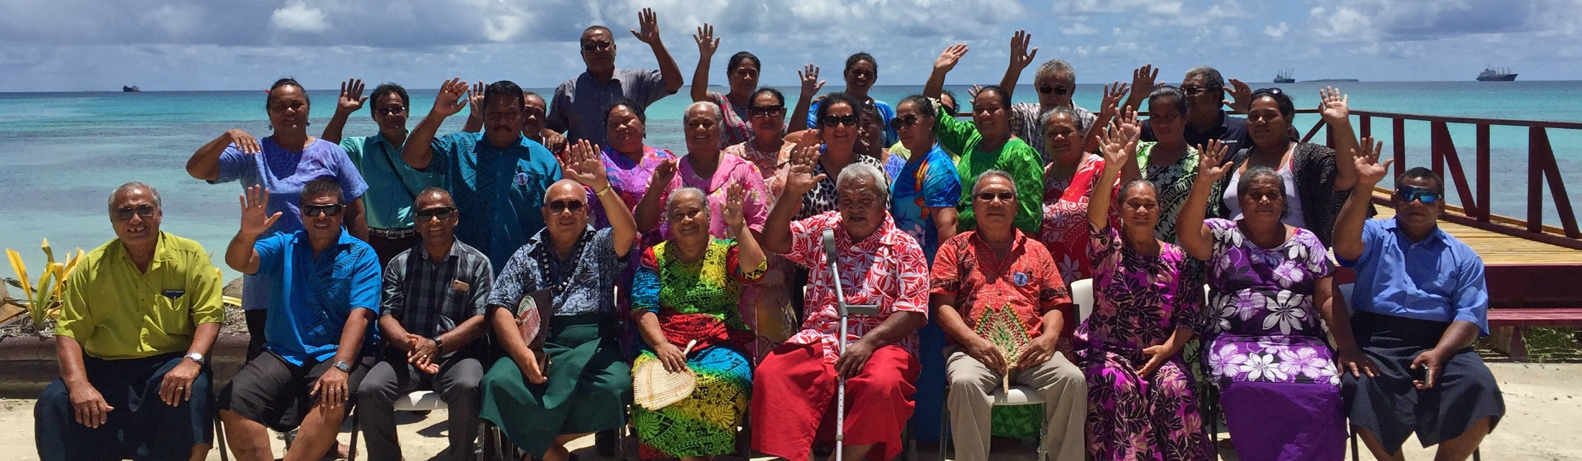
1 Corinthians 12:12-27 ESV
One Body with Many Members
12 For just as the body is one and has many members, and all the members of the body, though many, are one body, so it is with Christ. 13 For in one Spirit we were all baptized into one body—Jews or Greeks, slaves or free—and all were made to drink of one Spirit.
Notes:
Option 1: If using the recorded sermon by Rev James Bhagwan sermon: 1 Corinthians 12:12-27
Option 2: If someone else is preaching, then use their choice of reading.

Slide 11
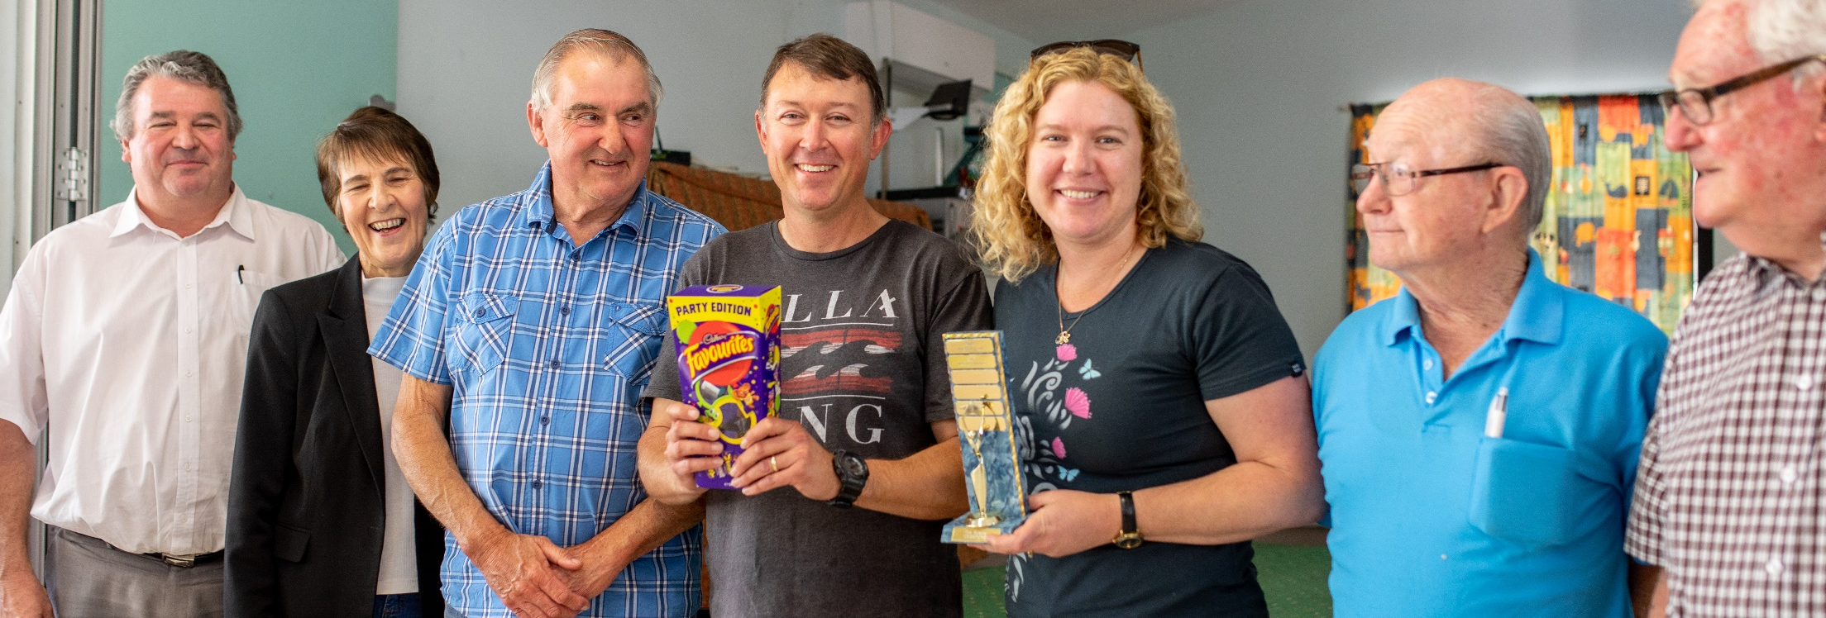
14 For the body does not consist of one member but of many. 15 If the foot should say, “Because I am not a hand, I do not belong to the body,” that would not make it any less a part of the body. 16 And if the ear should say, “Because I am not an eye, I do not belong to the body,” that would not make it any less a part of the body. 17 If the whole body were an eye, where would be the sense of hearing? If the whole body were an ear, where would be the sense of smell?

Slide 12
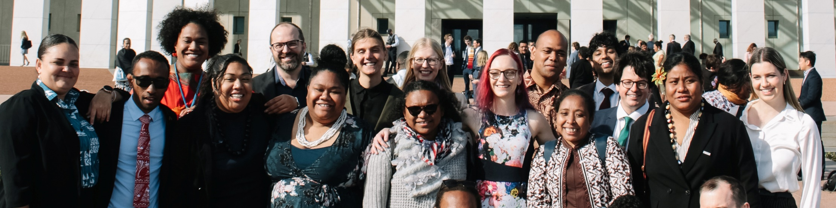
18 But as it is, God arranged the members in the body, each one of them, as he chose. 19 If all were a single member, where would the body be? 20 As it is, there are many parts yet one body. 21 The eye cannot say to the hand, “I have no need of you,” nor again the head to the feet, “I have no need of you.” 22 On the contrary, the parts of the body that seem to be weaker are indispensable, 23 and on those parts of the body that we think less honorable we bestow the greater honor, and our unpresentable parts are treated with greater modesty,

Slide 13
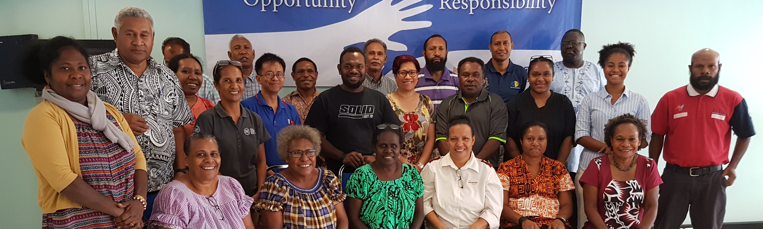
24 which our more presentable parts do not require. But God has so composed the body, giving greater honor to the part that lacked it, 25 that there may be no division in the body, but that the members may have the same care for one another. 26 If one member suffers, all suffer together; if one member is honored, all rejoice together.
27 Now you are the body of Christ and individually members of it.

Slide 14
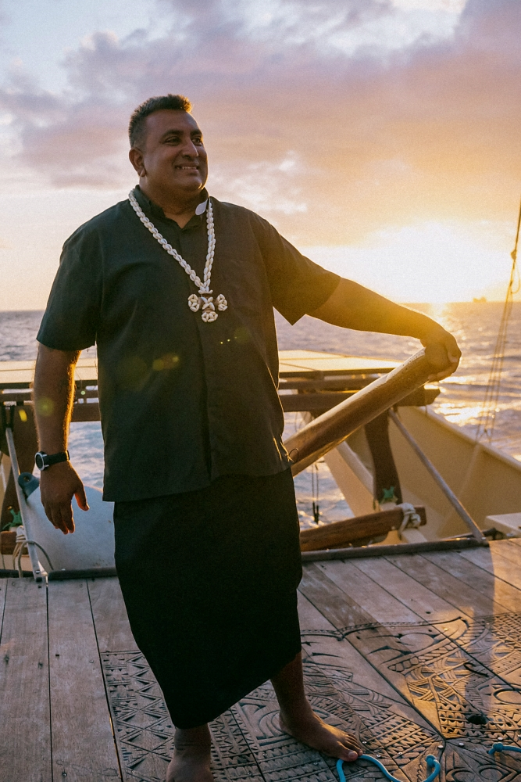
Sermon
Rev James Bhagwan,
General Secretary of the Pacific Conference of Churches

Slide 15
Song
Add the lyrics, video or the book number of the song you have chosen/​
Duplicate this slide for additional verses​

Slide 16
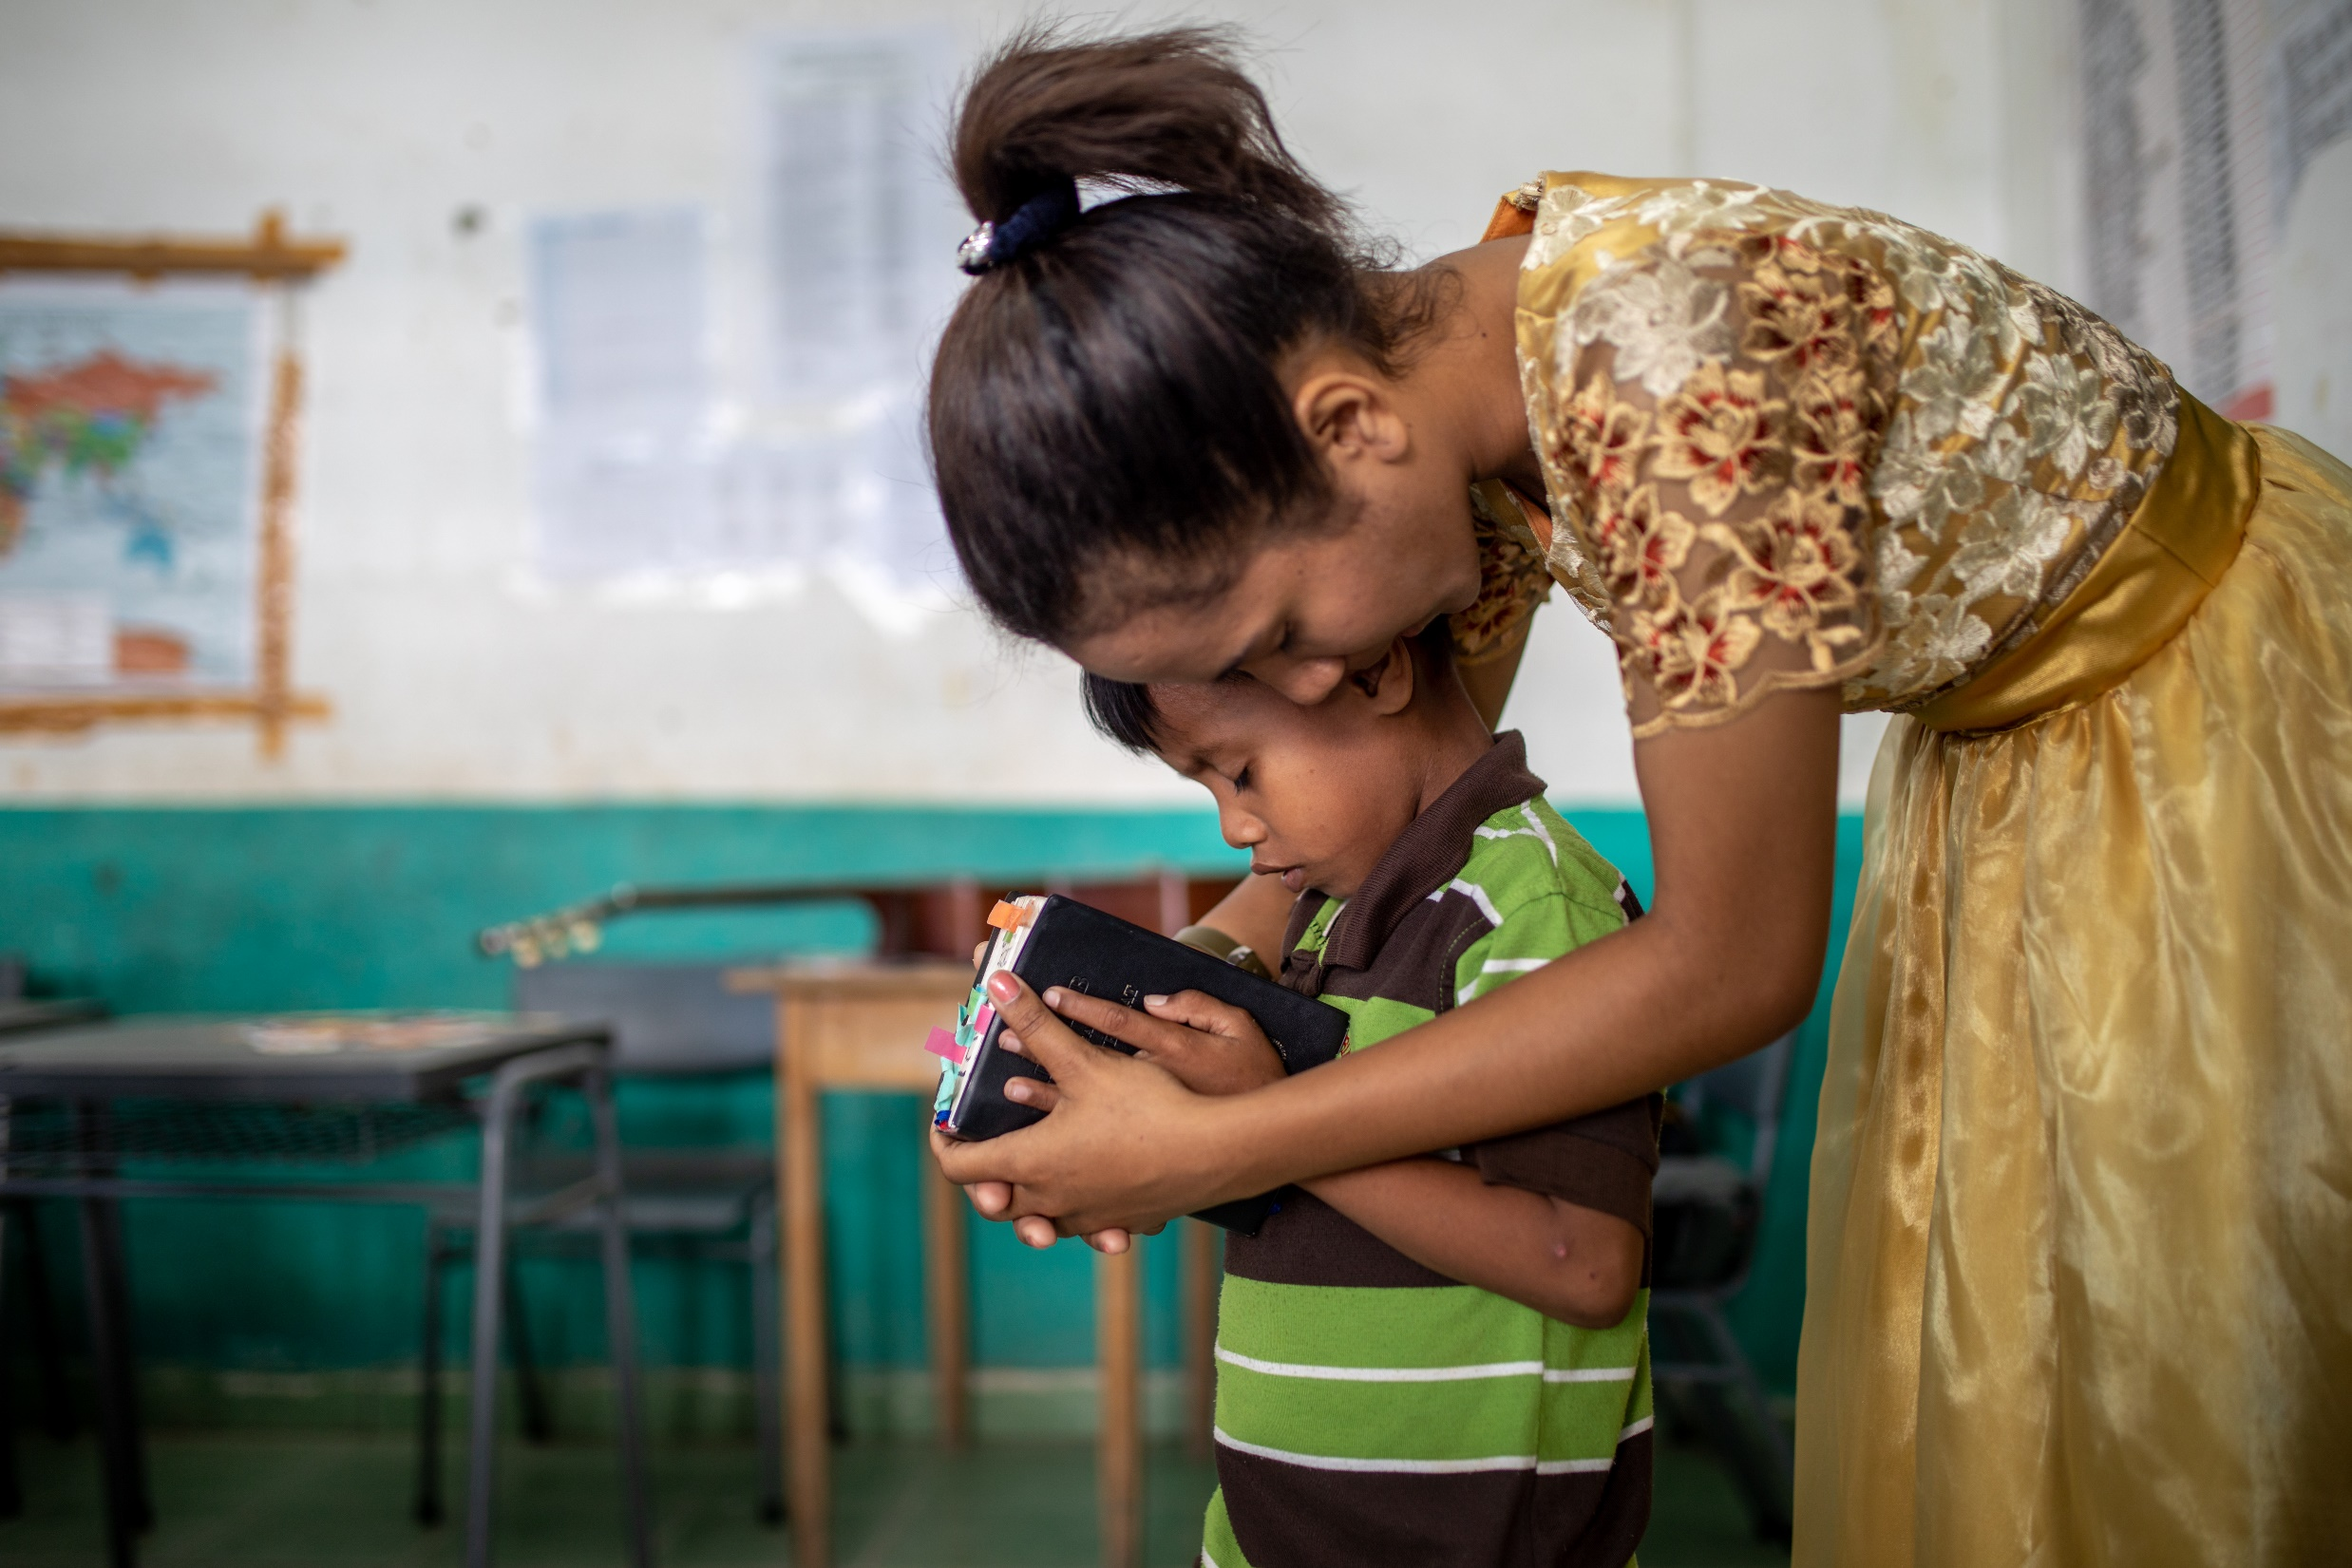
Prayers of
Intercession
Notes:
LEADER:
God of infinite compassion, from age to age we tell the stories of Jesus’ time on earth comforting the suffering, healing the sick, speaking out against injustice, challenging the powerful, and bringing hope to all humanity.
Though those feet no longer walk the earth, and those hands no longer rest on the afflicted, we know you still hear the calling of your people, and we bring our prayers for the world in this time.

Slide 17
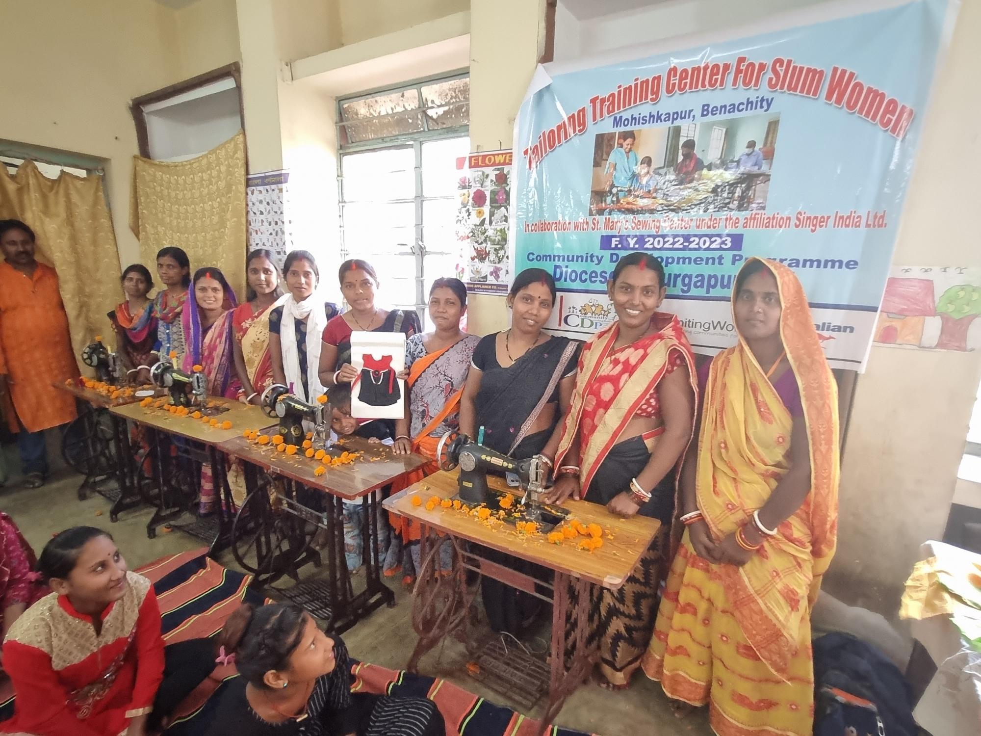
Notes:
SPEAKER 1:
We pray for all people struggling for the essentials of life – for food, clothing and shelter, but also for healthcare and education – we pray that every bowl and every belly might be filled, and that every child might have the hope that comes from learning and dreaming.
We pray for everyone who is oppressed or exploited in this time, and for victims of violence and trauma, that their wounds might be healed with peace, grace and justice.
SPEAKER 2:
We pray for our partners addressing extreme poverty in places like India, Sri Lanka, Indonesia and Timor-Leste. Give them hope and courage as they help the most marginalised people to overcome poverty and injustice.

Slide 18

Notes:
SPEAKER 3:
We pray for our partners across the Pacific who are fighting the impacts of disasters and the changing climate, at the same time as preparing their communities and building resilience to future disasters.
May we learn from their example and play our part to address the threat of climate change.

Slide 19
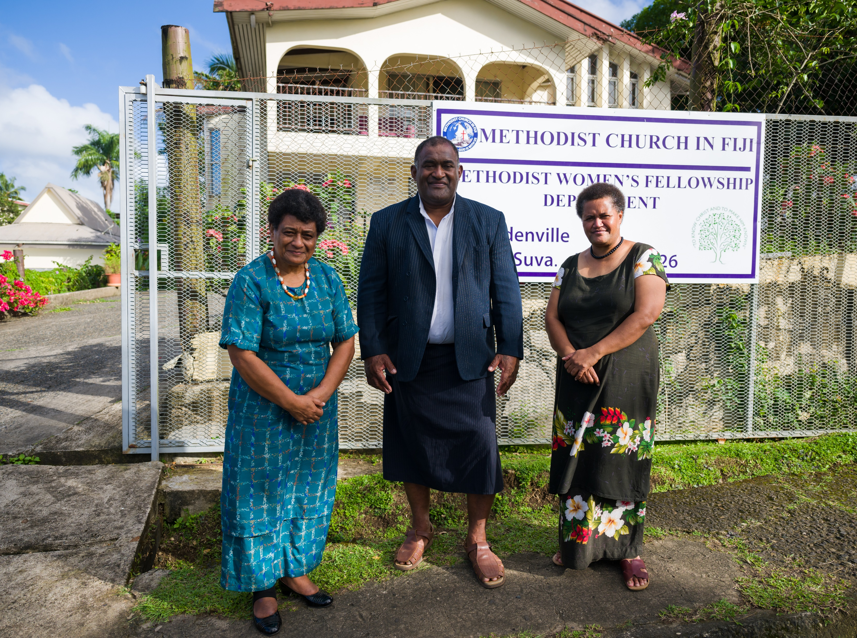
Notes:
SPEAKER 4:
We pray for our partners training and equipping the next generation of Christian leaders in places like Zimbabwe, South Sudan, Papua New Guinea and Fiji. Fill them with passion and creativity to be your hands and feet and spread hope in their communities.
SPEAKER 5:
We pray for our partners raising up women in the church and community and leading a discussion on the biblical basis for gender equality and anti-violence. In the Pacific, where rates of men’s violence against women are among the highest in the world, we pray that our partners’ messages continue to cut through and change hearts.

Slide 20
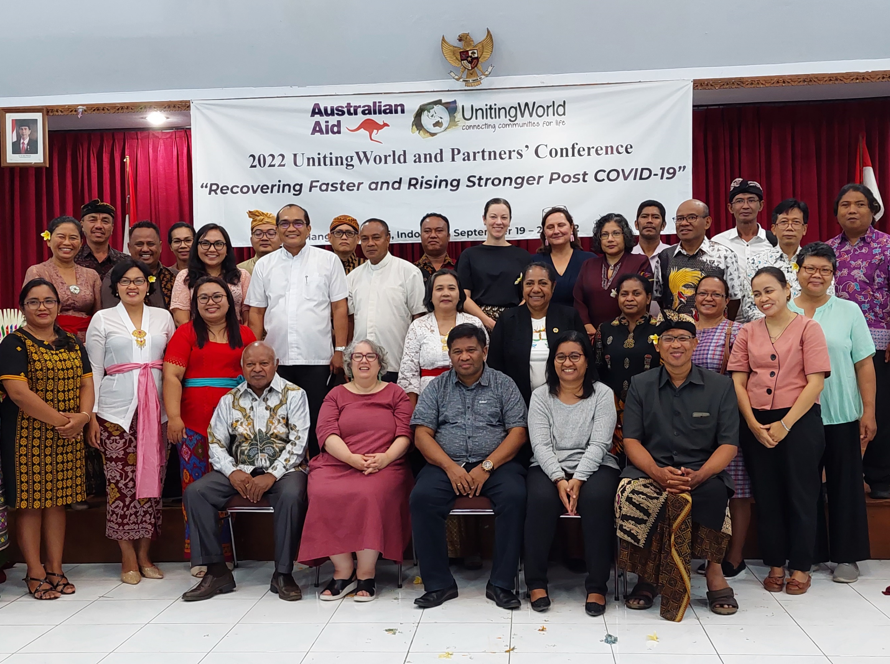
Notes:
LEADER:
Lord God, we pray for UnitingWorld staff and partners, and the life-changing work that you are doing through our Christian family cross the globe.
We pray for the courage to remain engaged with the messy, broken, beautiful world around us and that we would each find ways to play our part as the body of Christ – whether down the street or the other side of the world.
Amen

Slide 21
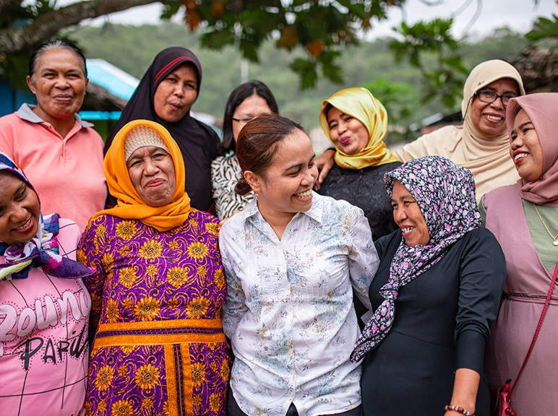
Offering
Every one of us has a role to play
alongside our church partners.
Your gift will be used with care, resourcing our partners to transform lives and communities. ​

Slide 22
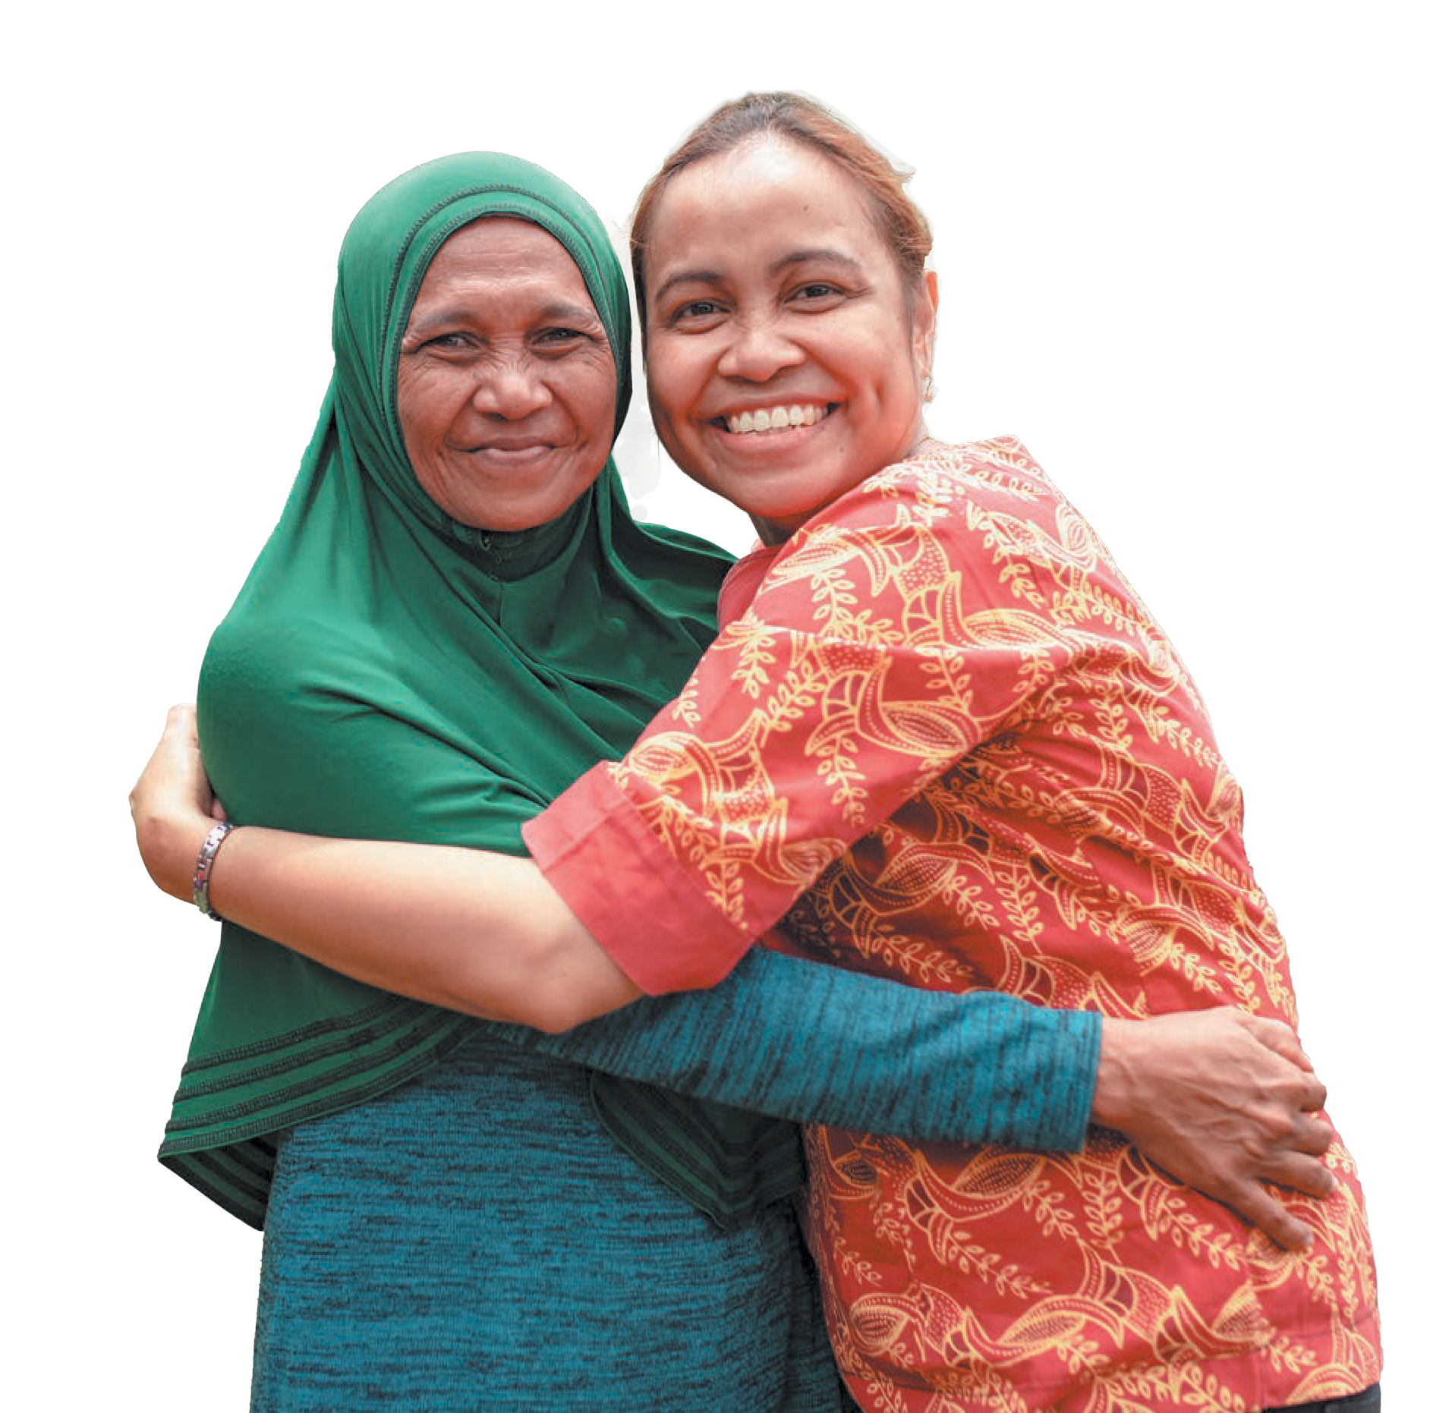
Dedication of Offering
Notes:
LEADER:
Loving God, we join today in celebration of your work in your world. We give you thanks for all the people reaching out in love and compassion in your name, and for the countless more acts of grace and works of your Spirit that go unnoticed.
We give you thanks, too, for calling us to be part of this story, participants by word and deed in the work of making your Kingdom known to all.
We give thanks for all those who have gone before us and championed this work, and those who stitched our call to support the global church into the Uniting Church's founding documents.
And as part of our response to that call, we bring these gifts, and with them, we recommit ourselves into your service.
Use our money and ourselves, here in our local community, and throughout your world.
For we ask in the name of our risen Lord, Jesus Christ.
Amen

Slide 23
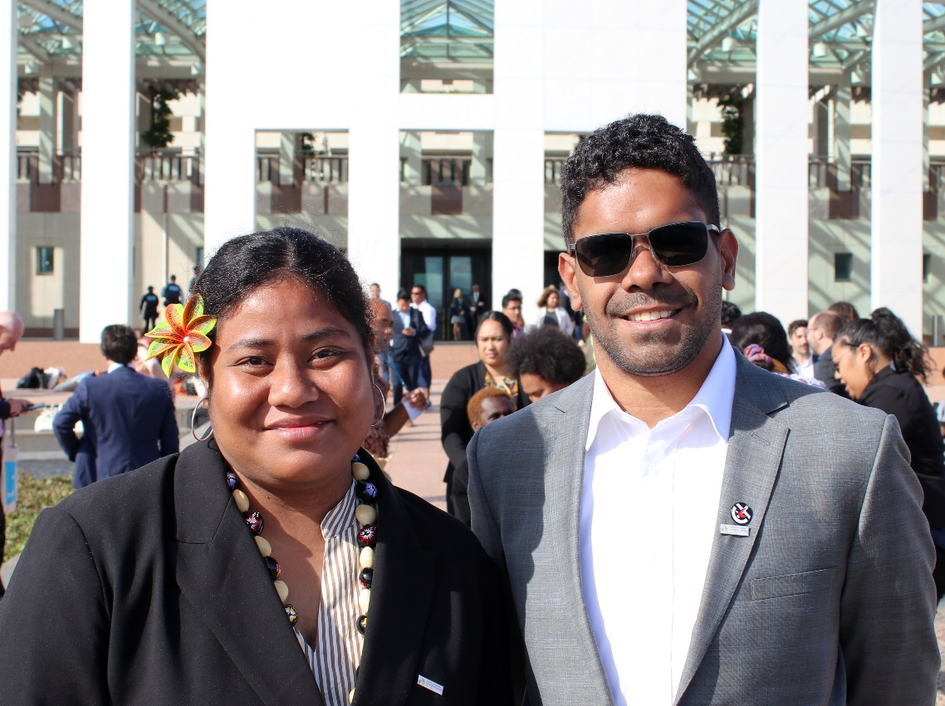
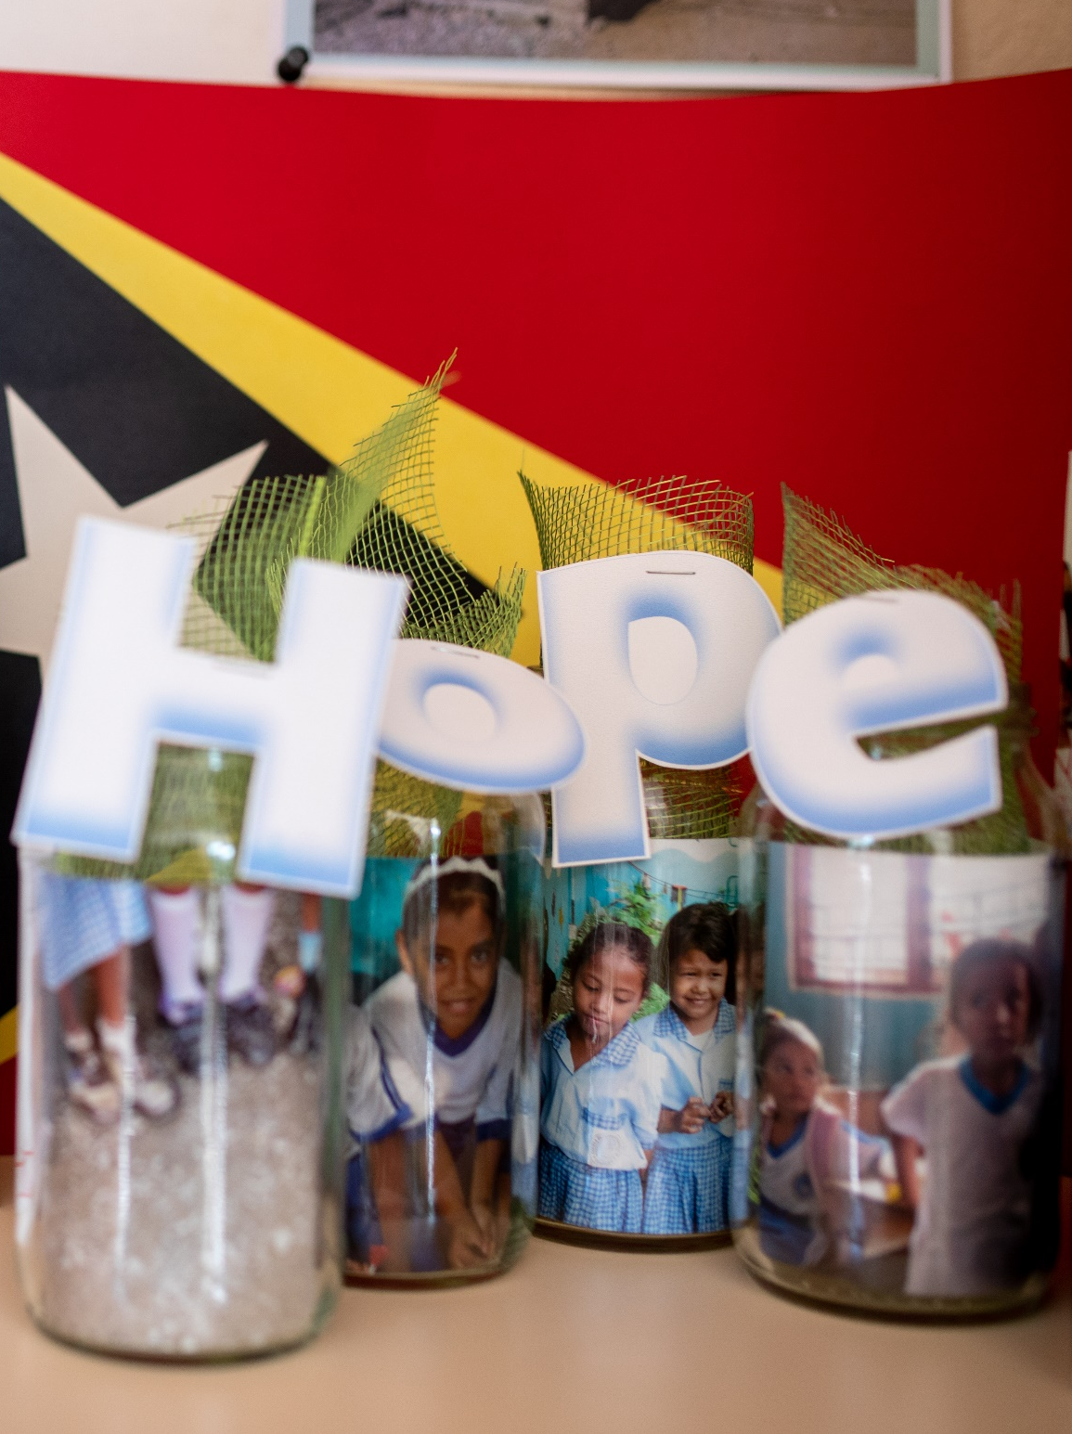
A Sending Blessing
Notes:
May God bless us with a spirit of solidarity to fight together against poverty, injustice, social inequality and environmental damage.
May God bless us with the spirit of courage to improve, renew and transform the social order that has lost its conscience because of greed and selfishness.
May God bless us with a spirit of gentleness to hear and understand the voices of those who are oppressed, left behind and pushed aside by the bustle of worldly pride.
May God bless us with a spirit of peace amidst the difficulties and challenges of the world so that we can continue to be God’s witnesses who radiate love, generosity, forgiveness and hope.
In the name of Christ.
Amen

Slide 24

Thank you for
celebrating with us! ​
To give online and find out
more about UnitingWorld
and our partners, please visit
www.unitingworld.org.au/sunday​

