Slide 1


Your church name
Date

Slide 2
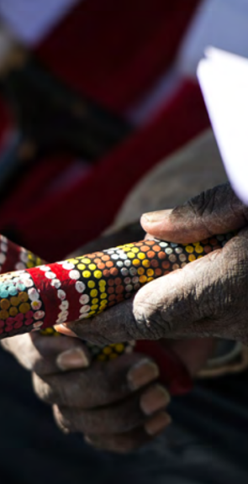

Acknowledging Country
Leader:
From before recorded time…

Slide 3
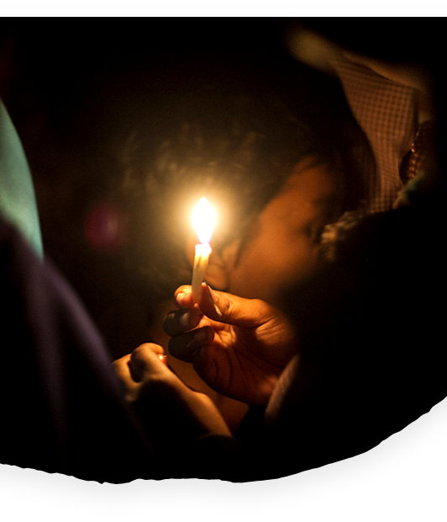
Call to worship
Leader:
Beloved siblings in Christ,
Let us unite in the presence of God,
who gathers us as
God’s beloved family.
A call is heard: look around you.
Congregation:
I have seen those
whom I did not know before
because they were strangers.
I have observed those
who were once foreigners.

Slide 4
Leader:
Now we have been united
within the family of God.
Today, in our togetherness,
let us experience the power of
God’s love that destroyed all boundaries.

Slide 5
Congregation:
There is no barrier
separating you and me.
Differences in language,
culture, life experiences,
viewpoints, none can
separate us from the love of God.
We are united by Christ who has risen.
Let us stand together in faith, in hope, and in God’s unparalleled love.
Leader:
Let us begin our worship with joy
and gratitude for God’s abundant love.

Slide 6

Welcome to
UnitingWorld Sunday

Slide 7
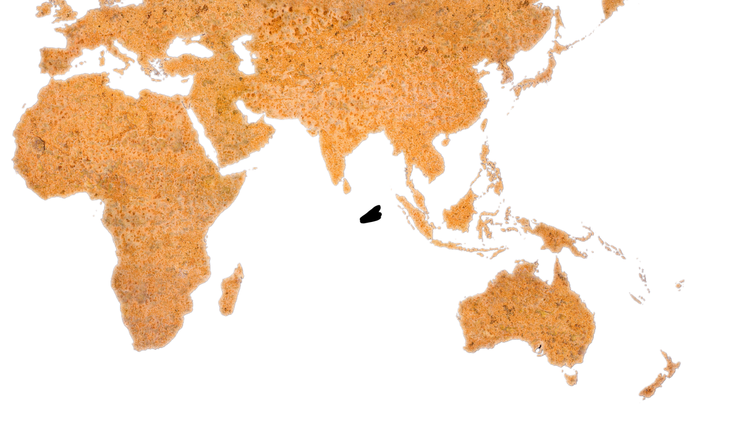
Friends, today marks a significant moment as we gather in worship to direct our focus towards the unfolding work of Christ in our interconnected world.
Within the unique context of South East Asia, the Uniting Church in Australia is linked in partnership with churches throughout the region, including Indonesia.

Slide 8
Our partners, often belonging to minority communities, exemplify extraordinary dedication and resilience as they navigate the complexities of their contexts. Notably, they engage in remarkable work within inter-faith contexts, fostering understanding, cooperation, and peace in diverse religious landscapes.
These partnerships are characterized by the vibrancy, inspiration, and the unwavering dedication of our fellow believers who serve as instruments of God's transformative power in their communities.
Many of these relationships span over the decades, leaving an enduring lasting impact on countless lives across generations.

Slide 9
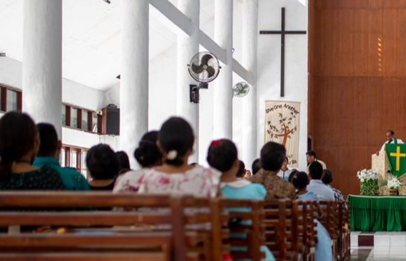
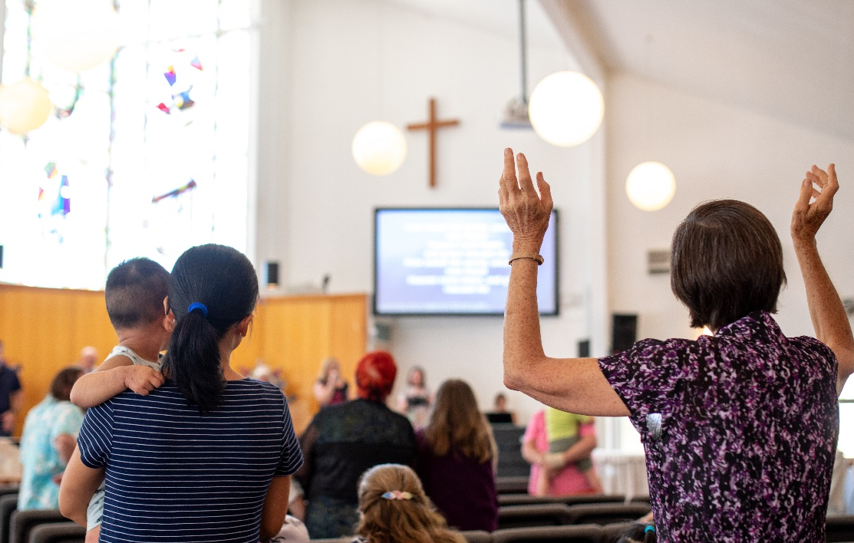
Through these enduring connections, we endeavor to embody the unity of Christ's body, working collaboratively to nurture hope and fight poverty, injustice and climate change.
UnitingWorld serves as the conduit for managing these partnerships on behalf of the wider Uniting Church. Today, we have the privilege of going deeper into their invaluable work and joining in celebration of our global neighbours.
Congregation in Timor-Leste
Congregation in Australia

Slide 10
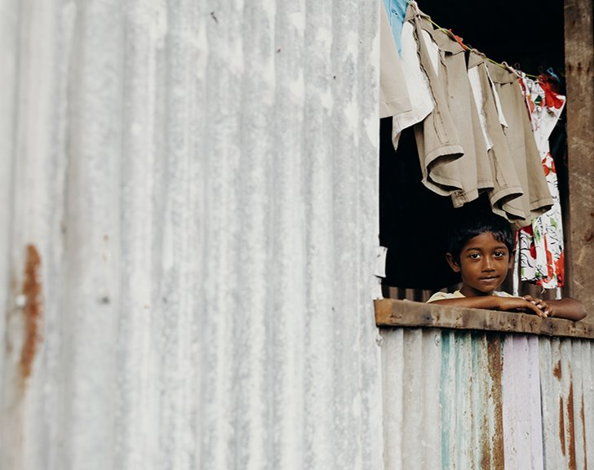
Prayer
Leader:
Gracious and merciful God,
We give thanks to You, O Lord, for the gift of life, the beauty of the universe, the serenity, and the companionship. Your presence among us as we gather in worship fills our hearts with gratitude beyond measure.
You, O Lord, understand the depths of our hearts intimately. We come before You to confess our sins, acknowledging those moments when we have fallen short of Your grace.

Slide 11
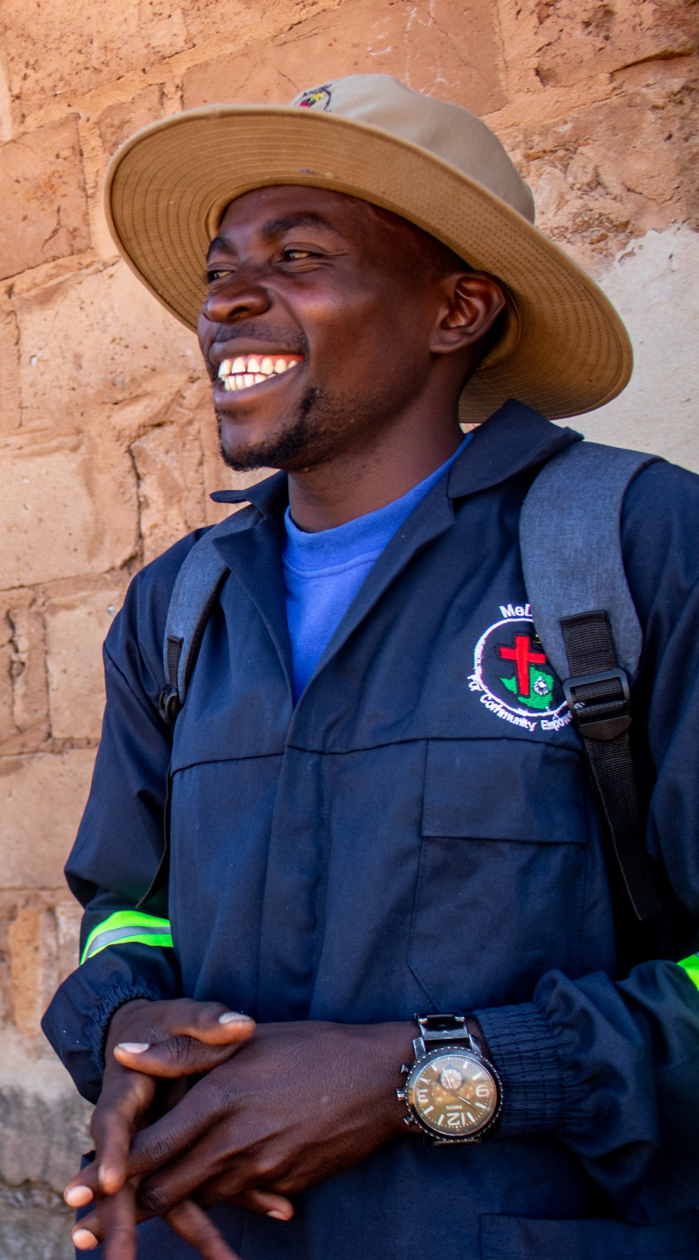
Forgive us, O Lord, for the times when we hear that we have to act justly, to love mercy and to walk humbly with you, but our ways of living defy your words.
Yet, we take solace in Your boundless mercy, knowing that You are always ready to receive us with open arms, to cleanse us from all unrighteousness, and to restore us into fellowship with You.

Slide 12
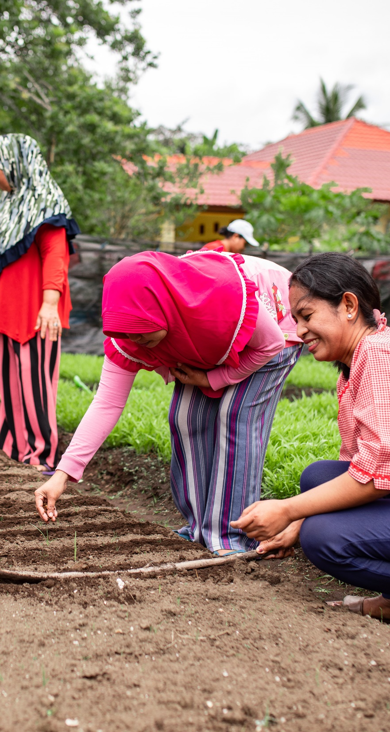
As we lay bare our shortcomings before You, grant us the strength to walk in Your ways, to love one another as You have loved us, to act justly and to seek reconciliation with those whom we have wronged.
May Your grace continue to abound in our lives, guiding us in the paths of righteousness and leading us into the fullness of Your joy.
In the name of Jesus Christ, our Lord and friend, we pray.
Amen.

Slide 13
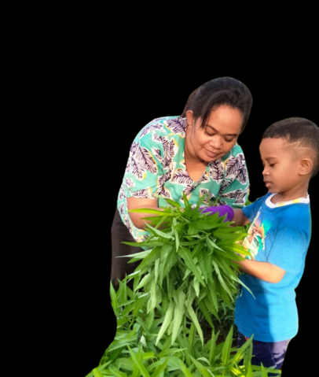
Prayer for Mothers
Dear God, Mother of all life,
Creator and Sustainer of the universe,
on this day we remember
all the mothers in the world.
Thank you for Your love that works
so mightily through them,
giving birth to life and nurturing
us in the family,
passing down wisdom, courage,
and compassion from
one generation
to another.

Slide 14
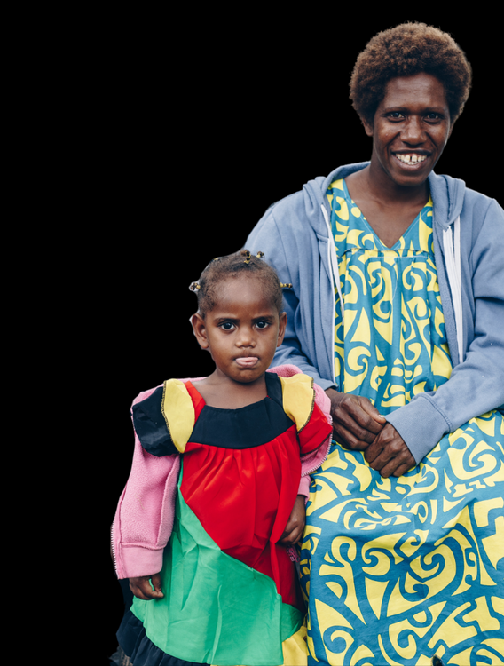
On this special day of Mother’s Day,
we ask You, Oh God, to bless all mothers, both old and young.
Let faith, hope and love, justice,
kindness, and humility toward You be passed on through them.
Be with them when life feels hard.
May your strength enable them to
walk through life’s storms so they
can testify firmly about
Your mercy and love.
In the Triune God we pray,
Creator, Savior,
and Transformer of Life. Amen.

Slide 15
Song
Add the lyrics, video or the book number of the song you have chosen/​
Duplicate this slide for additional verses​

Slide 16
Kids’ Talk

Slide 17
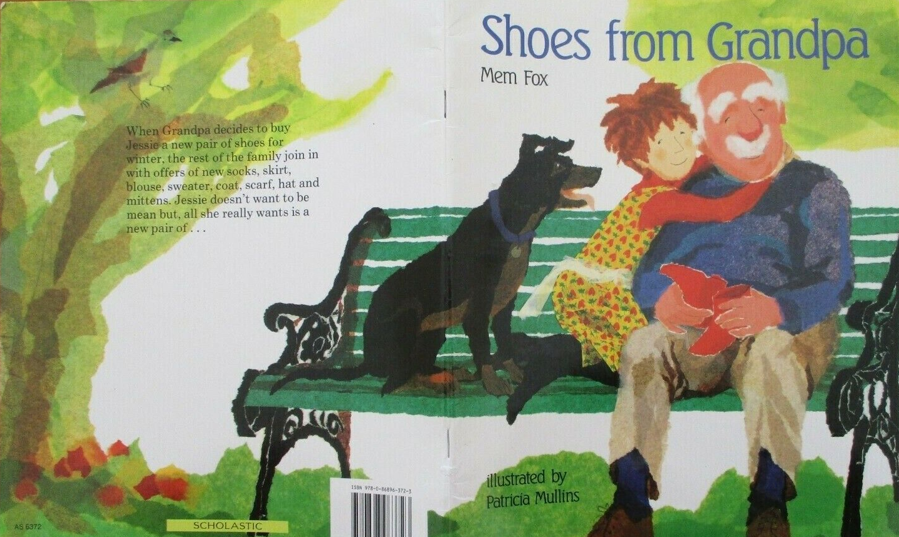
You can play the video on youtube now

Slide 18
Song
Add the lyrics, video or the book number of the song you have chosen/​
Duplicate this slide for additional verses​

Slide 19
Micah 6:1-8
God Challenges Israel
¹ Hear what the Lord says:
Rise, plead your case before the mountains,
and let the hills hear your voice.
² Hear, you mountains, the case of the Lord,
and you enduring foundations of the earth,
for the Lord has a case against his people,
and he will contend with Israel.
³ “O my people, what have I done to you?
In what have I wearied you? Answer me!

Slide 20
⁴ For I brought you up from the land of Egypt
and redeemed you from the house of slavery,
and I sent before you Moses, Aaron, and Miriam.
⁵ O my people, remember now what King Balak of Moab devised,
what Balaam son of Beor answered him,
and what happened from Shittim to Gilgal,
that you may know the saving acts of the Lord.”

Slide 21
What God Requires
⁶ “With what shall I come before the Lord
and bow myself before God on high?
Shall I come before him with burnt offerings,
with calves a year old?
⁷ Will the Lord be pleased with thousands of rams,
with ten thousands of rivers of oil?
Shall I give my firstborn for my transgression,
the fruit of my body for the sin of my soul?”
⁸ He has told you, O mortal, what is good,
and what does the Lord require of you
but to do justice and to love kindness
and to walk humbly with your God?

Slide 22
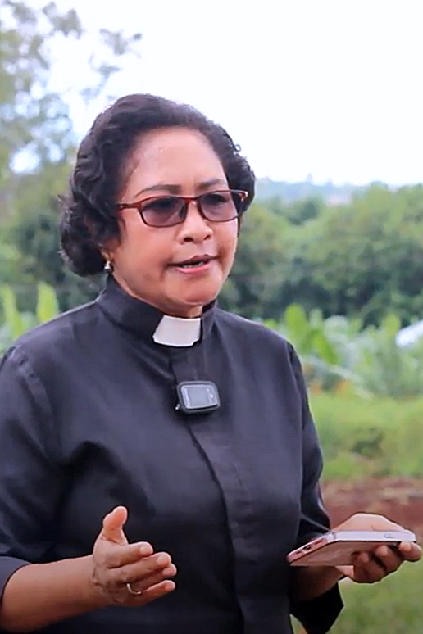
Sermon
Rev Dr Mery Kolimon,
Christian Evangelical Church in Timor, Indonesia

Slide 23
Play the sermon video

Slide 24
Song
Add the lyrics, video or the book number of the song you have chosen/​
Duplicate this slide for additional verses​

Slide 25
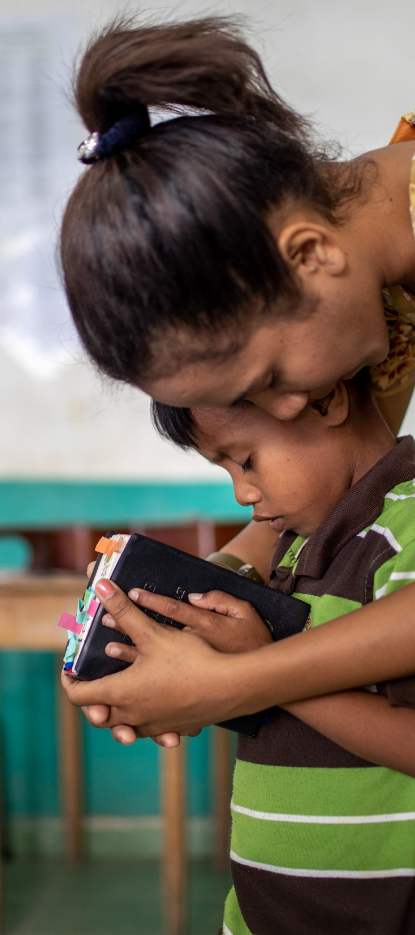
Prayers of Intercession
Leader:
God of creation, humbly we pray for all you have created, now facing devastation because of our greed and our indifference.
Guide us, O God, that we may become renewed stewards of the earth, that we may pursue justice and equity amid the culture of oppression and violence, respond to the needs of the poor and the marginalised in our communities, and uphold the dignity of humanity and the whole of creation.

Slide 26
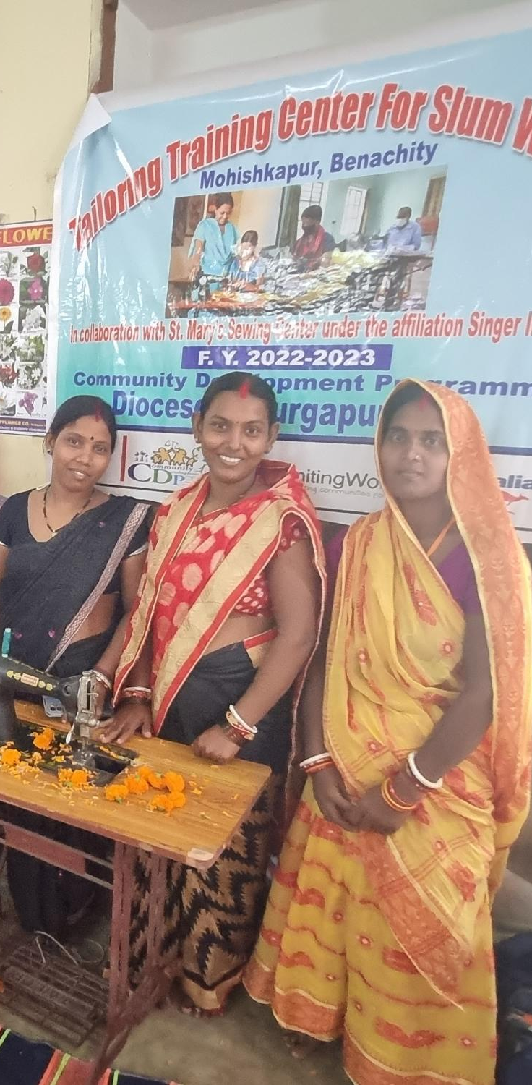
Speaker:
Move us, O God, to cry out for the concern of the earth.
Move us to reveal your shalom for the whole creation.
God in your great love and mercy:
Congregation:
God, renew us in Your Spirit
God restore the whole creation.

Slide 27
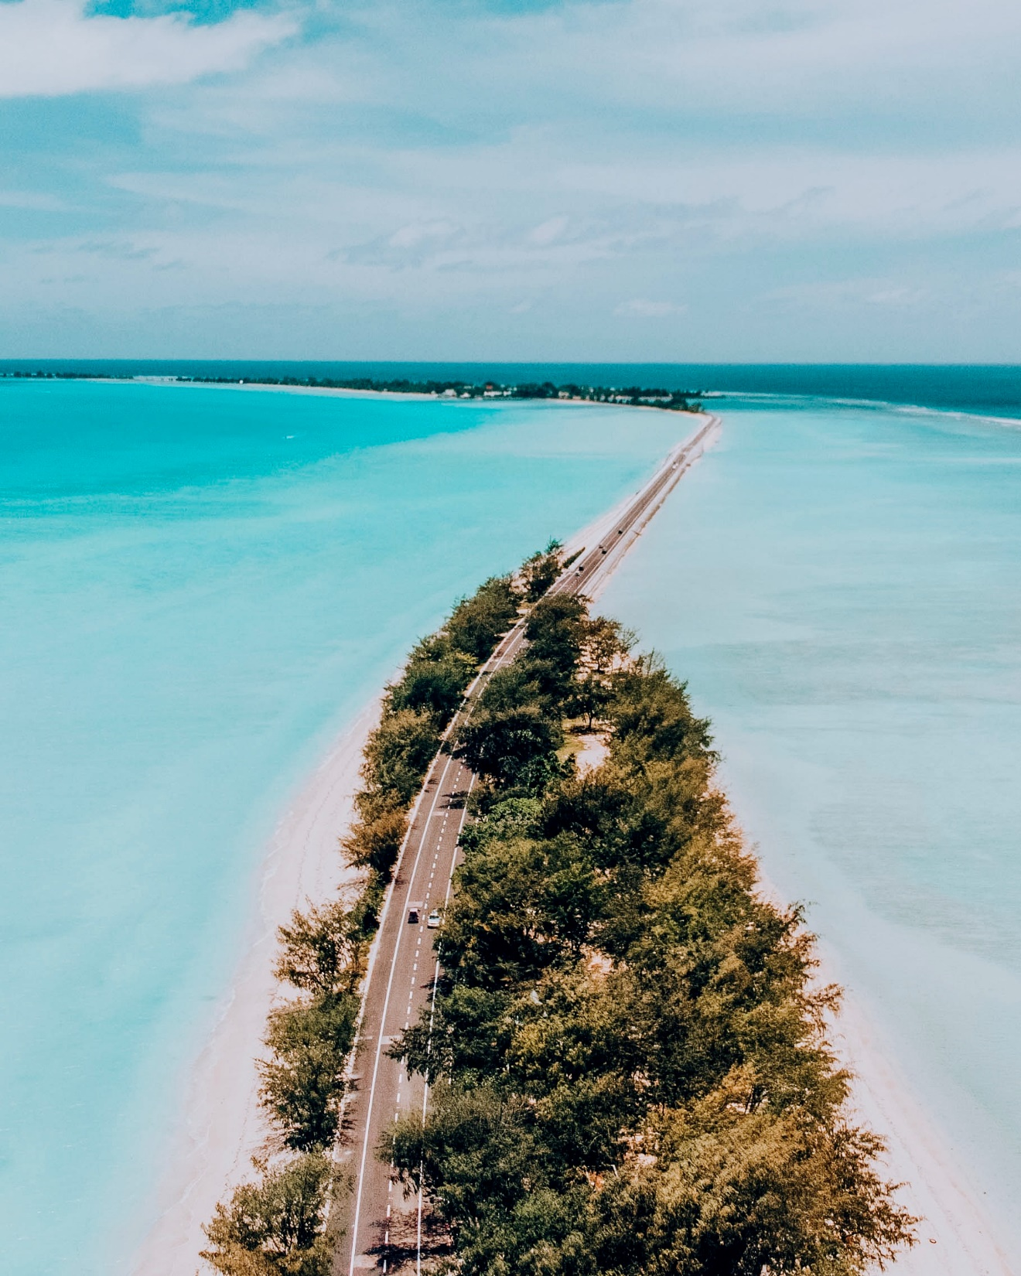
Leader:
God of justice, humbly we pray for the whole inhabited earth, threatened by division, wars and injustice.
Guide us, O God, that we may become renewed stewards of the earth, that we may work and act for the rights of the poor and oppressed, and amplify the voices of the women, youth and children in our societies.

Slide 28
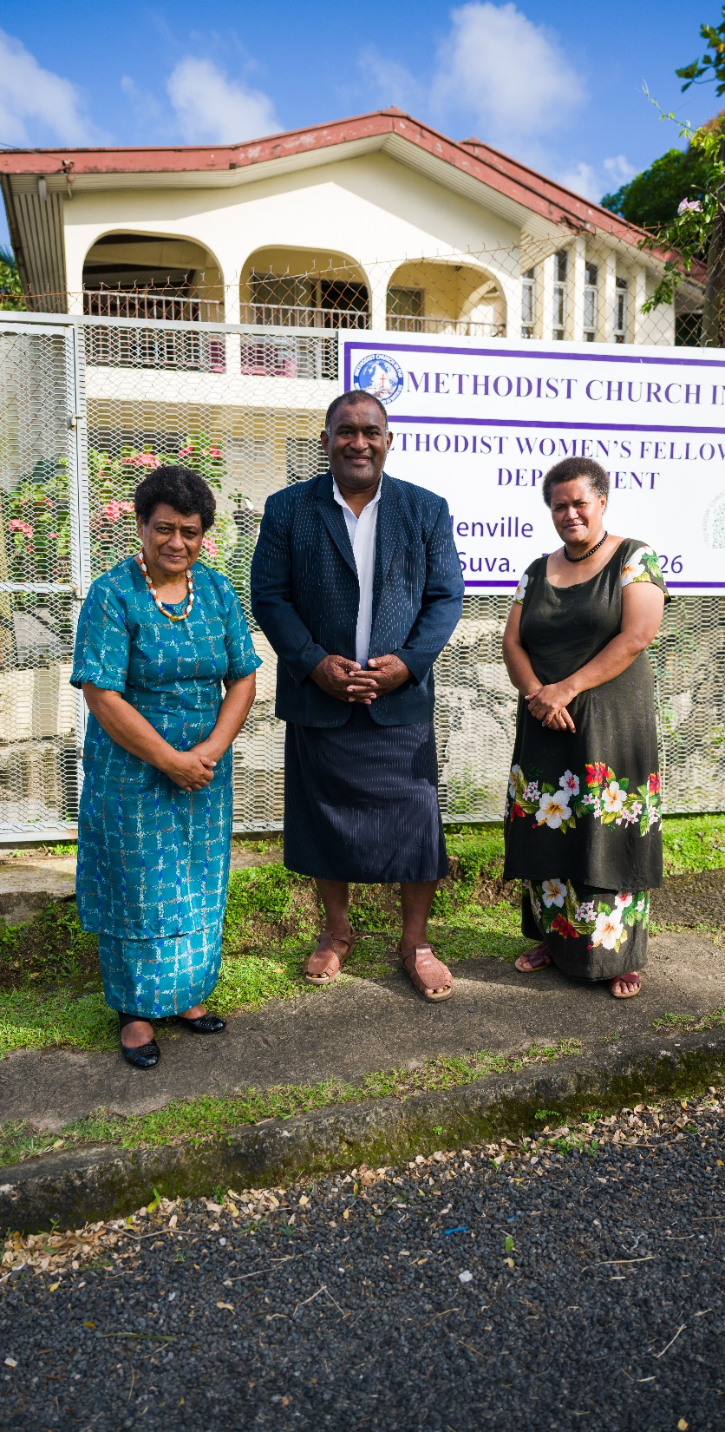
Speaker:
May we pray and work for God’s love and justice to reign.
Lead, O God, to proclaim your truth to power.
God, in your great love and mercy:
Congregation:
God, renew us in Your Spirit
God restore the whole creation.

Slide 29
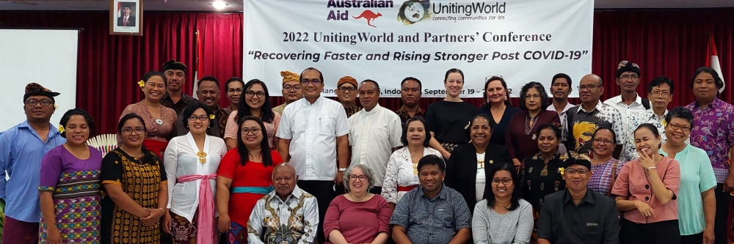
Leader:
God of wisdom and truth, renew us in your spirit so that we may follow your will and courageously carry out the mission you have entrusted amidst the challenges brought about by the changing times and adversities of today.
God of love, by your love we are united, by your love we find hope, and by your love we are renewed.
Amen.

Slide 30
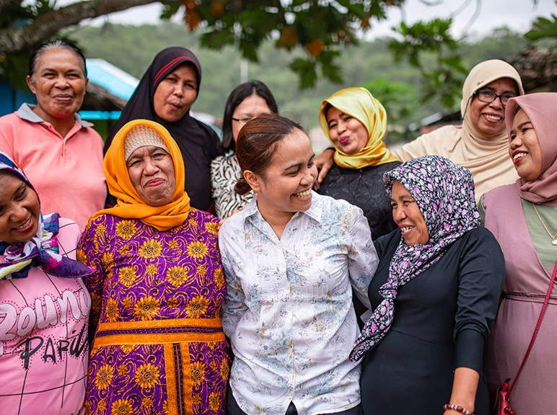
Offering
Every one of us has a role to play alongside our church partners.
Your gifts to UnitingWorld will be used with care, resourcing our partners to transform lives and communities. ​

Slide 31
Dedication of Offering
Leader:
Gracious and compassionate God,
You who call us to pursue justice, to love mercy, and to walk humbly, we give thanks for every individual striving to do good in our midst and throughout the world.
We are grateful for the offerings that have been collected, reflecting the generosity of each person who joyfully participates in the ministry of love for others. May these contributions bring about tangible change for those in need.

Slide 32
We give thanks for our unity and commitment to proclaiming the good news through social justice, wholeness, and the well-being of life.
As we present these offerings before You, O Lord, we ask for Your blessing upon them. May they be used wisely and effectively to further Your will on earth, bringing hope, healing and transformation to all who are touched by Your grace.

Slide 33
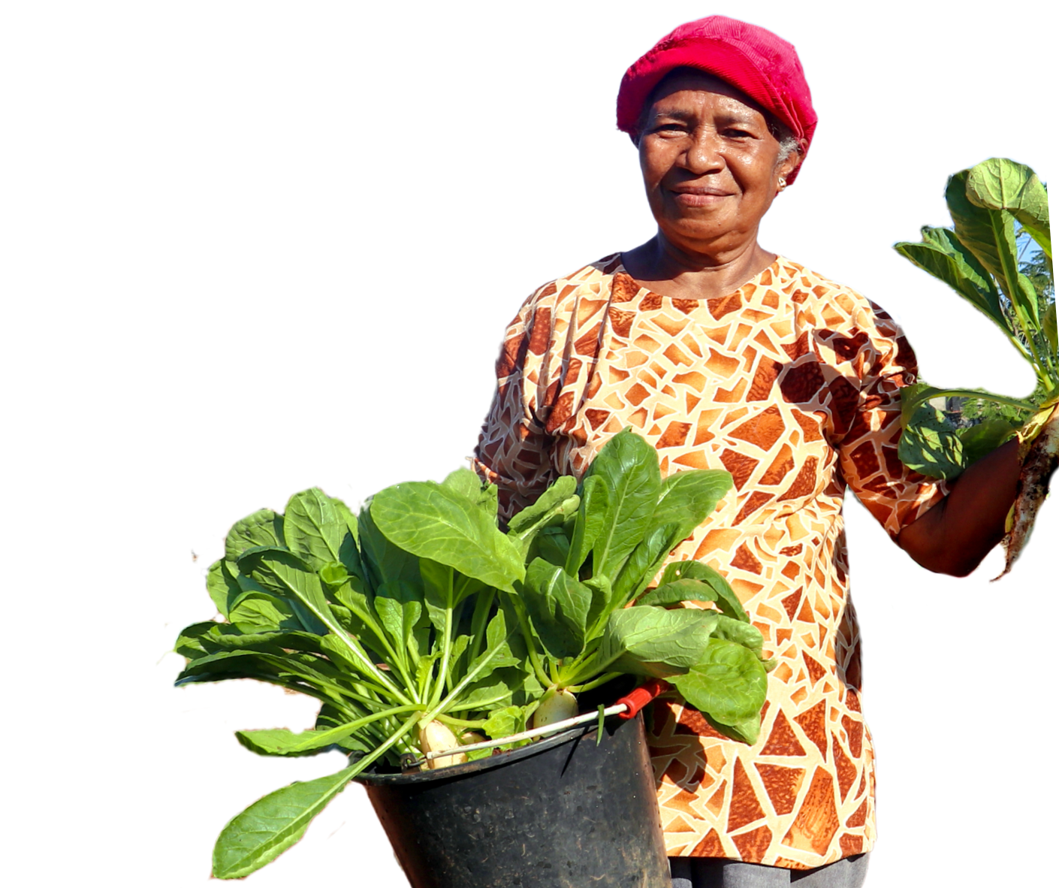
Empower us, O God, to continue in our mission with courage, compassion and
unwavering dedication.
May our actions be a testament to
Your love, and may they inspire
others to join in the work of
building a world filled with
justice, peace and joy.
In the name of
Jesus Christ,
our Lord and
Redeemer, we pray.
Amen.

Slide 34
Song
Add the lyrics, video or the book number of the song you have chosen/​
Duplicate this slide for additional verses​

Slide 35
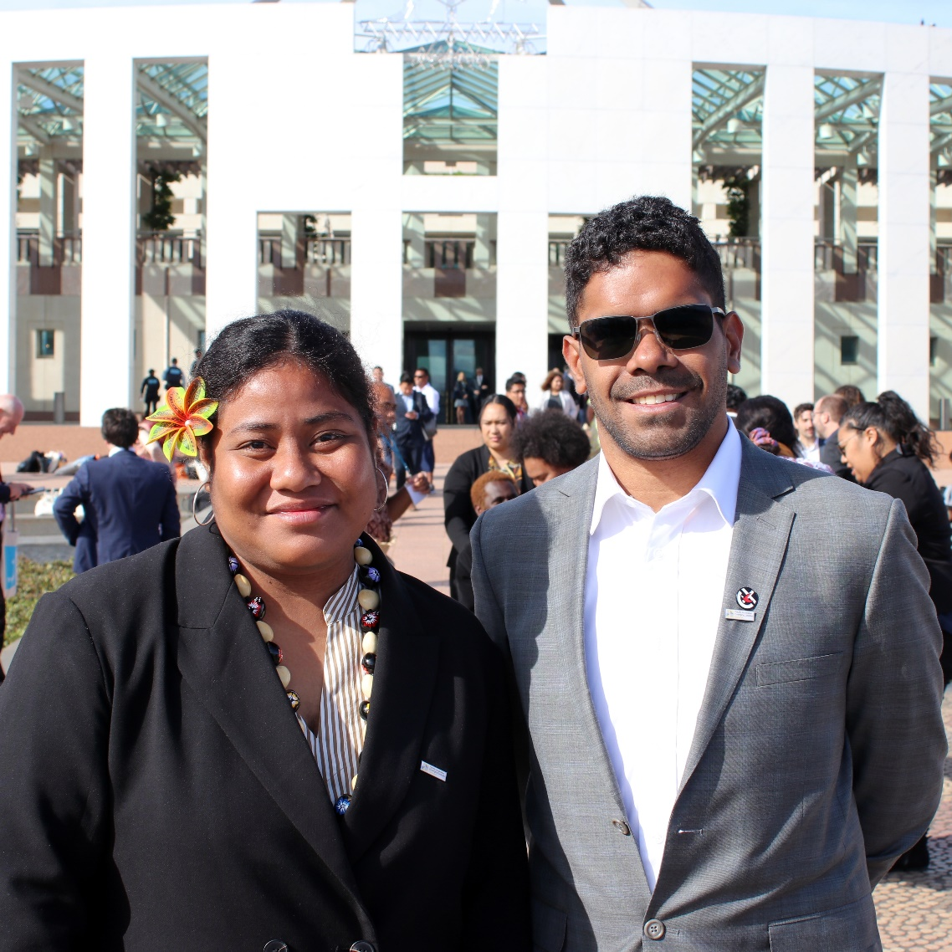
A Sending Blessing
May the light of Your justice guide our path as we strive to bring justice to others.
May the love of Your mercy grant us strength as we continue to fight for equity for all.
May Your blessings of humility keep us united with those in need, wherever we may be.
May Your peace shine ever brighter in the midst of our world, offering hope, joy and justice to all.

Slide 36
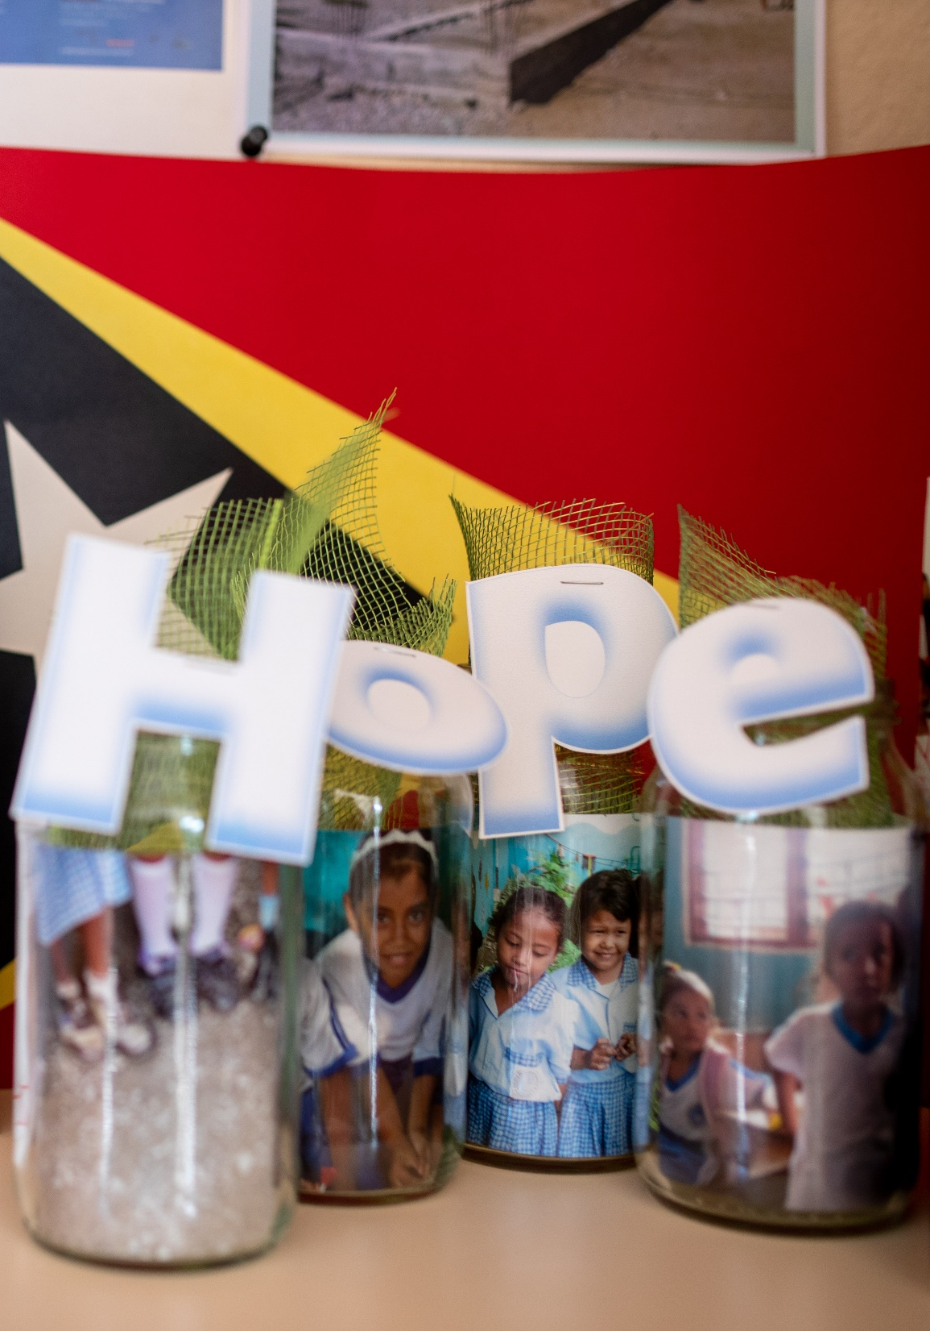
As we depart from this gathering, may Your presence go before us, empowering us to be agents of Your love and instruments of Your peace.
Go forth in the assurance of God's grace, mercy and everlasting love.
In the name of Christ:
Congregation:
Amen

Slide 37
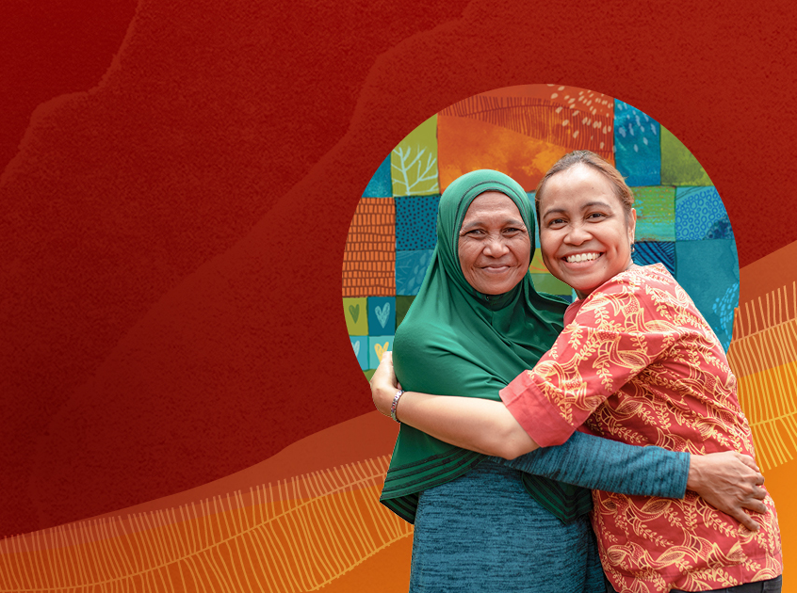

Thank you for
celebrating with us! ​
To give online and find out
more about UnitingWorld
and our partners, please visit
www.unitingworld.org.au/sunday​

